Slide 1
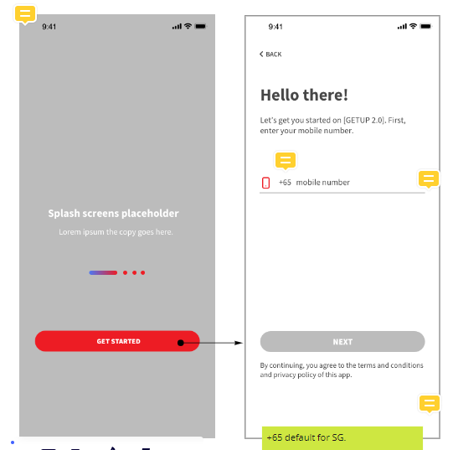
Country code admin can configure at solution domain
Current support Malaysia (+60) and Singapore (+65) only
It will be selection list for the country code
Before ‘NEXT’ button clickable, validation checking
If country code = Sg, the numbers of mobile number shall be 8 digits
If country code = My, the numbers of mobile number shall be 10 digits and 11 digits
Upon fulfil the validation checking then user can trigger the OTP
The numbers of mobile number can configure in the backend
Splash screen only display when: -
Upon user register/logged in the splash screen will be hidden from user
First time download app
Show again when user delete and reinstall the app
Terms & condition and privacy policy will be 2 clickable link in FE, the value will store in property table
Notes:
Pending Country Code design
Pending how to enter splash screen confirmation
Pending screen for user to choose sign up / login
Pending Solution Domain design

Slide 2
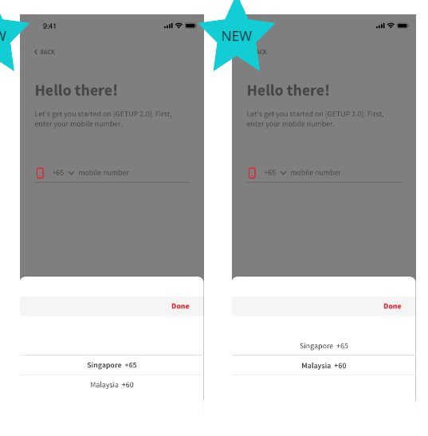
Country picker screen

Slide 3
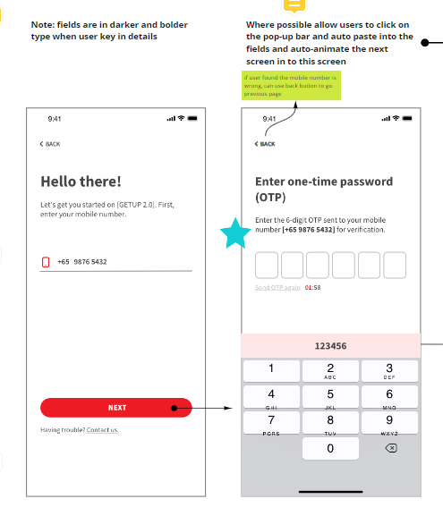
Mobile number entered previously
System check: -
New mobile number, process with sign up flow
Existing GETUP mobile number, upon OTP verified direct them to home page
Next available OTP count down
Upon reached count down time, ‘Send OTP again’ will be clickable and allow system to send again the mobile OTP
Entered mobile number, and click ‘NEXT’

Slide 4
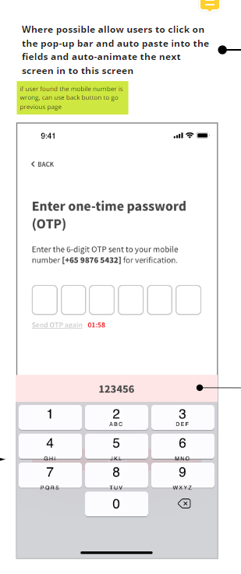
FE OTP handling
iOS
Upon received OTP, populate it on top of the keyboard
Tap on the OTP auto fill in
User need to tap on next button to proceed
Android
Upon received OTP, auto fill into the field
User need to tap on the next button to proceed

Slide 5
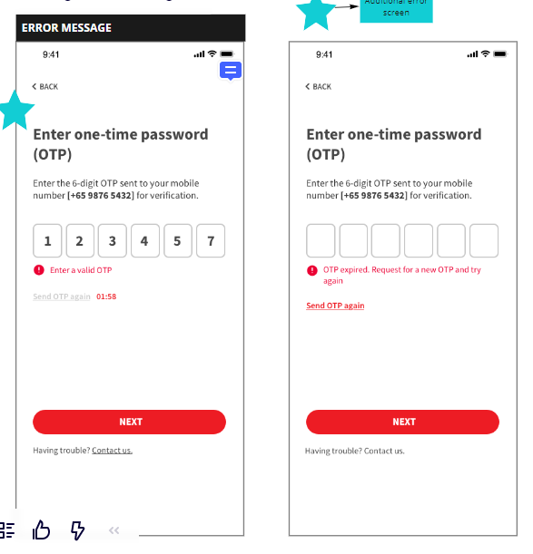
OTP Validation checking
Invalid OTP
OTP expired
Reset the field to blank if the OTP was invalid

Slide 6
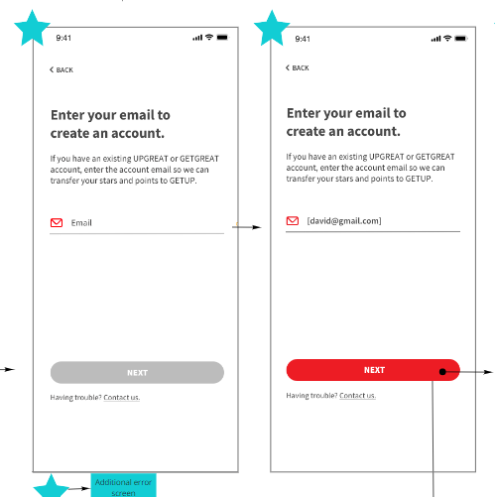
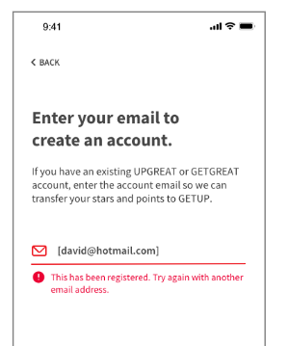
Enter valid email format then the ‘Next’ button is clickable. E.g. xxx@xxx.xxx
If validation success, proceed and send email verification
Email already registered in GETUP
Notes:
Email field validation
Must input email then next button is clickable
Check whether email already registered in GETUP

Slide 7
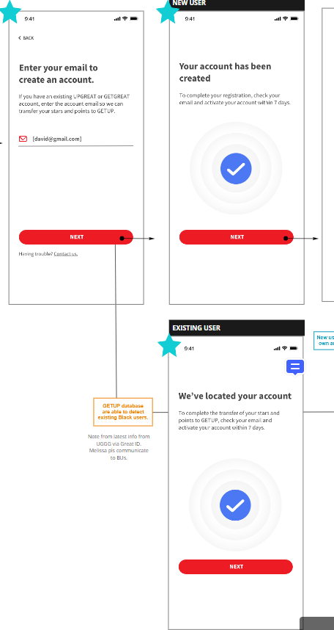
New email, not even in GG/UG
Send email verification
Direct user to verify as great eastern policy page
Email is existing GG/UG user
Send email verification, before user verify the email no need retrieve the profile
Direct user to GETUP home page
#There’s some exceptional case, kindly refer next slide

Slide 8
Exceptional case need to be handle: -
See Liang onboard to GETUP by using mobile number 123, but he enter Chew’s email address (chew@gmail.com)
Due to See Liang don’t have Chew’s email address (chew@gmail.com) access, therefore he unable to verify the email
Now Chew onboard to GETUP by using mobile number 456, and he use his own email address (chew@gmail.com)
Upon Chew enter the email and system trigger the email verification to Chew at the same time, previous email verification trigger by See Liang will be invalid by system
Due to See Liang already in GETUP home page, when the system detected Chew verified his email address with his mobile no, upon See Liang launch the App again, he will be request to enter another email address

Slide 9
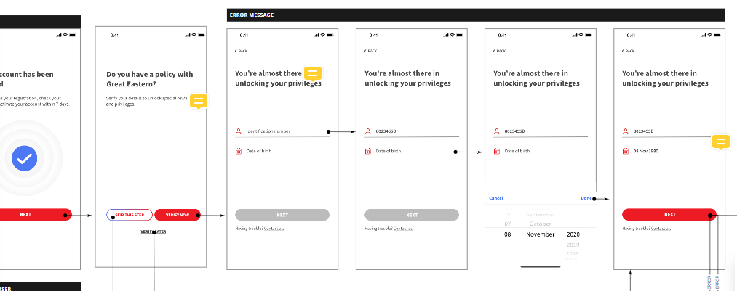
For new GETUP user, system will prompt Verify Great Eastern policy holder page for onboarding
Backend upon received the NRIC and DOB will call CIF system to verify whether is existing GE policy holder

Slide 10
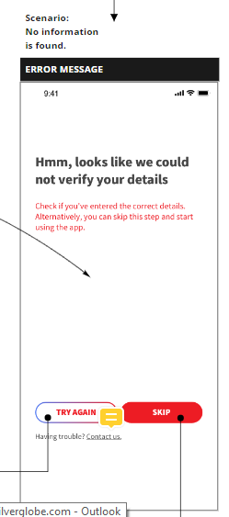
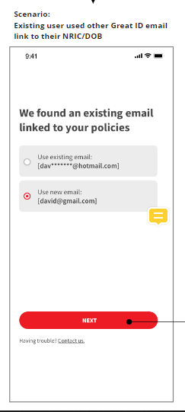
Policy Holder validation
Can’t get any profile with CIF
Policy information already used by other GETUP account
Policy not being used in GETUP but used in existing GG/UG with other different email address

Slide 11
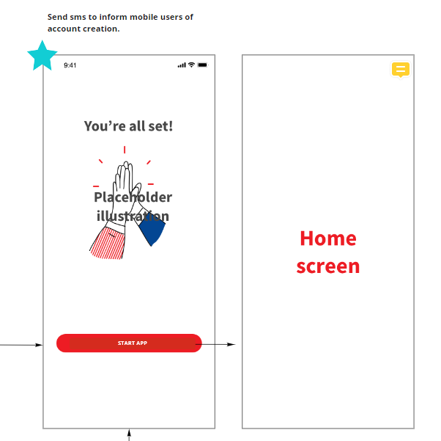
Notes:
Pending Animation
Pending Home Page screen

