Slide 1
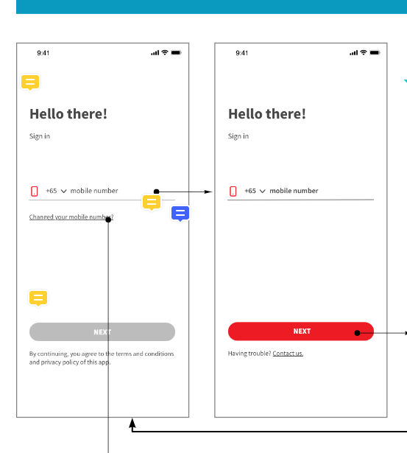
Upon user logout from the app, they will be land on this login page
Country code admin can configure at solution domain
Current support Malaysia (+60) and Singapore (+65) only
It will be selection list for the country code
Before ‘NEXT’ button clickable, validation checking
If country code = Sg, the numbers of mobile number shall be 8 digits
If country code = My, the numbers of mobile number shall be 10 digits and 11 digits
Upon fulfil the validation checking then user can trigger the OTP
The numbers of mobile number can configure in the backend

Slide 2
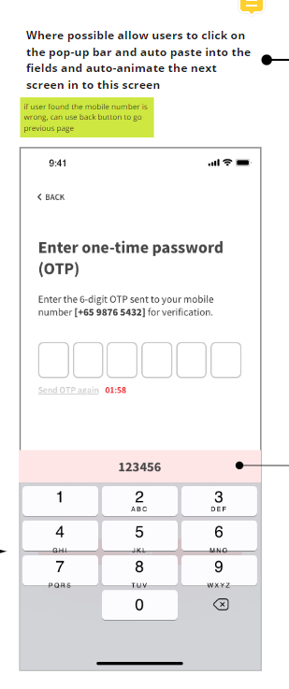
FE OTP handling
iOS
Upon received OTP, populate it on top of the keyboard
Tap on the OTP auto fill in
User need to tap on next button to proceed
Android
Upon received OTP, auto fill into the field
User need to tap on the next button to proceed

Slide 3
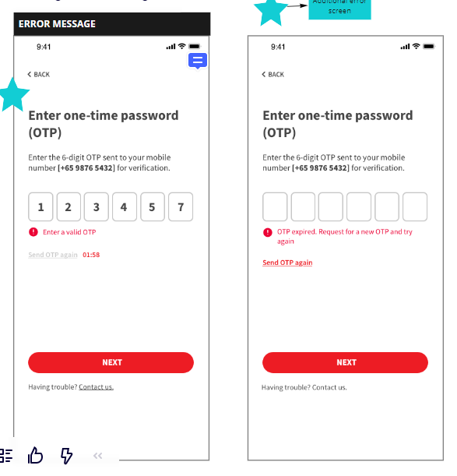
OTP Validation checking
Invalid OTP
OTP expired
User will be direct to home page upon successful verified OTP
Reset the field to blank if the OTP was invalid

Slide 4
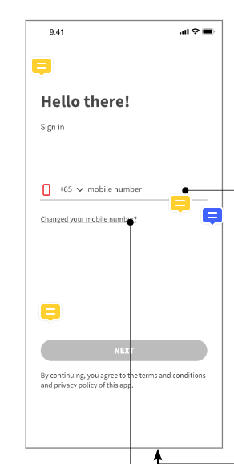
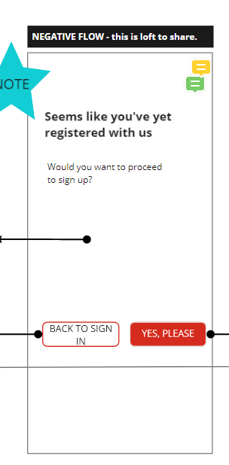
System check: -
Existing GETUP mobile number, upon OTP verified direct them to home page
New mobile number, prompt the confirmation page
Direct user to onboarding flow when tap on this, kindly refer next slide for next page flow
Direct user back to login page when tap on this

