Slide 1
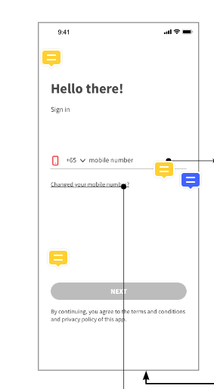
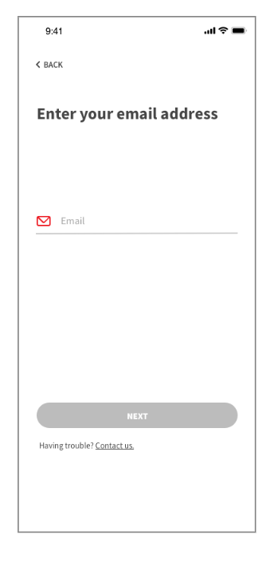
Click on change your mobile no will direct user to change mobile number flow

Slide 2
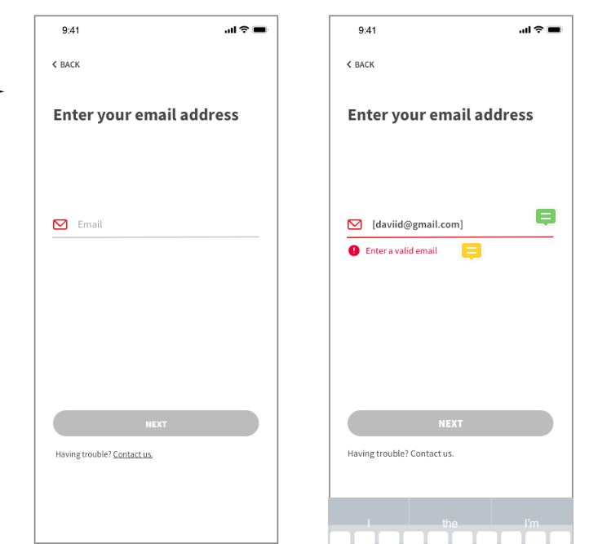
Enter valid email format then the ‘Next’ button is clickable. E.g. xxx@xxx.xxx
System will check whether the email address exist in GETUP system

Slide 3
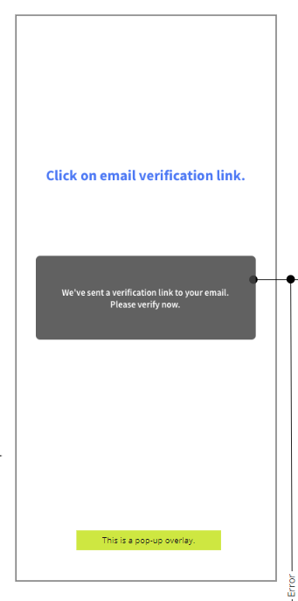
Upon system send the email verification, the screen flow will stop here until user click on the link in the email

Slide 4
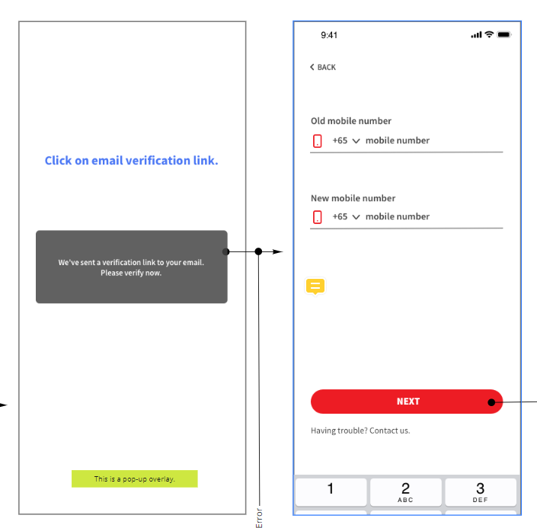
Upon user click on the link in the email, GETUP app will open this page, for user to enter the old mobile number and new mobile number

Slide 5
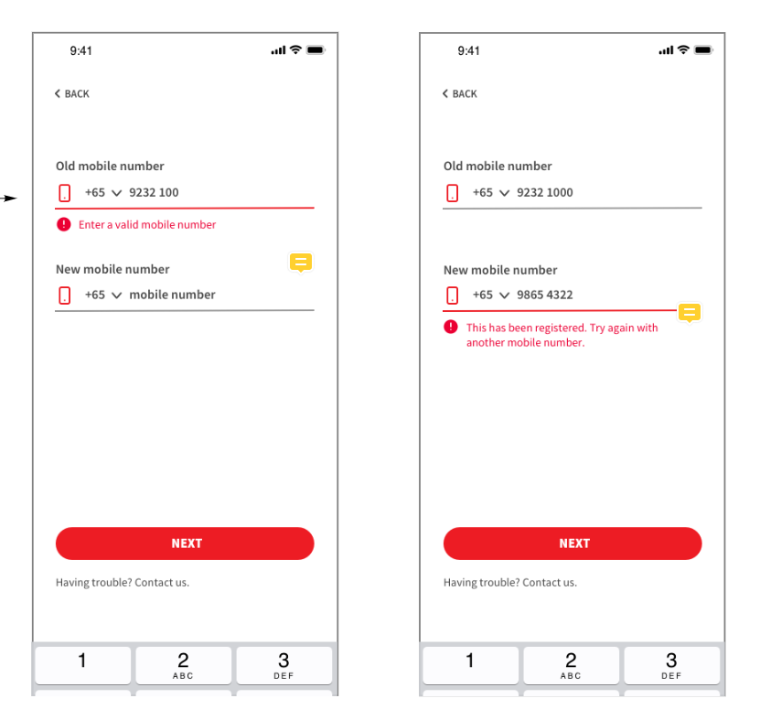
Prompt error if the number didn’t match with the email address
Prompt error when entered new mobile number already registered in system

Slide 6
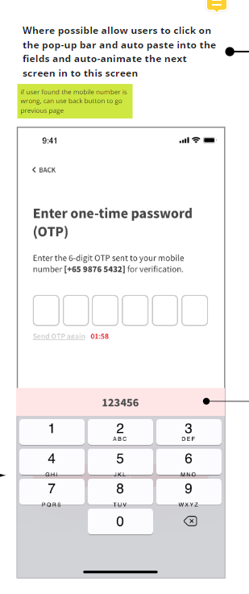
FE OTP handling
iOS
Upon received OTP, populate it on top of the keyboard
Tap on the OTP auto fill in
User need to tap on next button to proceed
Android
Upon received OTP, auto fill into the field
User need to tap on the next button to proceed

Slide 7
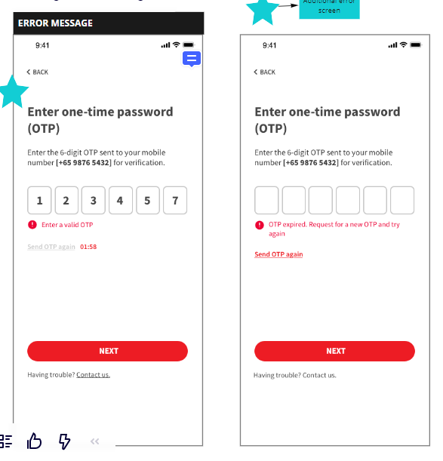
OTP Validation checking
Invalid OTP
OTP expired
User will be direct to home page upon successful verified OTP
Reset the field to blank if the OTP was invalid

Slide 8
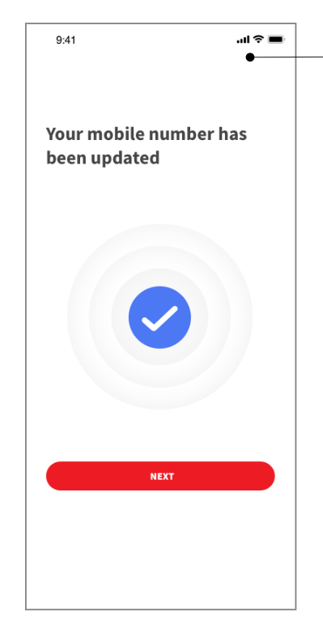
Direct user to home page upon successfully updated the moblie number

