Slide 1
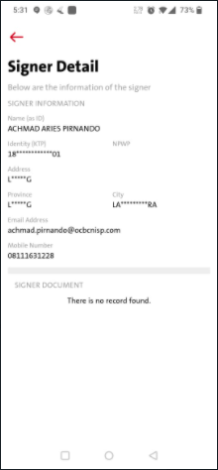
1. If there is NO ktp or npwp, it will display copywriting below:
EN: No document uploaded yet
ID: Tidak ada dokumen yang diupload
2. If there is ktp or npwp uploaded it will display either one or both accordingly.
3. This also apply for Document Details - On Registration check screen
No document uploaded yet

