Slide 1
OCBC NISP VELOCITY Additional Remark

Slide 2
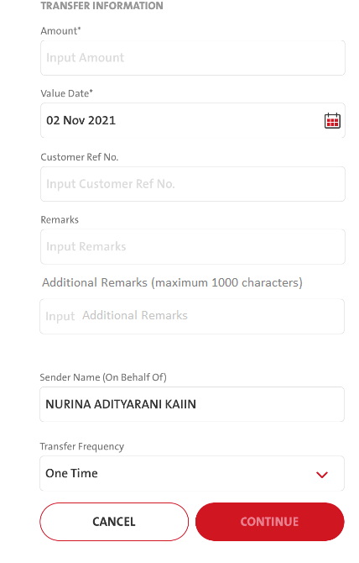
Additional Remark Field ---→ Please apply to FUND TRANSFER:
OCBC NISP FUND TRANSFER
OAT
IFT
DOMESTIC TRANSFER
Online
RTGS
LLG
TELEGRAPHIC TRANSFER
After Remarks field, add a new field with maximum characters are 1000:
FE Request: TransactionFundTransferSubmit
- Additional_info (additional remark) ----------------------------------------------------------------------- BE Request: fundstransfer/submit 10.12
Response:TransactionFundTransferSubmit
Additional_info (additional remark)
FE - Copywriting
ENG → Additional Remarks (maximum 1000 characters)
IND → Keterangan Tambahan (maksimum 1000 karakter)
FE - Copywriting
IND → Masukkan Keterangan Tambahan

Slide 3
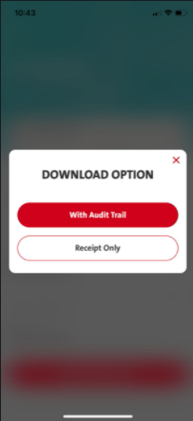
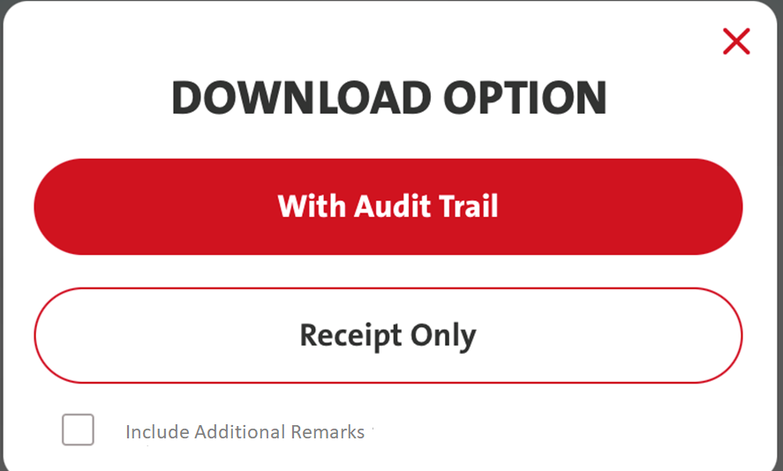
TRANSACTIONS – TRANSACTION SUMMARY – MANUAL – VIEW RECEIPT – DOWNLOAD RECEIPT
&
TRANSACTIONS – TRANSACTION SUMMARY – NON BULK FILE UPLOAD – VIEW TRANSACTIONS - VIEW RECEIPT – DOWNLOAD RECEIPT
Add a check box on the DOWNLOAD OPTION window:
If the transaction types are (FE will validate against Prod_cd if below trx type are met: (FE checking BE response RetrieveTaskTransaction)
- Internal Fund Transfer - IFT
- Own Fund Transfer - OAT
- LLG/SKN - LLG
- RTGS - RTGS
- Online Transfer - OLT
- Telegraphic Transfer - TT
Audit Trail with Check box: FE call RetrieveTransactionReceipt; send IsRetrieveDetails = Yes
Receipt Only with Check box: FE request: RetrieveTransactionReceipt (Receipt Only)
is_additional_info = Y/N
BAU
Audit Trail – isretrieveDetails = Y
Receipt Only – IsRetrieveDetails = N
With Check box:
Audit Trail – isRetrieveDetails = True
is_additional_info = Y
Receipt Only – isRetrieveDetails = False
is_additional_info = Y
2021.11.08
CHANGED TO TRUE OR FALSE
FE needs to pass isRetrieveDetails = true/ false to BE

Slide 4
iOS – Audit Trail & check Box
NB
Selected - Audit Trail & Check Box
FE passed Retrieve Details = Y
(But log display Retrieve Details = False)
(BE request retrieve Details = N)
BAU – FE Request
Audit Trail – isretrieveDetails = Y
Receipt Only – IsRetrieveDetails = N
With Check box:
Audit Trail – isRetrieveDetails = Y
is_additional_info = Y
Receipt Only – isRetrieveDetails = N
is_additional_info = Y
FE - NB – selected – Audit Trail & check box (Checked with iOS – sending Y but log display False)
2021-11-08 10:51:28,541 INFO [[ACTIVE] ExecuteThread: '0' for queue: 'weblogic.kernel.Default (self-tuning)'] listerner.MCBSolution:332 - MCB Listerner onCall :: [ FUNC_MCB_TRANS_RECEIPT ]2021-11-08 10:51:28,542 INFO [[ACTIVE] ExecuteThread: '0' for queue: 'weblogic.kernel.Default (self-tuning)'] common.FuncServices:107 - RetrieveTransactionReceipt :- REQUEST [00e90d1985a3b0437e878aff466cd4eb3f] { "pymtMasterId": "668b74bb-347f-479f-abf8-4212e7776f6a",
"isRetrieveDetails": false, Incorrect – should display Y (iOS passed Y to BE)
"is_additional_info": "Y",
BE request – Incorrect (could be due to the display of false ↑
2021-11-08 10:51:28,551 INFO [[ACTIVE] ExecuteThread: '0' for queue: 'weblogic.kernel.Default (self-tuning)'] common.VCRestService:89 - com.silverlake.mleb.mcb.module.vc.common.VCGenericService-transaction/receipt :- [****0ED13E3288E294A6B62EE1] REQUEST { "pymt_master_id": "668b74bb-347f-479f-abf8-4212e7776f6a",
"is_detail": "N",
"is_additional_info": "Y",
NOTE: has been passing Y or N for isRetrieveDetails

Slide 5
iOS – Receipt & check Box
BAU – FE Request
Audit Trail – isretrieveDetails = Y
Receipt Only – IsRetrieveDetails = N
With Check box:
Audit Trail – isRetrieveDetails = Y
is_additional_info = Y
Receipt Only – isRetrieveDetails = N
is_additional_info = Y
FE - NB – selected – Audit Trail & check box (Checked with iOS – sending Y but log display False)
2021-11-08 12:28:58,251 INFO [[ACTIVE] ExecuteThread: '3' for queue: 'weblogic.kernel.Default (self-tuning)'] listerner.MCBSolution:332 - MCB Listerner onCall :: [ FUNC_MCB_TRANS_RECEIPT ]2021-11-08 12:28:58,253 INFO [[ACTIVE] ExecuteThread: '3' for queue: 'weblogic.kernel.Default (self-tuning)'] common.FuncServices:107 - RetrieveTransactionReceipt :- REQUEST [006e8e852a861a4b6faae8aca772811fd7] { "pymtMasterId": "34541d74-7dde-46d7-8473-706aa3029a2f",
"isRetrieveDetails": false,
"is_additional_info": "Y",
BE Request - Correct
2021-11-08 12:28:58,261 INFO [[ACTIVE] ExecuteThread: '3' for queue: 'weblogic.kernel.Default (self-tuning)'] common.VCRestService:89 - com.silverlake.mleb.mcb.module.vc.common.VCGenericService-transaction/receipt :- [****67F1EDB082589D329D9E3B] REQUEST { "pymt_master_id": "34541d74-7dde-46d7-8473-706aa3029a2f",
"is_detail": "N",
"is_additional_info": "Y",

Slide 6
Android – Audit & check Box
BAU – FE Request
Audit Trail – isretrieveDetails = Y
Receipt Only – IsRetrieveDetails = N
With Check box:
Audit Trail – isRetrieveDetails = Y
is_additional_info = Y
Receipt Only – isRetrieveDetails = N
is_additional_info = Y
FE - NB – selected – Audit Trail & check box (not includig isdetails= Y due to not mandatory?
2021-11-08 12:43:20,419 INFO [[ACTIVE] ExecuteThread: '0' for queue: 'weblogic.kernel.Default (self-tuning)'] listerner.MCBSolution:332 - MCB Listerner onCall :: [ FUNC_MCB_TRANS_RECEIPT ]2021-11-08 12:43:20,421 INFO [[ACTIVE] ExecuteThread: '0' for queue: 'weblogic.kernel.Default (self-tuning)'] common.FuncServices:107 - RetrieveTransactionReceipt :- REQUEST [00964d98d797374336acc96c02a993454d] { "pymtMasterId": "668b74bb-347f-479f-abf8-4212e7776f6a",
“isRetrieveDetail – missing – shouldn’t be an issue but (Will add)
"is_additional_info": "Y",
BE request – Correct
2021-11-08 12:43:20,428 INFO [[ACTIVE] ExecuteThread: '0' for queue: 'weblogic.kernel.Default (self-tuning)'] common.VCRestService:89 - com.silverlake.mleb.mcb.module.vc.common.VCGenericService-transaction/receipt :- [****43F5622A78C938FDC81C69] REQUEST { "pymt_master_id": "668b74bb-347f-479f-abf8-4212e7776f6a",
"is_detail": "Y",
"is_additional_info": "Y",

Slide 7
Android – Receipt & check Box
BAU – FE Request
Audit Trail – isretrieveDetails = Y
Receipt Only – IsRetrieveDetails = N
With Check box:
Audit Trail – isRetrieveDetails = Y
is_additional_info = Y
Receipt Only – isRetrieveDetails = N
is_additional_info = Y
FE - NB – selected – Receipt & check box (this one - includig isdetails = Y (confirm with android if sending isRetrieveDetails Y?)
2021-11-08 12:44:02,781 INFO [[ACTIVE] ExecuteThread: '10' for queue: 'weblogic.kernel.Default (self-tuning)'] common.FuncServices:107 - RetrieveTransactionReceipt :- REQUEST [00cbb5c23e779941eb90ba4f395fc45247] { "pymtMasterId": "668b74bb-347f-479f-abf8-4212e7776f6a", "isRetrieveDetails": false, Incorrect display – should display Y.
"is_additional_info": "Y",
BE request – Correct
2021-11-08 12:44:02,789 INFO [[ACTIVE] ExecuteThread: '10' for queue: 'weblogic.kernel.Default (self-tuning)'] common.VCRestService:89 - com.silverlake.mleb.mcb.module.vc.common.VCGenericService-transaction/receipt :- [****43F5622A78C938FDC81C69] REQUEST { "pymt_master_id": "668b74bb-347f-479f-abf8-4212e7776f6a",
"is_detail": "N",
"is_additional_info": "Y",

