Slide 1
Term Deposit onboarding
Easier, simplified and real-time onboarding applying available authentication, verification and validation capabilities to determine instant approvals
Out-of-Box Solution
Customer On Board
(eKYC & Credit Assessment)
Instant Product Issuance
Real-time access
to information
Product Selection
Customer Registration
Onboarding
Online Credentials
Fund Term Deposit
Customer
Access App
Capture Customer Details
eKYC (CTOS)
Create Digital Login ID
Login to App
Select Product
ID Document Verification
Facial Verification - 4 sec Selfie
Authentication Questions
CIF Creation (Account Open)
Transfer fund to FD
Apply Verification Code
Terms & Conditions
CR Assessment
(CTOS)
FPX Transfer from account in another Bank to Term Deposit Account
Employment & Income info (EPF)
Credit Rating Data References (CTOS)
Underwriting
Loan Amount & Tenure

Slide 2
Term Deposit onboarding
Fund Term Deposit
Login to App
Transfer fund to FD
FPX Transfer from account in another Bank to Term Deposit Account

Slide 3
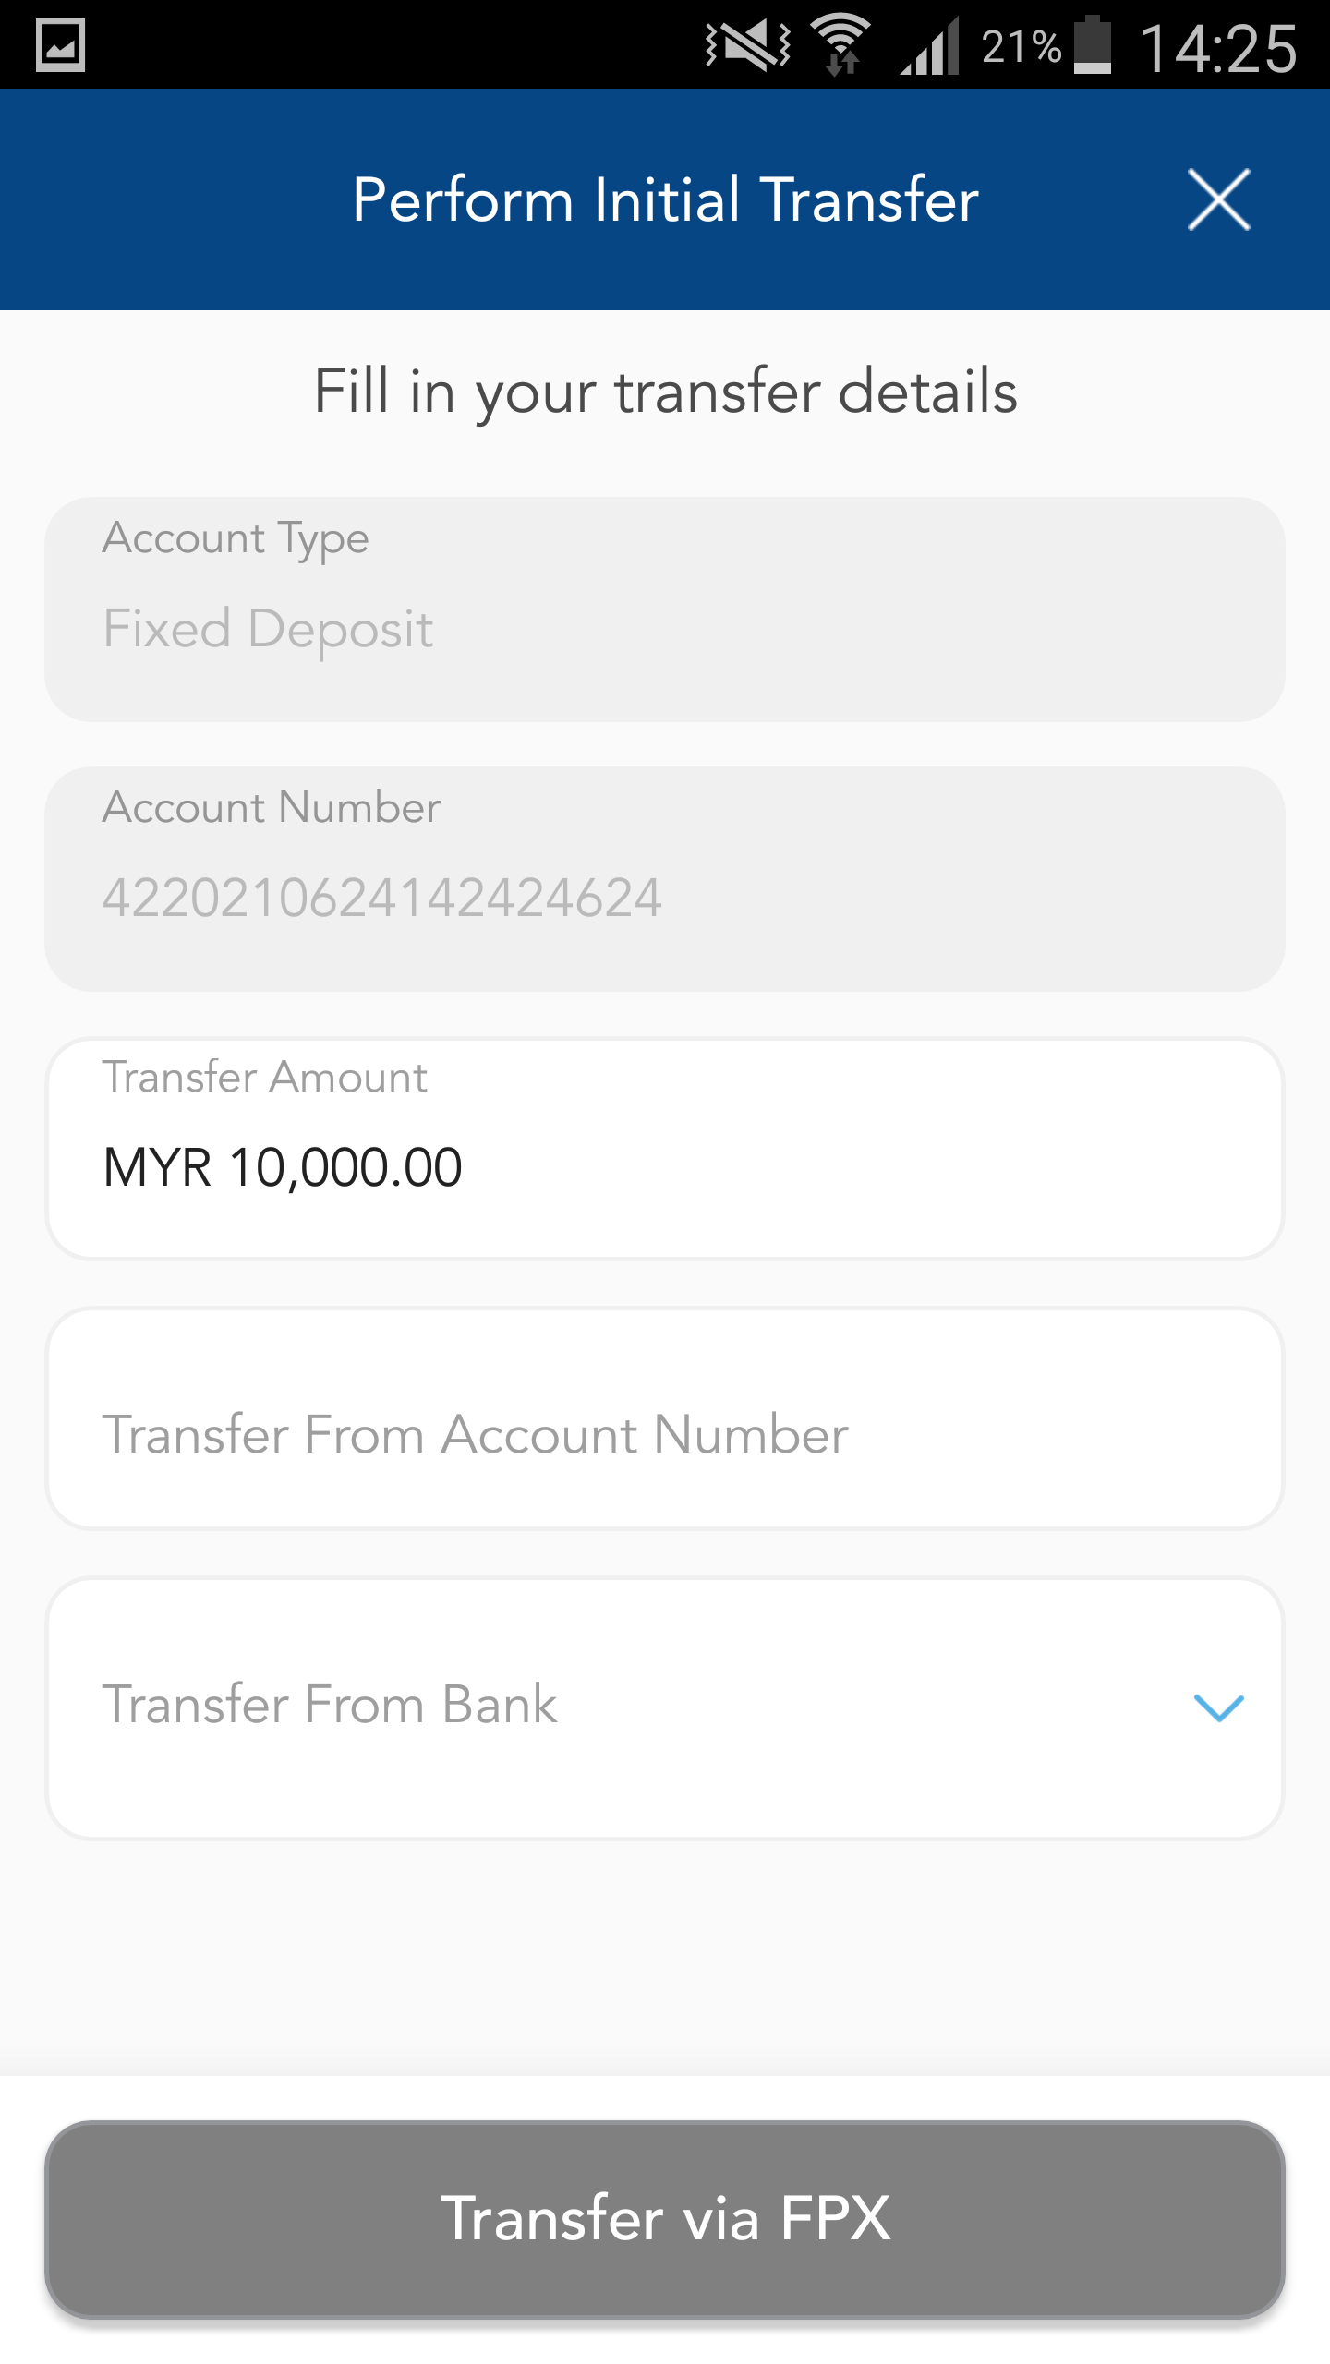
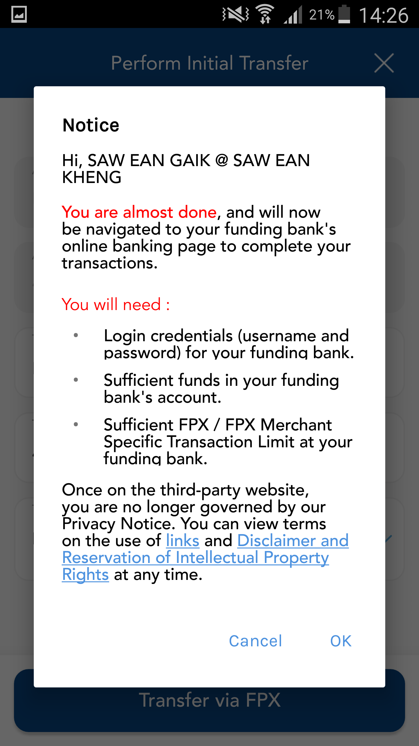
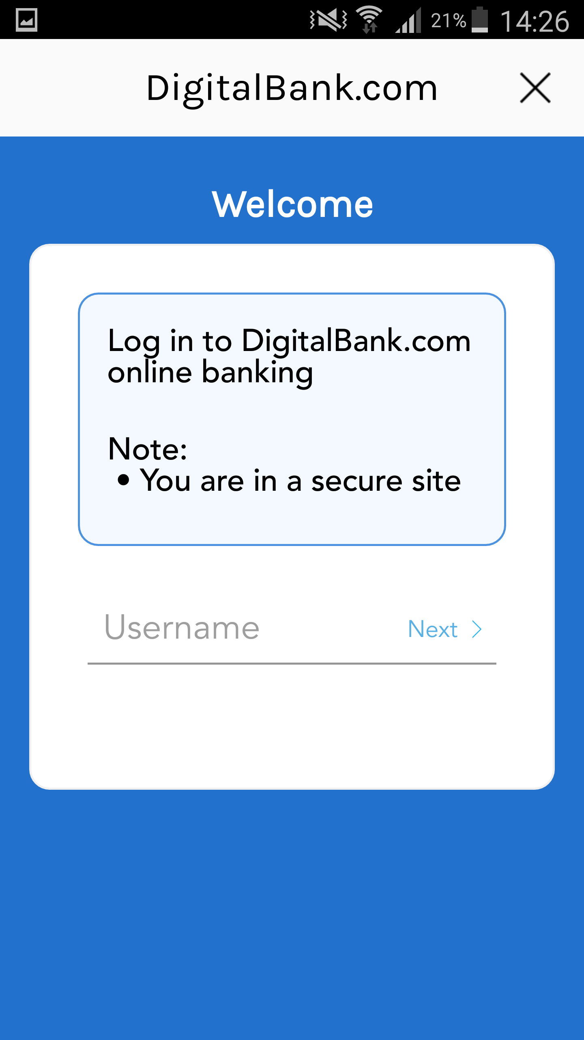
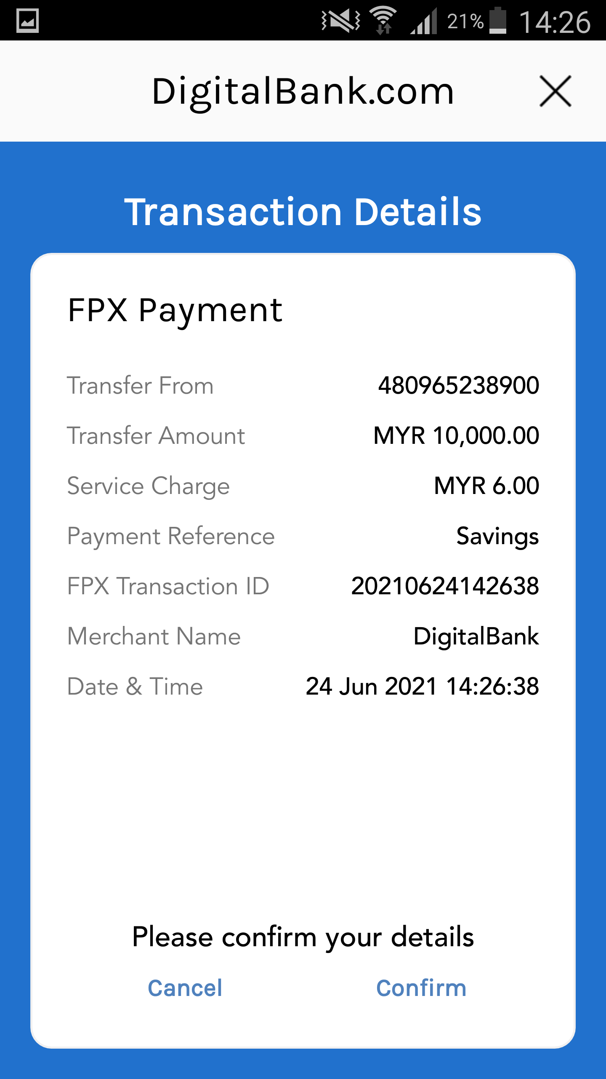
Term Deposit onboarding
Fund Term Deposit
Login to App
Hi, Lim Beng Ching
Transfer Fund to FD
FPX Transfer from account in another Bank to Term Deposit Account

