Slide 1


Savings Account onboarding
Easier, simplified and real-time onboarding applying available authentication, verification and validation capabilities to determine instant approvals
Out-of-Box Solution
Customer On Board
(eKYC & Credit Assessment)
Instant Product Issuance
Real-time access
to information
Product Selection
Customer Registration
Onboarding
Online Credentials
Activate Account
Customer
Access App
Capture Customer Details
eKYC (CTOS)
Create Digital Login ID
Login to App
Select Product
ID Document Verification
Facial Verification - 4 sec Selfie
Authentication Questions
CIF Creation (Account Open)
Transfer fund to Savings Account
Apply Verification Code
Terms & Conditions
CR Assessment
(CTOS)
FPX Transfer from account in another Bank to Savings Account
Employment & Income info (EPF)
Credit Rating Data References (CTOS)
Underwriting
This part in red is not working yet.

Slide 2

Savings Account onboarding
Activate Account
Login to App
Transfer fund to Savings Account
FPX Transfer from account in another Bank to Savings Account

Slide 3
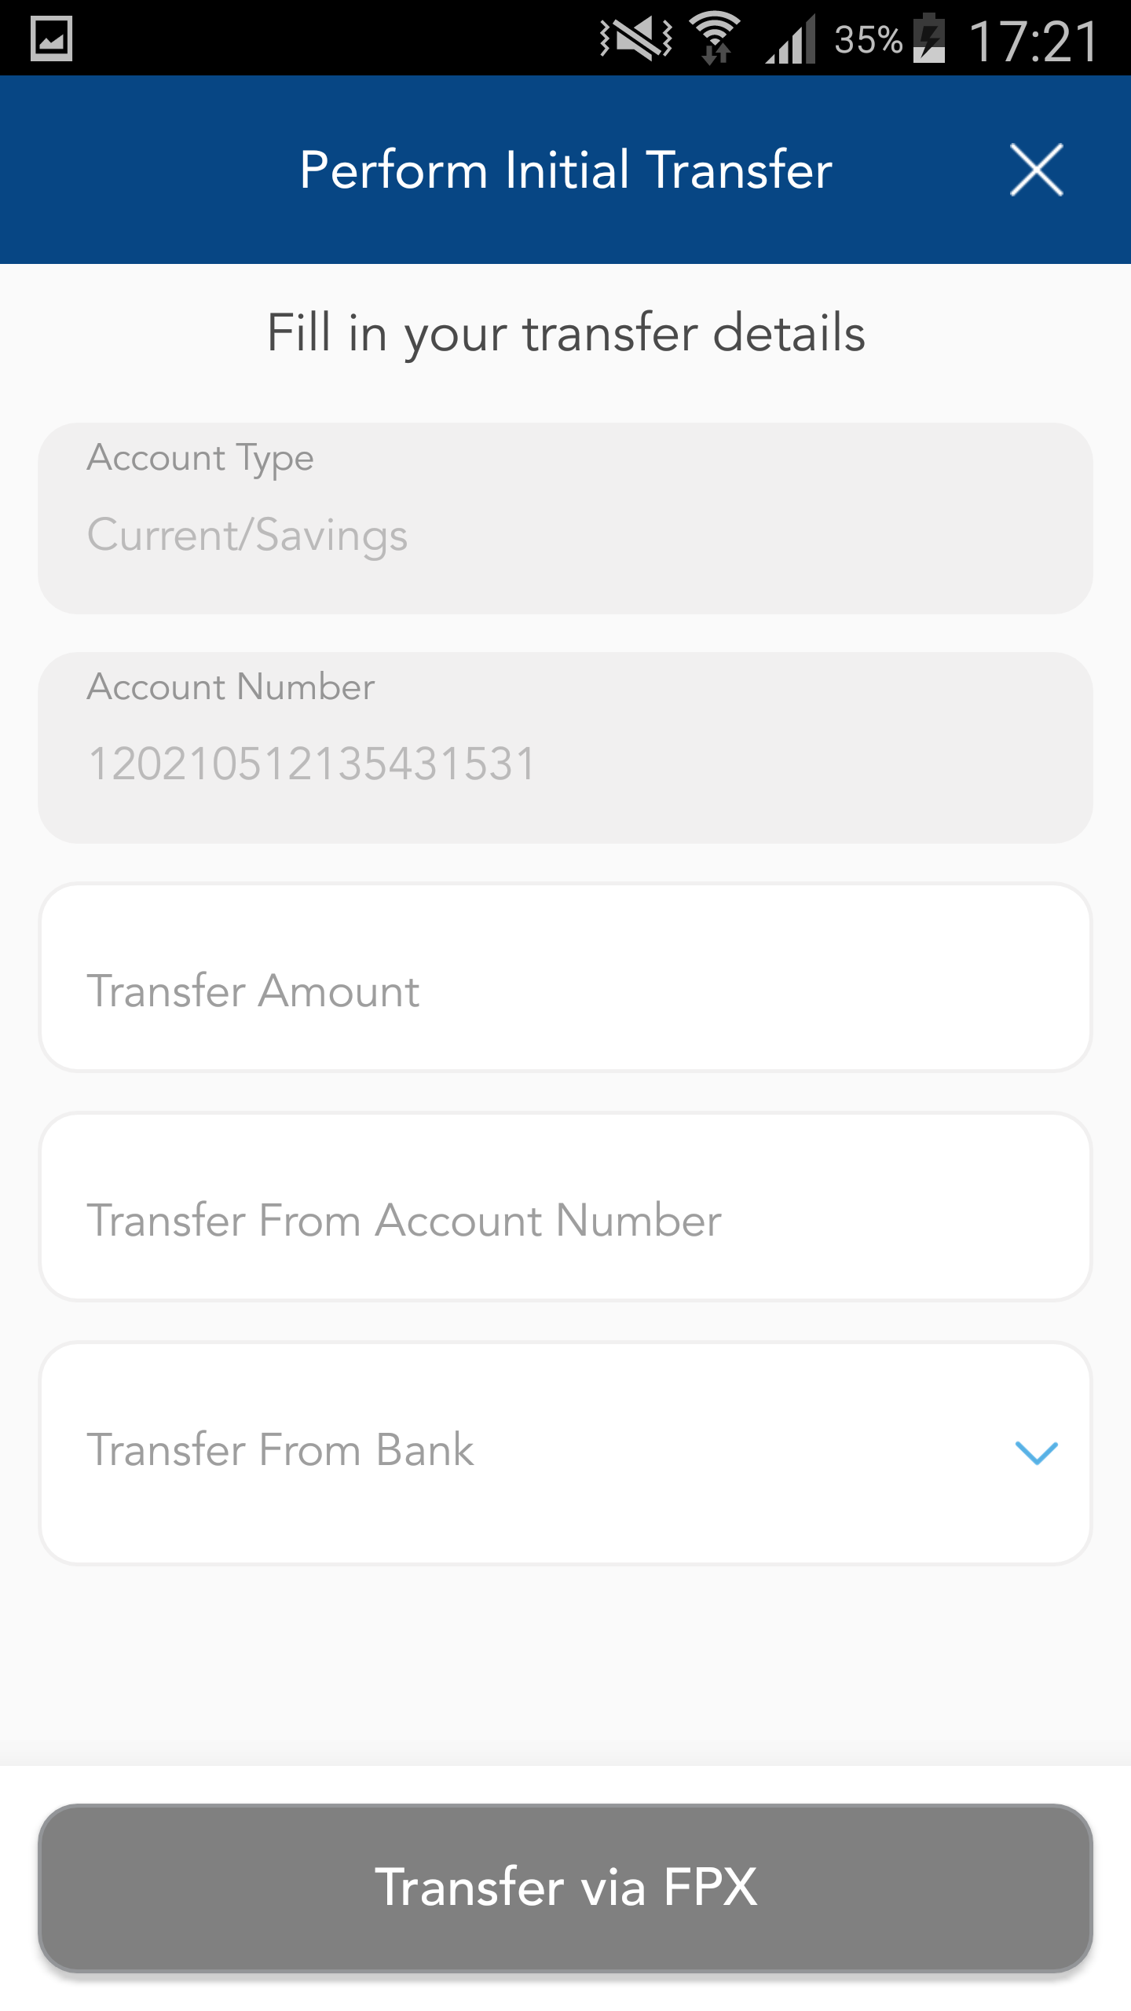
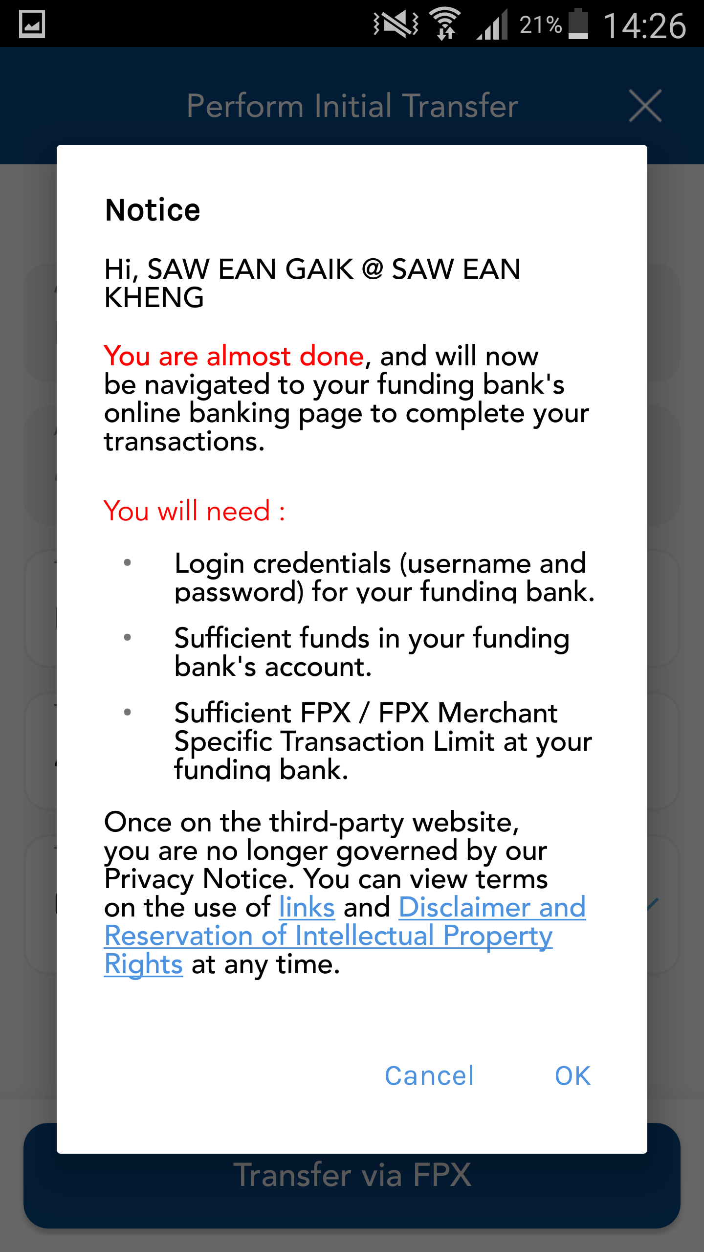
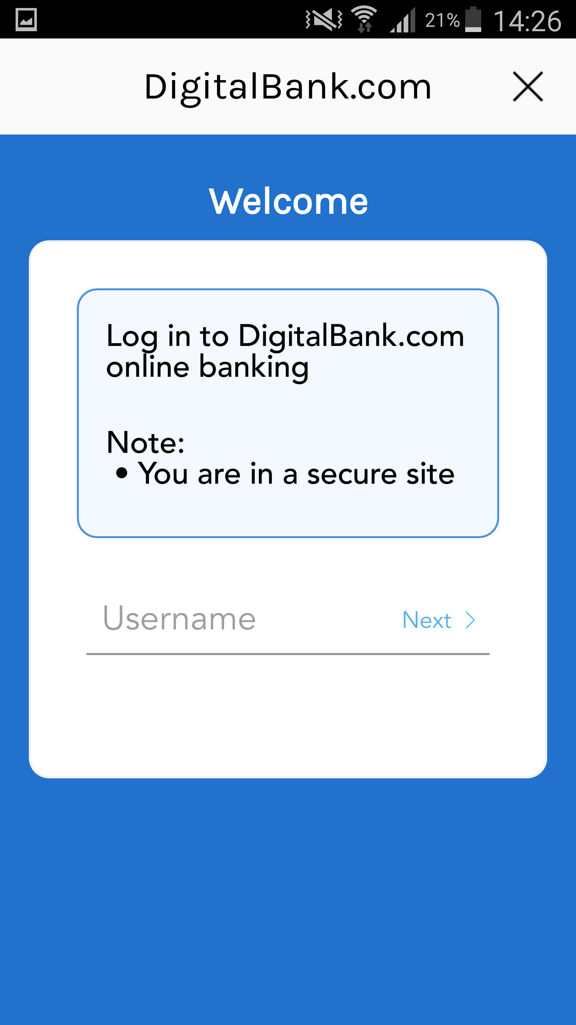
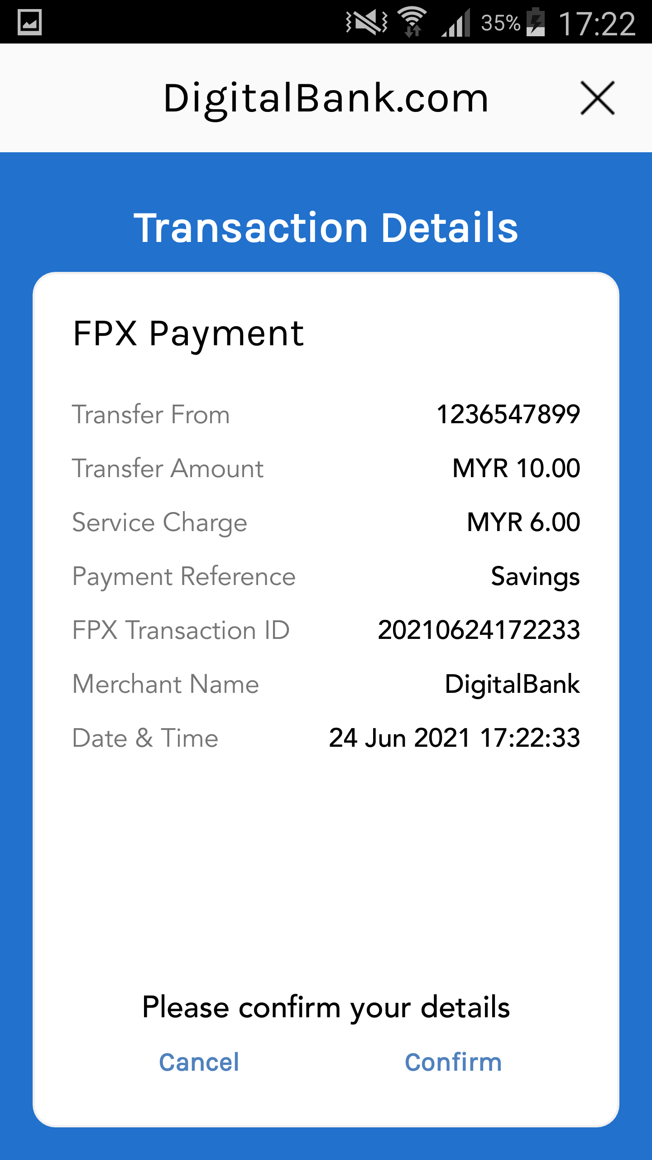
Savings Account onboarding
Activate Account
Login to App
Hi, Lim Beng Ching
Transfer fund to Savings Account
FPX Transfer from account in another Bank to Savings Account

