Slide 1


Financing onboarding
Easier, simplified and real-time onboarding applying available authentication, verification and validation capabilities to determine instant approvals
Out-of-Box Solution
Customer On Board
(eKYC & Credit Assessment)
Instant Product Issuance
Instant Disbursement to Saving Account
Real-time access
to information
Product Selection
Customer Registration
Onboarding
Online Credentials
Loan Disbursement
Customer
Access App
Capture Customer Details
eKYC (CTOS)
Create Digital Login ID
Login to App
Select Product
ID Document Verification
Facial Verification - 4 sec Selfie
Authentication Questions
Instant Loan Approval
Activate Savings Account for Loan Disbursement
Apply Verification Code
Terms & Conditions
CR Assessment
(CTOS)
CIF Creation (Account Open)
FPX Transfer from account in another Bank to Savings Account
Employment & Income info (EPF)
Credit Rating Data References (CTOS)
Underwriting
Loan Amount & Tenure
Loan Disbursed to Savings Account

Slide 2

Financing onboarding
Loan Disbursement
Login to App
Activate Savings Account for Loan Disbursement
FPX Transfer from account in another Bank to Savings Account
Loan Disbursed to Savings Account

Slide 3
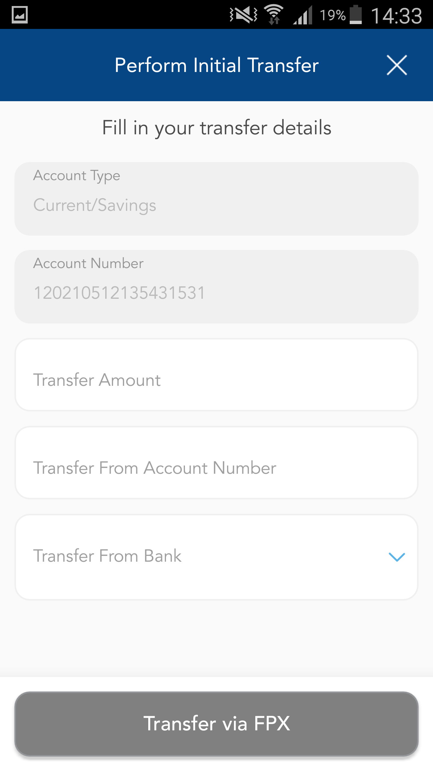
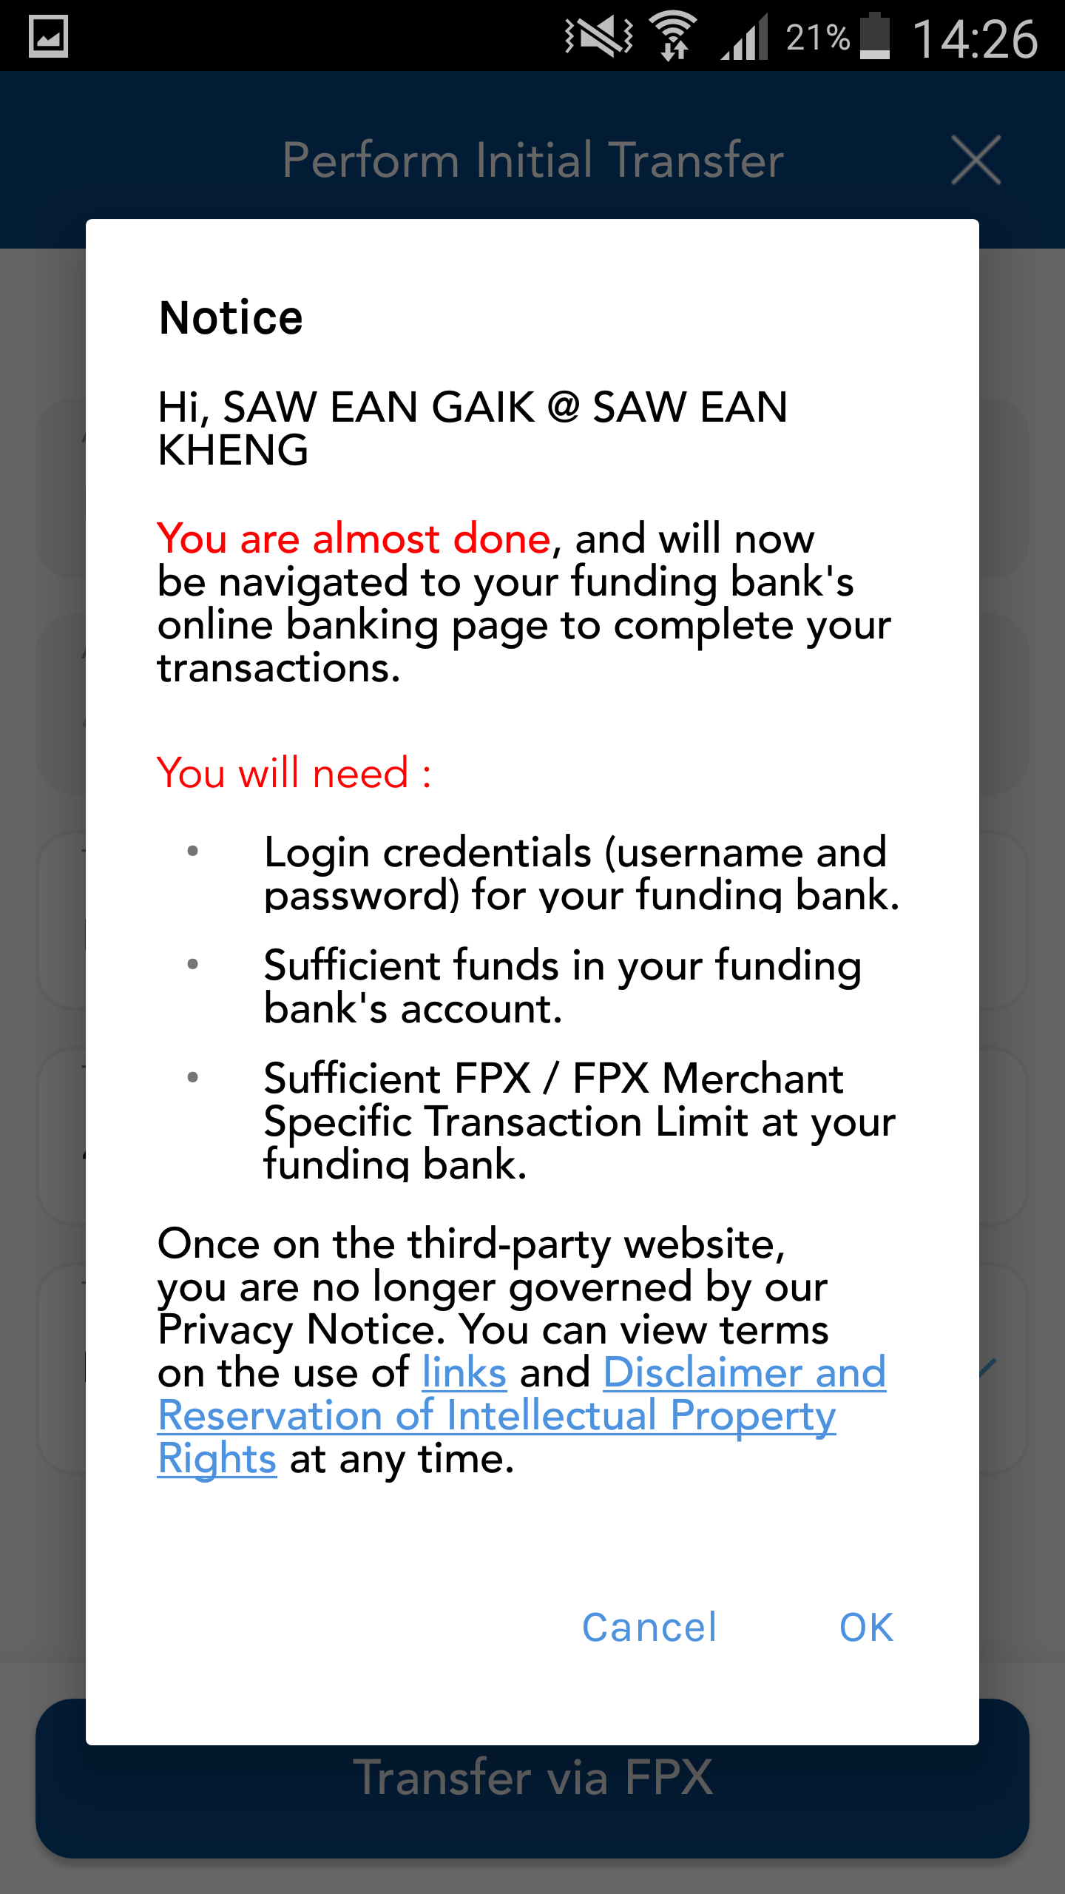
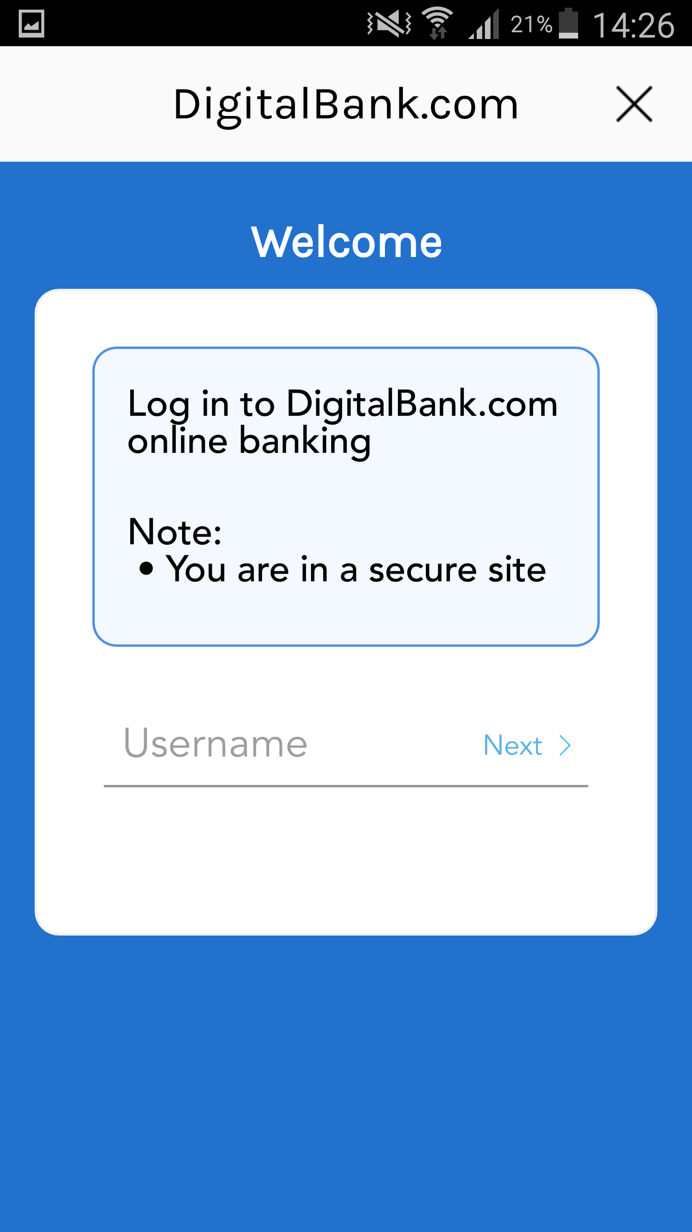
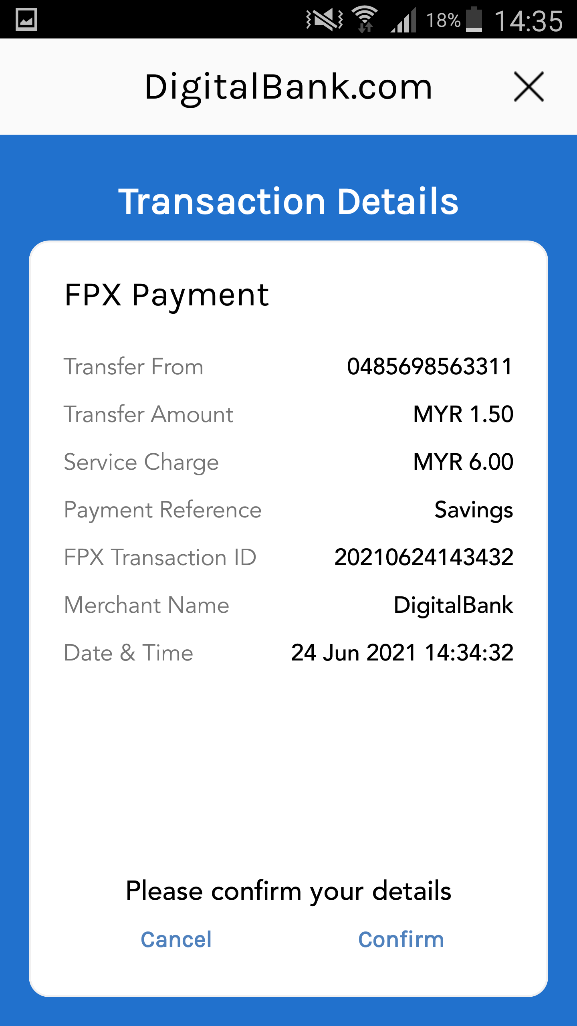
Financing onboarding
Loan Disbursement
Login to App
Hi, Lim Beng Ching
Activate Savings Account for Loan Disbursement
FPX Transfer from account in another Bank to Savings Account
Loan Disbursed to Savings Account

Slide 4
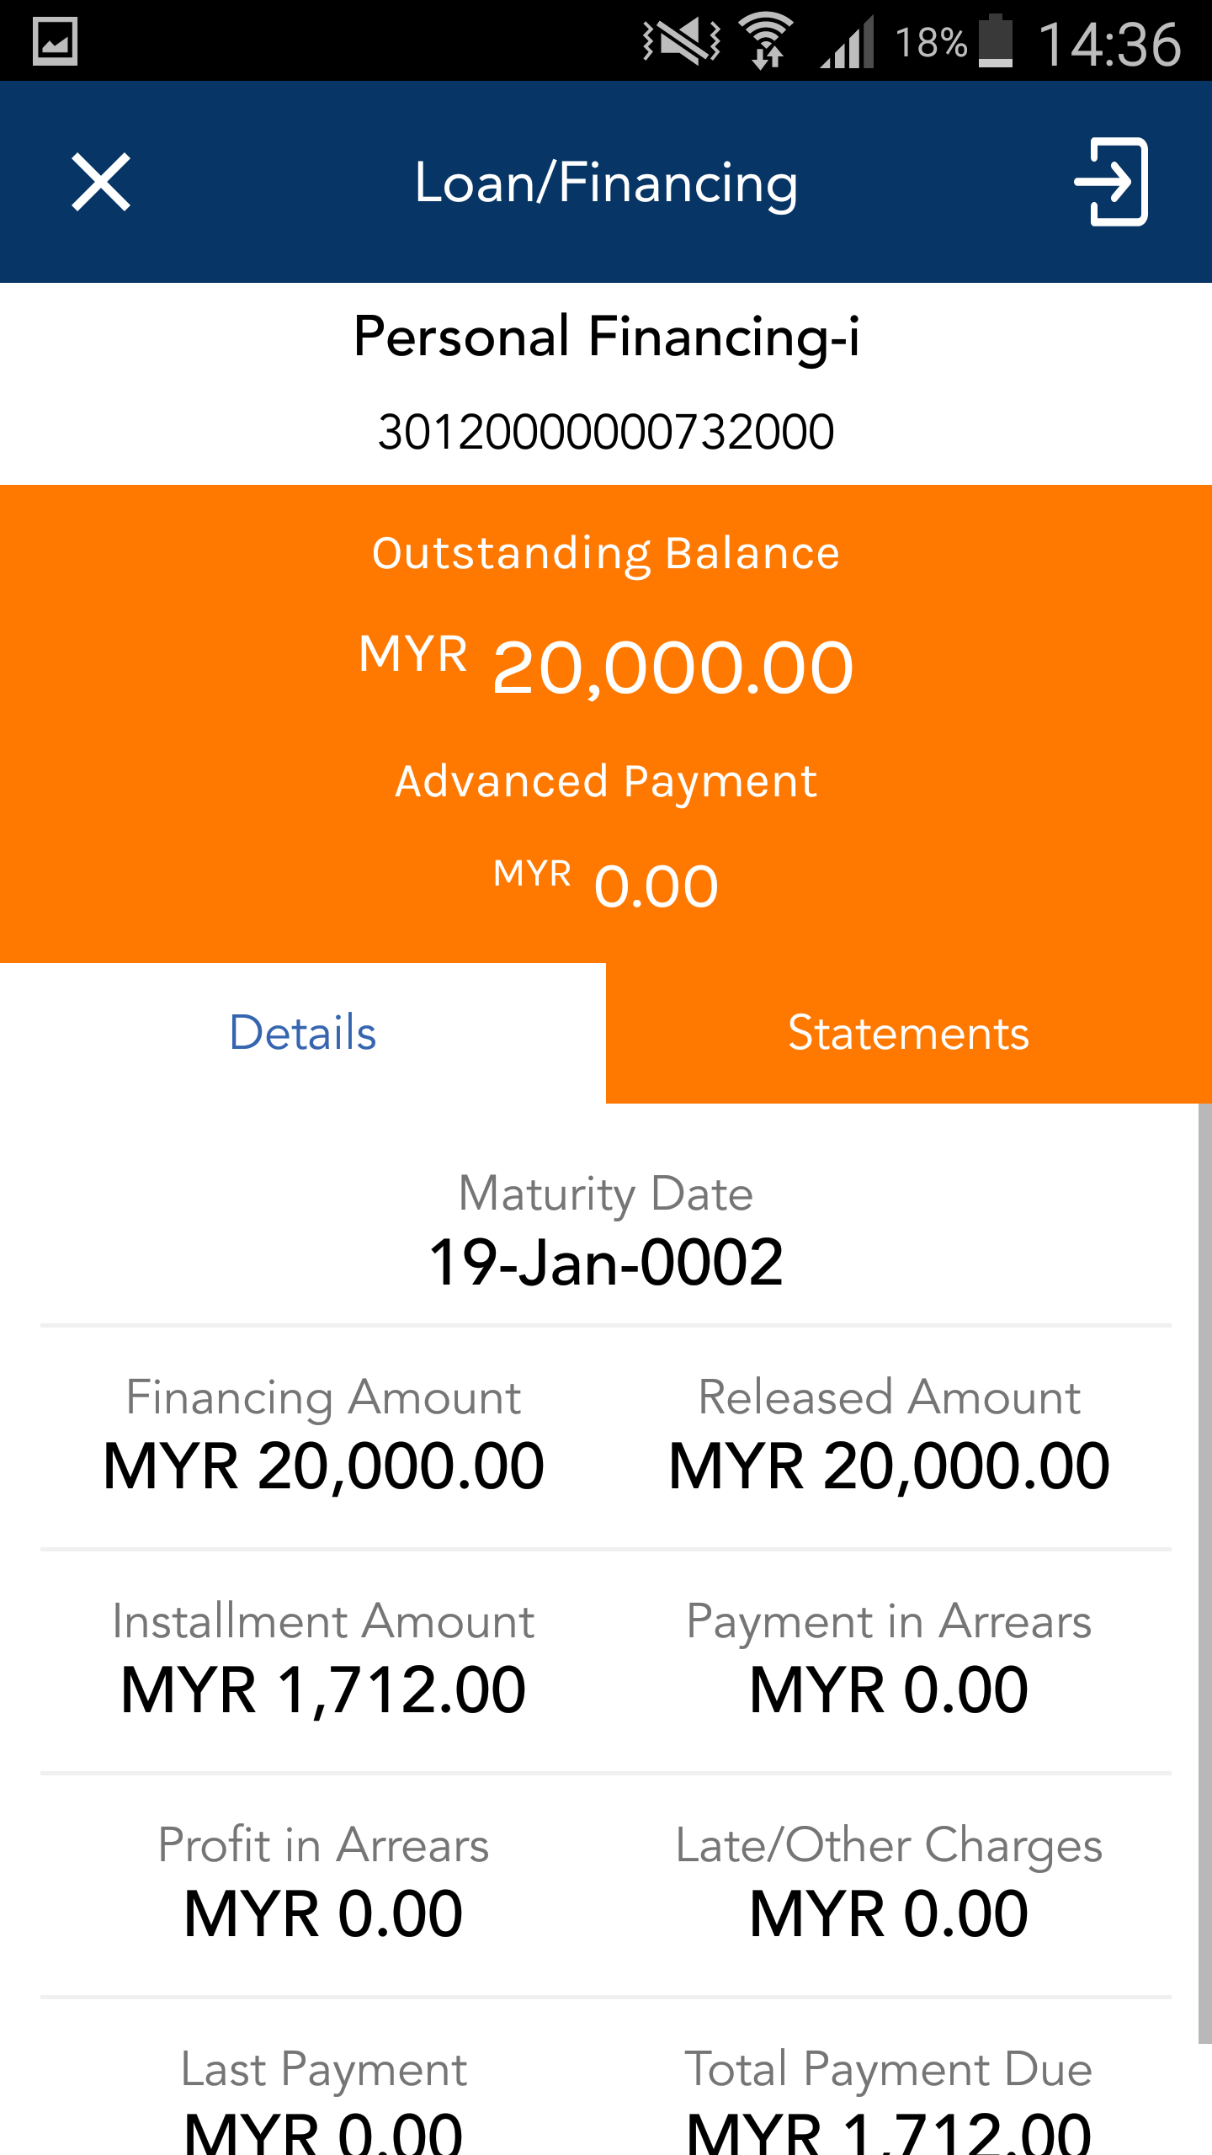
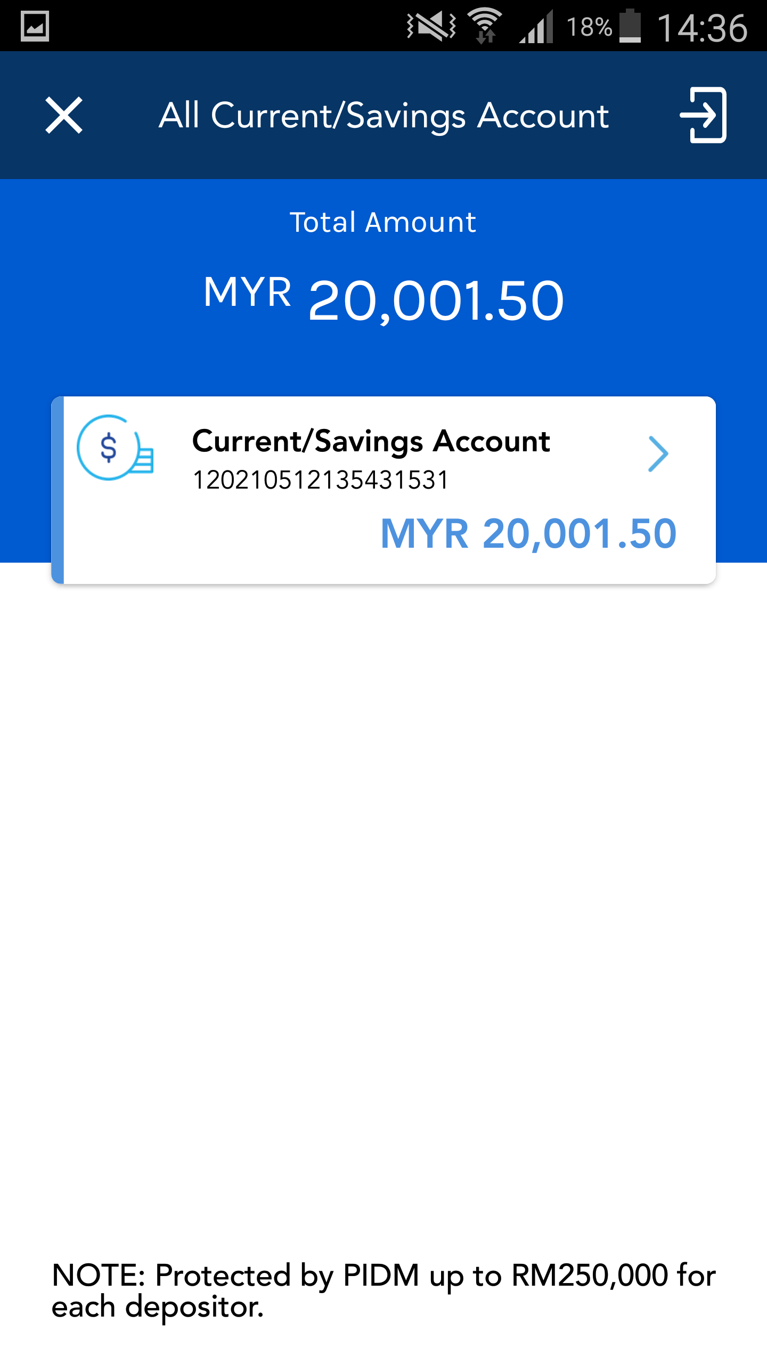
Financing onboarding
Loan Disbursement
Login to App
Activate Savings Account for Loan Disbursement
FPX Transfer from account in another Bank to Savings Account
Loan Disbursed to Savings Account

