Slide 1
Credit Card onboarding
Easier, simplified and real-time onboarding applying available authentication, verification and validation capabilities to determine instant approvals
Out-of-Box Solution
Customer On Board
(eKYC & Credit Assessment)
Instant Product Issuance
Instant Usage
Real-time access
to information
Product Selection
Customer Registration
Onboarding
Online Credentials
Customer
Access App
Capture Customer Details
eKYC (CTOS)
Create Digital Login ID
Select Product
ID Document Verification
Facial Verification - 4 sec Selfie
Authentication Questions
Apply Verification Code
Terms & Conditions
CR Assessment
(CTOS)
Employment & Income info (EPF)
Credit Rating Data References (CTOS)
Underwriting
CIF Creation (Account Open)
Instant Virtual
Card Issuance

Slide 2
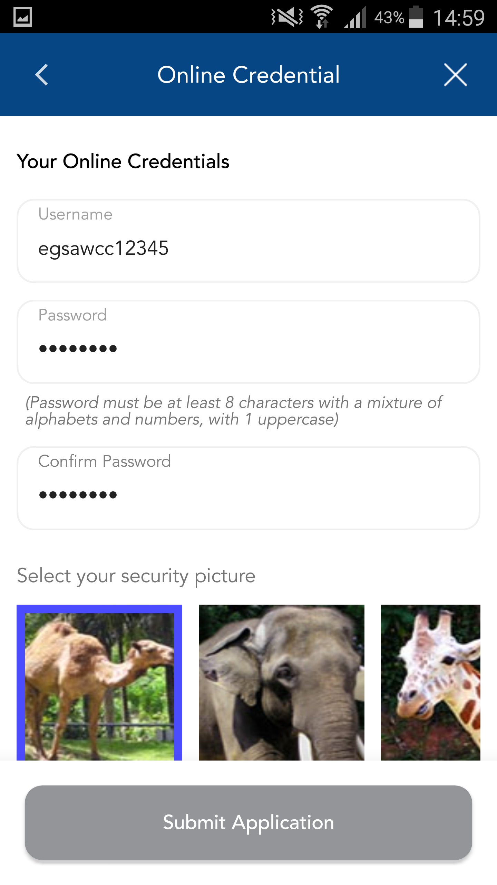
Credit Card onboarding
Online Credentials
Create Digital Login ID

