Slide 1
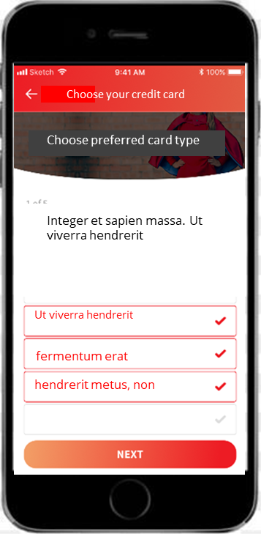
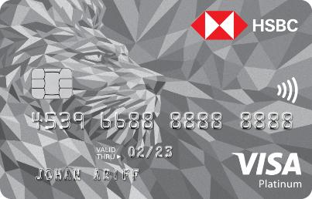
Choose your credit card
Your selection
Choose preferred card type
What sort of cards do you prefer?
What sort of cards do you prefer?
Rewards me with airmiles
Rewards me with airmiles
Cash back
8x Reward points on contactless spend
5x Reward points on online, groceries and Overseas spending
1% contribution on charity spend
Made from 85% recycled plastic
Cash back
Reward points
Reward points
Zero Annual Fees
Zero Annual Fees
We want a questionare to guide the user
Select
Questionairie , please see next slide

Slide 2
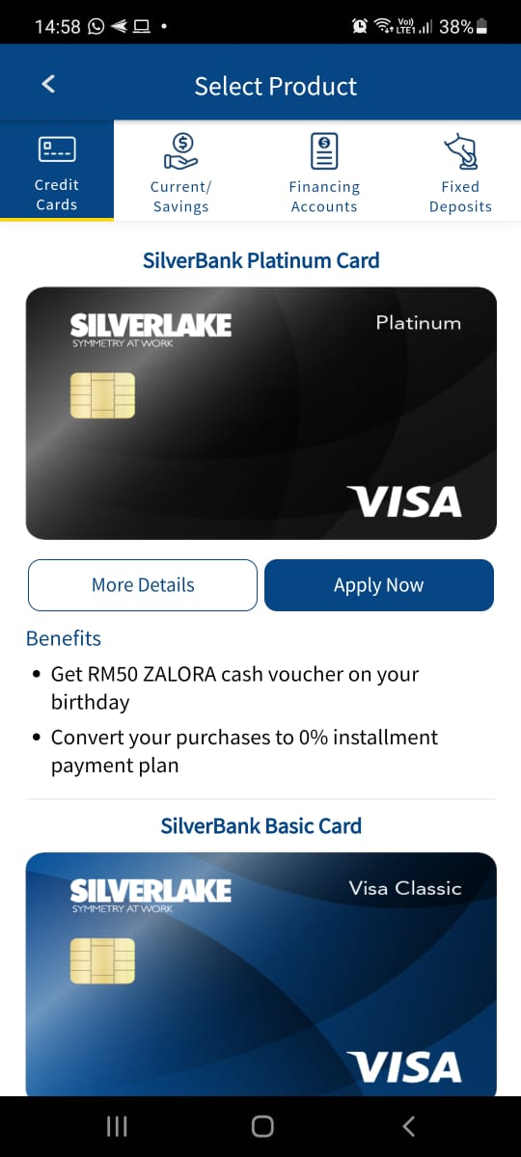
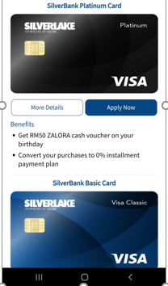
On the showroom app, modify this page to include a “Card recommendation” button . Button would appear at the very top.
Please use the same button shape, font and blue colour as Apply Now
Card recommendation

Slide 3
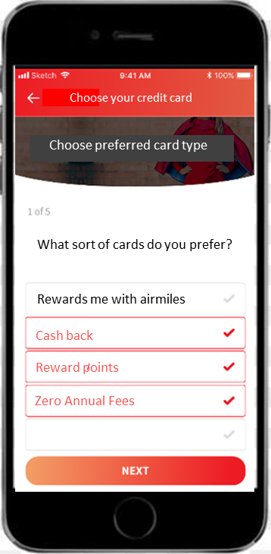
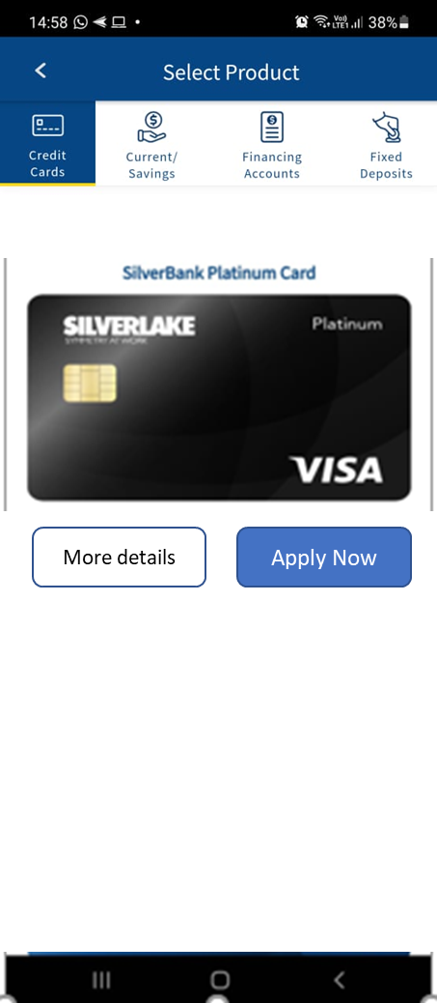
What type of Credit card are you looking for?
Islamic Credit Card
Replace the question with the following.
The button is single select only.
Non - Islamic Credit Card
Next
What type of usage is the credit card for?
Travel
Grocery Shopping
Online Shopping
Next
Driving
Next
How do you want to be rewarded?
Cash
Reward Points
The blue button is standardized . Please use the same font, colour for button
Lounge Access at airports
On the last “ Next” button, display a single Card , with the same more details and apply now. This page, can copy exactly 1 card from the card listing page
Next

Slide 4
More details
Apply Now

Slide 5
What type of Credit card are you looking for?
- Islamic Credit card
- Non Islamic Credit card
What type of usage is the credit card for?
- Travel
Grocery Shopping
Online Shopping
Driving
How do you want to be rewarded?
- Cash back
Reward Points
Lounge Access at airports

