Slide 1
Fund Transfer – BI FAST

Slide 2
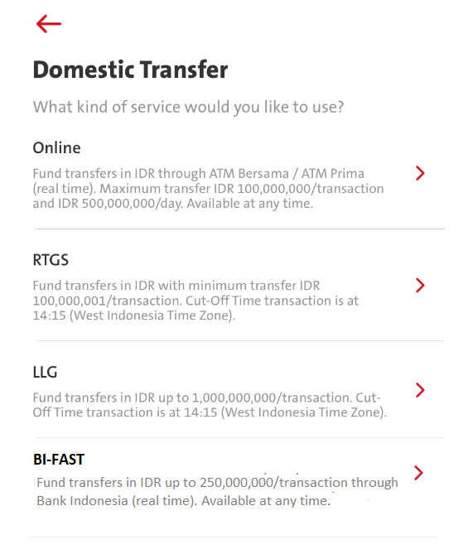
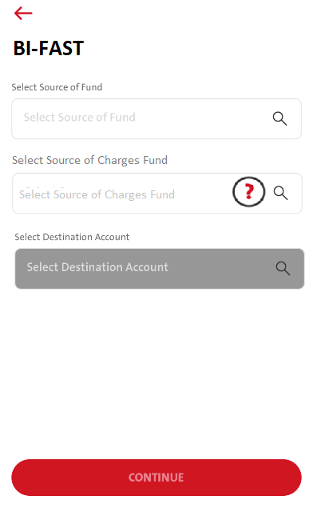
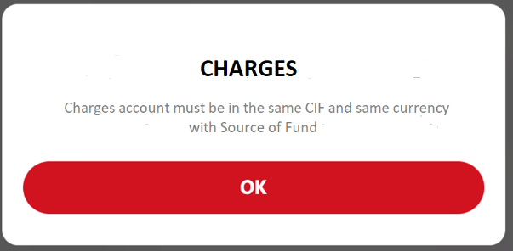
BI FAST Transfer
customer need to select Source of Fund, then only follow by Source of Charge Fund and lastly Destination.
Grey off the next selection if the item before not being select.
transactionFundTransferStep1
Need to handle new prod_cd: FAST
Please check if:
transactionFundTransferMenu
retrieveTransactionCurrencyList
Need to change
menu id : 5107role : Sb_sglacc, sb_paymkr (same with another trx in fundtransfer)

Slide 3
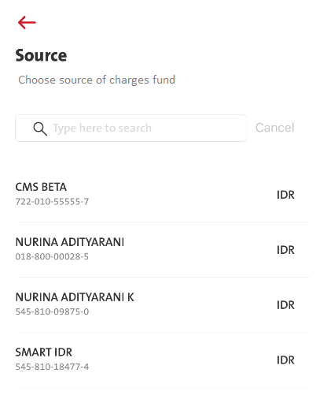
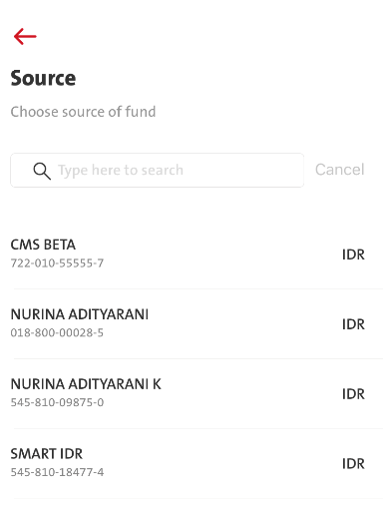
BI FAST Transfer
transactionSourceOfFund
Need to handle new prod_cd: FAST
Both source of fund and source of charges are using same omni API.
FE Need to call 10.30 Get Charges List
But FE need to call BE to get source of charges, as BE need to perform sorting on the list and only return the list that have same CIF and currency with source of fund.

Slide 4
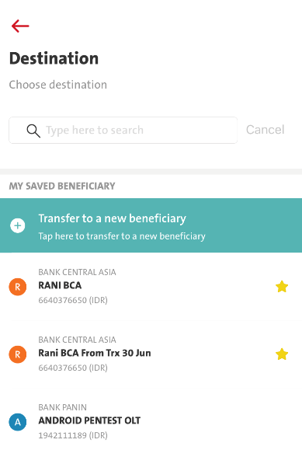
BI FAST Transfer
FE need to check if Proxy Data return from BE.
If Proxy Data is return, display:
Bank Name
Alias Name – Proxy Data
Beneficiary A/C No (Ccy)
Example 1: Example 2:
BANK CENTRAL ASIA BANK CENTRAL ASIA
RANI BCA – rani@abc.com RANI BCA – 6281122334455
6640376650 (IDR) 6640376650 (IDR)
If Proxy Data not return, display:
Bank Name
Alias Name
Beneficiary A/C No (Ccy)
Example
BANK CENTRAL ASIA
RANI BCA
6640376650 (IDR)

Slide 5
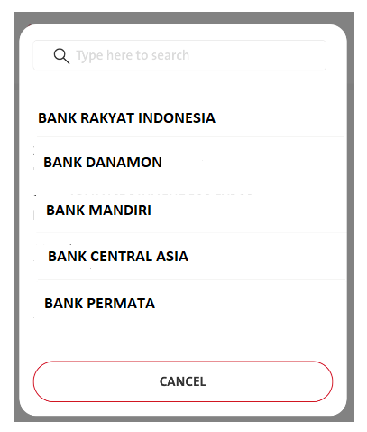
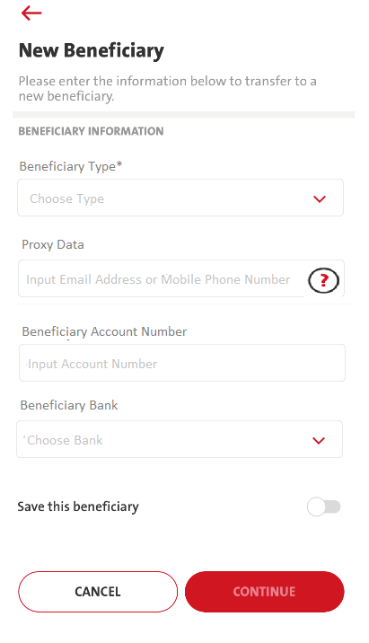
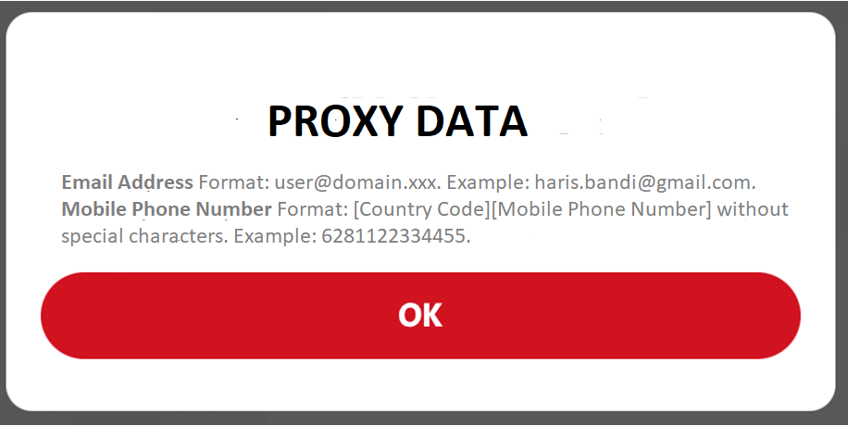
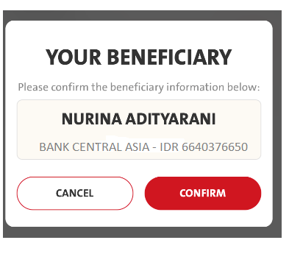
BI FAST Transfer
Beneficiary Type:
FAST01: Acc No
FAST02: Mobile No
FAST03: Email Address
If select FAST01, Proxy Data field need to grey off.
If select FAST02 or FAST03, Acc number and bank need to grey off.
Bank list can use back retrieveBankList but need to enhance to support prd_cd FAST
BE – needs to sent 01 by default
Press CONTINUE, call Omni new API (10.29 Inquiry Transaction BIFAST) to verify proxy/Account. Both new and saved bene also need to call this because the response object need to return back to Omni during submit fund transfer.

Slide 6
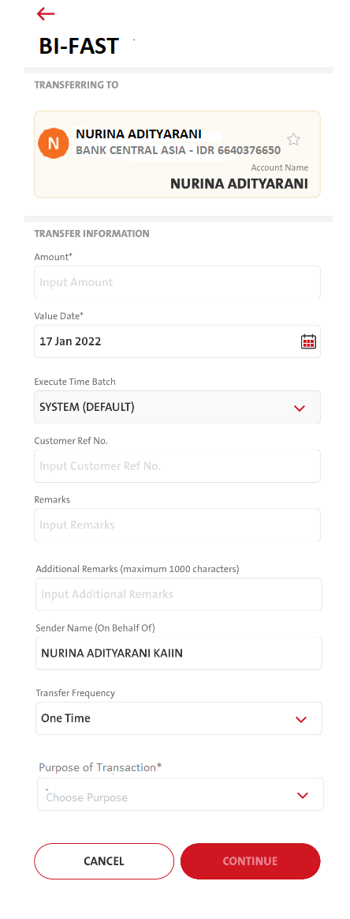
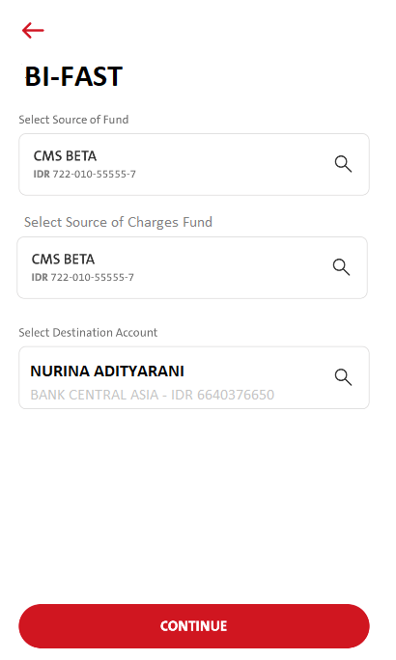
BI FAST Transfer
If the Beneficiary isn’t saved, the format will be (as is):
Account Name
Beneficiary Bank – Beneficiary Ccy + A/C No
Example:
NURINA ADITYARANI
BANK CENTRAL ASIA – IDR 6640376650
If the Beneficiary is saved, the format will be:
Regular – Account No (as is)
Alias Name
Beneficiary Bank – Beneficiary Ccy + A/C No
Example:
RANI BCA
BANK CENTRAL ASIA – IDR 6640376650
Proxy – Email Address or Proxy – Mobile Phone Number
Alias Name – Proxy Data
Beneficiary Bank – Beneficiary Ccy + A/C No
Example 1:
RANI BCA – rani@abc.com
BANK CENTRAL ASIA – IDR 6640376650
Example 2:
RANI BCA – 6281122334455
BANK CENTRAL ASIA – IDR 6640376650
Confirmed, no cross currency as of now

Slide 7
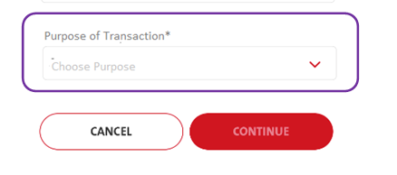
BI FAST Transfer
Selections are as below:
01 - Investment
02 - Transfer of Wealth
03 - Purchase
99 – Others
Note: “Others” no need extra fields to input other purpose.

Slide 8
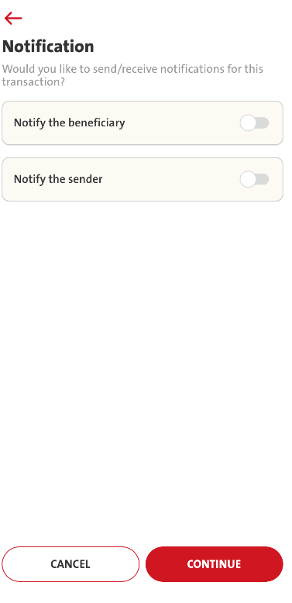
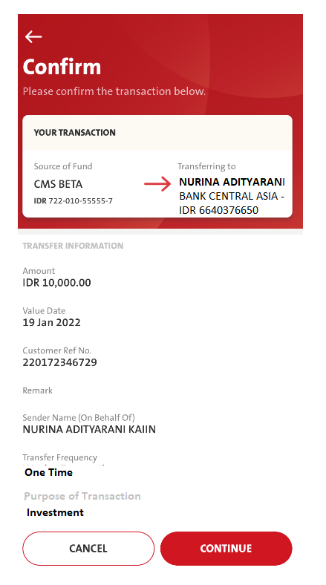
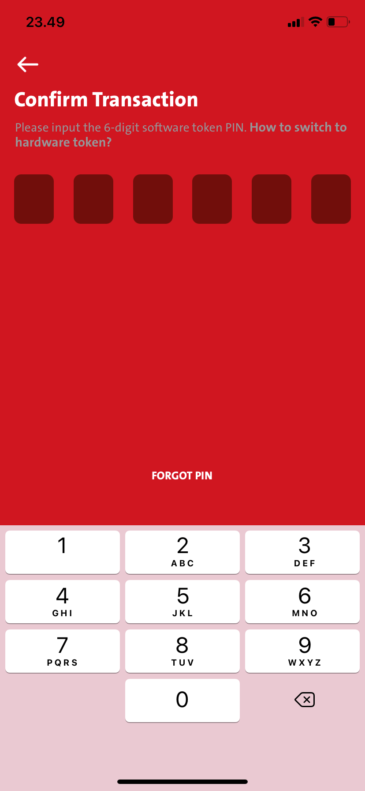
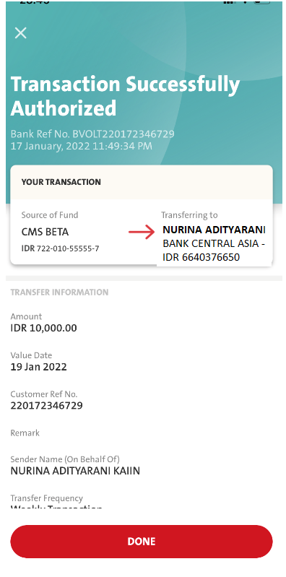
BI FAST Transfer
Screen flow follow BAU fund transfer.
Need to perform validation check during confirmation
10.12
validation_check pass “Y”
Confirmed, remain having skip token flow for payment maker

Slide 9
BI FAST Transfer
Confirmation Screen
TRANSACTION INFORMATION will display information (in a row):
Amount
Value Date
Customer Ref No.
Remark
Additional Remarks
Sender Name (On Behalf Of)
Transfer Frequency
Transaction Every (Will be displayed if Transaction Frequency = Weekly or Monthly)
Start Date (Will be displayed if Transaction Frequency = Weekly or Monthly)
End Date (Will be displayed if Transaction Frequency = Weekly or Monthly)
NOTIFICATION SETTINGS will display information (in a row):
Notify Recipient
Notify Sender
Acknowledgement Screen
TRANSACTION INFORMATION will display information (in a row):
Amount
Value Date
Customer Ref No.
Remark
Additional Remarks
Sender Name (On Behalf Of)
Transfer Frequency
Transaction Every (Will be displayed if Transaction Frequency = Weekly or Monthly)
Start Date (Will be displayed if Transaction Frequency = Weekly or Monthly)
End Date (Will be displayed if Transaction Frequency = Weekly or Monthly)
NOTIFICATION SETTINGS will display information (in a row):
Notify Recipient
Notify Sender

Slide 10
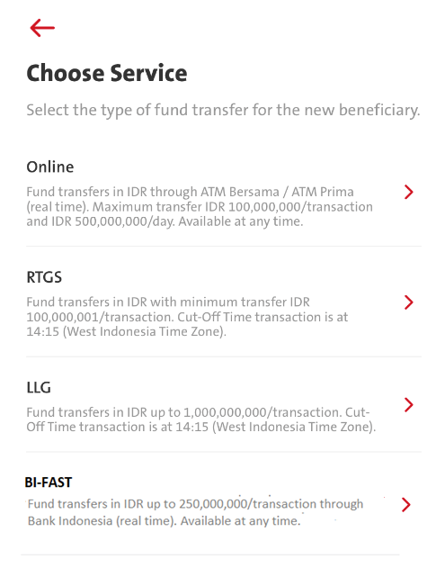
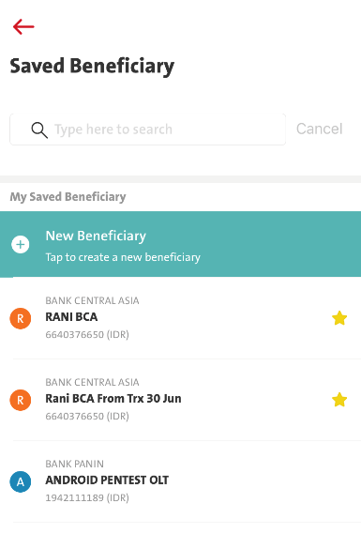
BI FAST Manage Bene
Apply same logic as slides 4 fund transfer

Slide 11
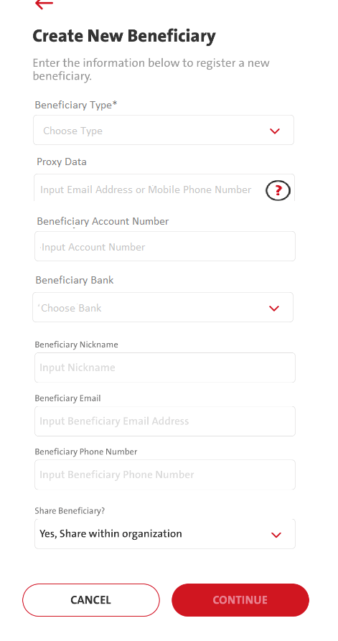
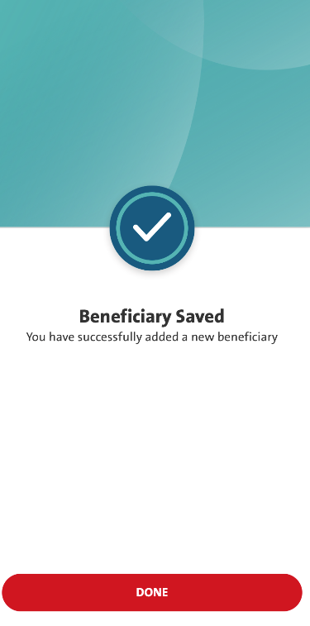
BI FAST Manage Bene
Beneficiary Type:
FAST01: Acc No
FAST02: Mobile No
FAST03: Email Address
If select FAST01, Proxy Data field need to grey off.
If select FAST02 or FAST03, Acc number and bank need to grey off.
Bank list can use back retrieveBankList but need to enhance to support prd_cd FAST
Press CONTINUE, call Omni new API (10.29 Inquiry Transaction BIFAST) to verify proxy/Account. (Still asking OCBC)
FE needs to call add bene BAU flow.

Slide 12
BI FAST Manage Bene
BI FAST have View, Edit and Delete bene flow. Click on FUND TRANSFER in view bene will go through Source of fund, source of charges fund then follow by input page.

Slide 13
BI FAST Manage Recurring
Only add transfer type into it

Slide 14
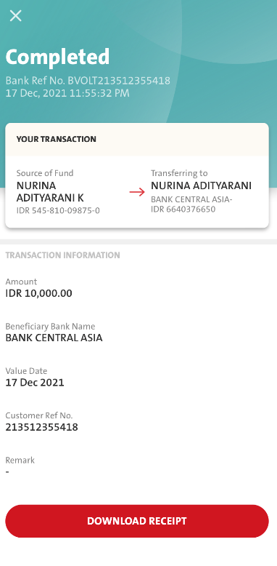
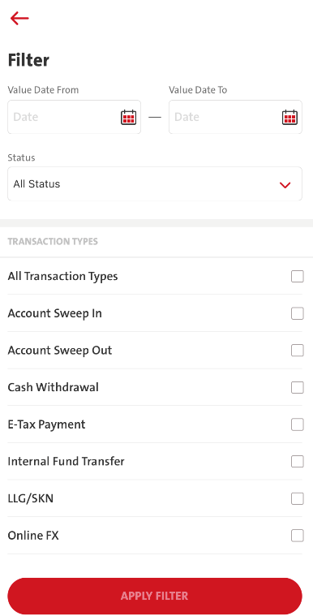
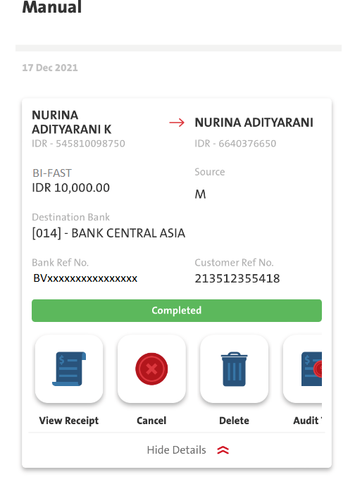
BI FAST Transaction Summary

Slide 15
BI FAST Transaction Summary
Involve Manual and Non Bulk file upload View Transactions layer
Transaction Type in filter need to add BI-FAST
BI-FAST transaction summary layout is following Online Transfer.
Receipt Screen is following the fund transfer receipt.
TRANSACTION INFORMATION will display information (in a row):
Amount
Value Date
Customer Ref No.
Remark
Additional Remarks
Sender Name (On Behalf Of)
Transfer Frequency
Transaction Every (Will be displayed if Transaction Frequency = Weekly or Monthly)
Start Date (Will be displayed if Transaction Frequency = Weekly or Monthly)
End Date (Will be displayed if Transaction Frequency = Weekly or Monthly)
NOTIFICATION SETTINGS will display information (in a row):
Notify Recipient
Notify Sender

Slide 16
No | ENG | ID
1 | Fund transfers in IDR up to 250,000,000/transaction through Bank Indonesia (real time). Available at any time. | Transfer dana dalam Rupiah sampai dengan Rp 250,000,000/transaksi. Layanan tersedia setiap saat.
2 | Select Source of Fund | Pilih Sumber Dana
3 | Select Source of Charges Fund | Pilih Sumber Dana Biaya
4 | Select Destination Account | Pilih Rekening Tujuan
5 | CONTINUE | LANJUT
6 | Source | Sumber
7 | Choose source of fund | Pilih sumber dana
8 | Choose source of charges fund | Pilih sumber dana biaya
9 | Type here to search | Ketik di sini untuk pencarian
10 | Cancel | Batal
11 | CHARGES | BIAYA
12 | Charges account must be in the same CIF and same currency with Source of Fund | Rekening biaya wajib menggunakan CIF yang sama dan mata uang yang sama dengan rekening sumber dana
13 | Destination | Tujuan
14 | Choose Destination | Pilih tujuan
15 | MY SAVED BENEFICIARY | DAFTAR PENERIMA TERSIMPAN
16 | Transfer to a new beneficiary | Transfer ke penerima baru
17 | Tap here to transfer to a new beneficiary | Klik di sini untuk transfer ke penerima baru
18 | New Beneficiary | Penerima Baru
19 | Please enter the information below to transfer to a new beneficiary. | Silakan masukkan informasi di bawah ini untuk transfer ke penerima baru.
20 | BENEFICIARY INFORMATION | INFORMASI PENERIMA
21 | Beneficiary Type* | Tipe Penerima*

Slide 17
No | ENG | ID
22 | Choose Type | Pilih Tipe
23 | Proxy Data | Data Proxy
24 | Input Email Address or Mobile Phone Number | Masukkan Alamat Surat Elektronik atau Nomor Telepon Selular
25 | Email Address Format: user@domain.xxx. Example: haris.bandi@gmail.com. Mobile Phone Number Format: [Country Code][Mobile Phone Number] without special characters. Example: 6281122334455. | Format Alamat Surat Elektronik: user@domain.xxx. Contoh: haris.bandi@gmail.com. Format Nomor Telepon Selular: [Kode Negara][Nomor Telepon Selular] tanpa karakter spesial. Contoh: 6281122334455.
26 | Beneficiary Account Number | Nomor Rekening Penerima
27 | Input Account Number | Masukkan Nomor Rekening
28 | Beneficiary Bank | Bank Penerima
29 | Choose Bank | Pilih Bank
30 | Save as Beneficiary | Simpan penerima ini
31 | YOUR BENEFICIARY | PENERIMA ANDA
32 | Please confirm the beneficiary information below: | Silakan konfirmasi informasi penerima di bawah ini:
33 | CONFIRM | KONFIRMASI
34 | TRANSERRING TO | TRANSFER KE
35 | TRANSFER INFORMATION | INFORMASI TRANSFER
36 | Amount* | Nominal*
37 | Input Amount | Masukkan Nominal
38 | Value Date* | Tanggal Valuta*
39 | Execute Time Batch | Batch Waktu Eksekusi
40 | Customer Ref No. | Nomor Referensi Nasabah
41 | Input Customer Ref No. | Masukkan Nomor Referensi Nasabah
42 | Remarks | Masukkan Keterangan

Slide 18
No | ENG | ID
43 | Additional Remarks (maximum 1000 characters) | Keterangan Tambahan (maksimum 1000 karakter)
44 | Sender Name (On Behalf Of) | Nama Pengirim 9Atas Nama)
45 | Transfer Frequency | Frekuensi Transfer
46 | Purpose of Transaction* | Tujuan Transaksi
47 | Notification | Notifikasi
48 | Would you like to send/receive notifications for this transaction? | Apakah anda ingin mengirim/menerima notifikasi untuk transaksi ini?
49 | Notify the beneficiary | Beritahu penerima
50 | Notify the sender | Beritahu pengirim
51 | Confirm | Konfirmasi
52 | Please confirm the transaction below. | Silakan konfirmasi transaksi di bawah ini.
53 | YOUR TRANSACTION | TRANSAKSI ANDA
54 | TRANSFER INFORMATION | INFORMASI TRANSFER
55 | NOTIFICATION SETTINGS | PENGATURAN NOTIFIKASI
56 | Confirm Transaction | Konfirmasi Transaksi
57 | Please input the 6-digit software token PIN. How to switch to hardware token? | Silakan masukkan 6-digit PIN software token. Bagaimana mengganti ke hardware token?

