Slide 1
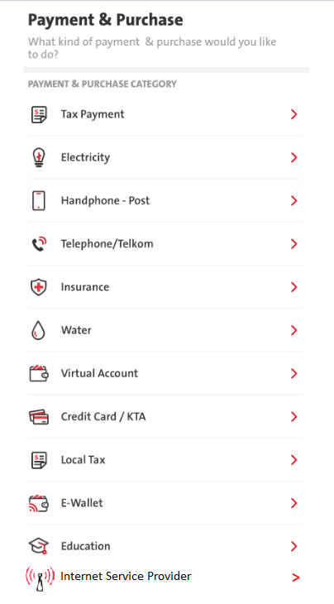
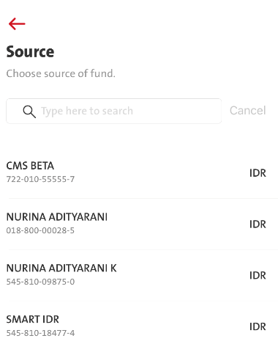
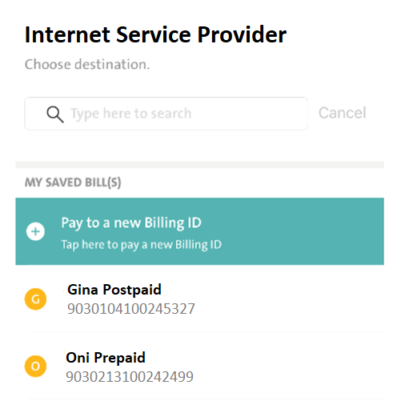
Menu: Transactions – Payment & Purchase – New Category – Internet Service Provider

Slide 2
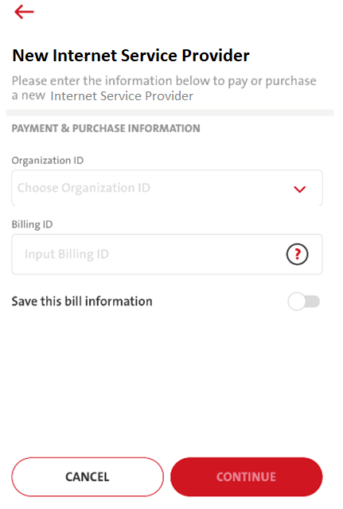

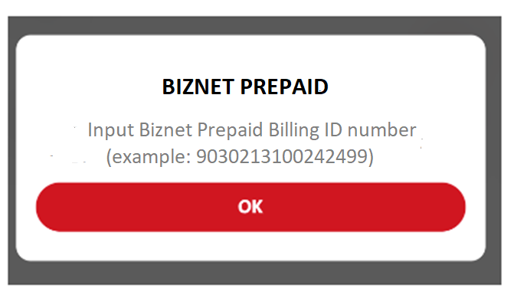
Organization ID consists of:
BIZNET PREPAID
BIZNET POSTPAID
Billing ID Pop Up Info sample:

Slide 3
No | ENG | ID
1 | Internet Service Provider | Penyedia Jasa Internet
2 | New Internet Service Provider | Penyedia Jasa Internet Baru
3 | Please enter the information below to pay or purchase a new Internet Service Provider | Masukkan informasi di bawah ini untuk membayar atau membeli Penyedia Jasa Internet baru
 | Pop Up Billing Info
4 | BIZNET PREPAID Input Biznet Prepaid Billing ID number (example: 9030213100242499) | BIZNET PREPAID Masukkan nomor ID Pelanggan Biznet Prepaid (contoh: 9030213100242499)
5 | BIZNET POSTPAID Input Biznet Postpaid Billing ID number (example: 9030104100245327) | BIZNET POSTPAID Masukkan nomor ID Pelanggan Biznet Postpaid (example: 9030104100245327)

