Slide 1
QC1295 – Block My User
Mobility Frontend | Mobility Backend | Omni
Click Block My User
Call RetrieveTnCv2
BE request Omni 3.11 ws URL: [api_endpoint]/others/v2/tnc
Omni response TnC Type to BE
Display Input Screen & Cache TnC
BE response TnC Type to FE
Check S0014 code
User Input data
Yes
BE receives response from Omni.
BE returns message copywriting to FE
BE needs to cater copywriting below:@ Slide # 5.
User Input data
Omni response to BE
Click TnC & Close TnC.
No
Tick on TnC check box.
BE request Omni 3.14 ws URL: [api_endpoint]/user/block_myuser
Remark: Please do not send validation_Check
Only Send Mandatory parameters to omni
Click on Submit Button: Call Block Me WS.
Display Successful screen
Return to Landing Screen – To be confirmed
End

Slide 2
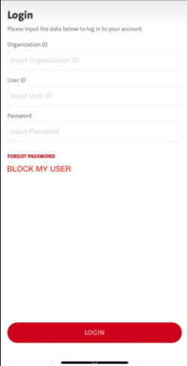
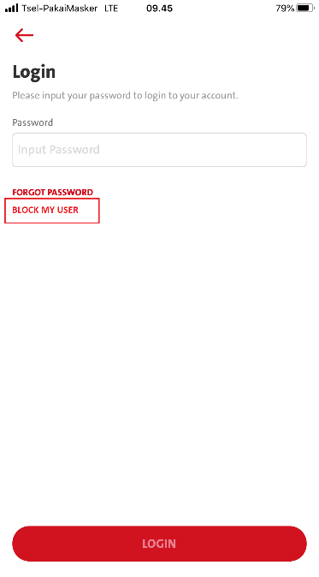
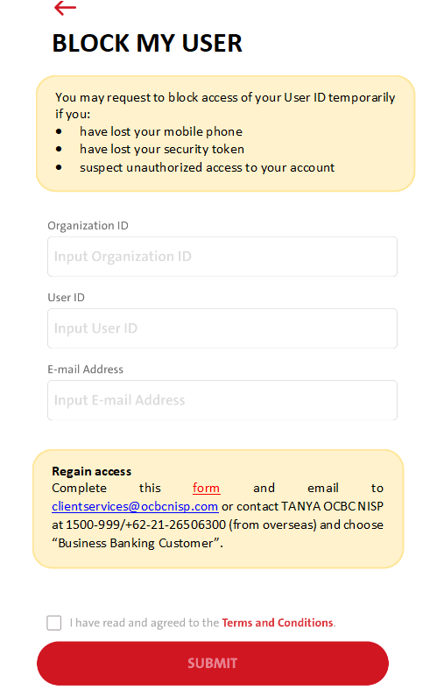
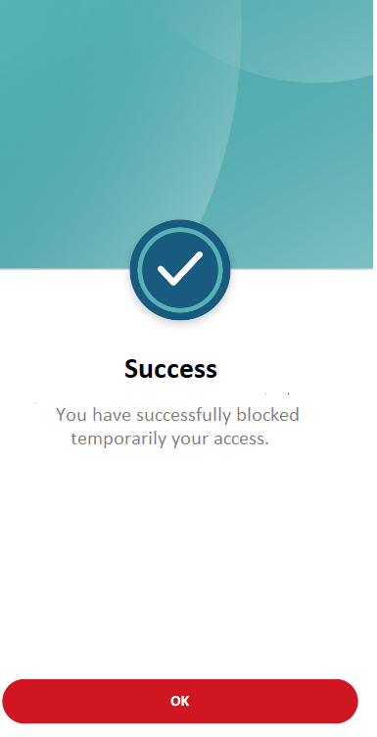
And
Login screen in unbound scenario
Login screen when finger-print or face ID authentication failure.

Slide 3
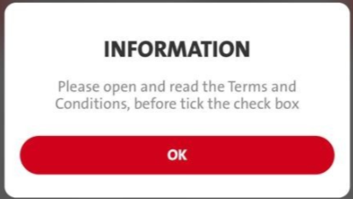
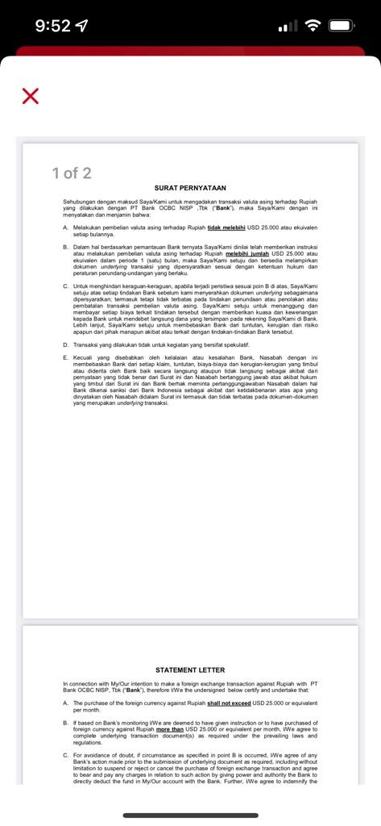
EN
INFORMATION
Please open and read the Terms & Condition, before tick the check box.
ID
INFORMASI
Silakan buka dan baca Syarat dan Ketentuan, sebelum klik check box.
form:
Pending New service
FE: RetrieveTnC
Disable checkbox before reading the TnC file.-
Click TnC file to read
Enable checkbox after reading TnC file.
Remark: Pending Omni spec updates for Spec 13.4 – tnc type : BLOCK
Click SUBMIT call - Omni Spec 3.14:- user/block_myuser
Pending BE for new service

Slide 4
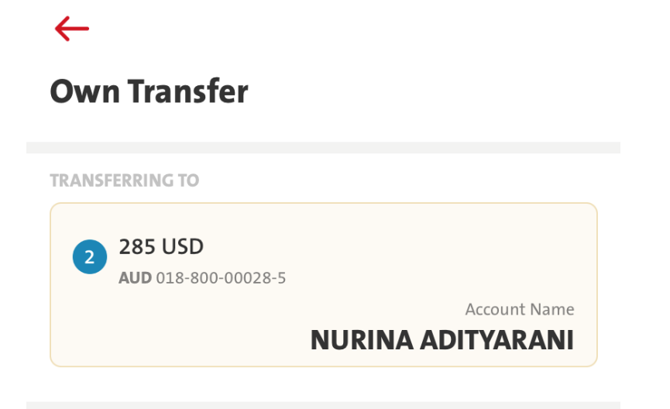
Please use the same shape & colour for the box with the box on Transferring to:
Use the destinated frame & color
Use the destinated frame & color

Slide 5
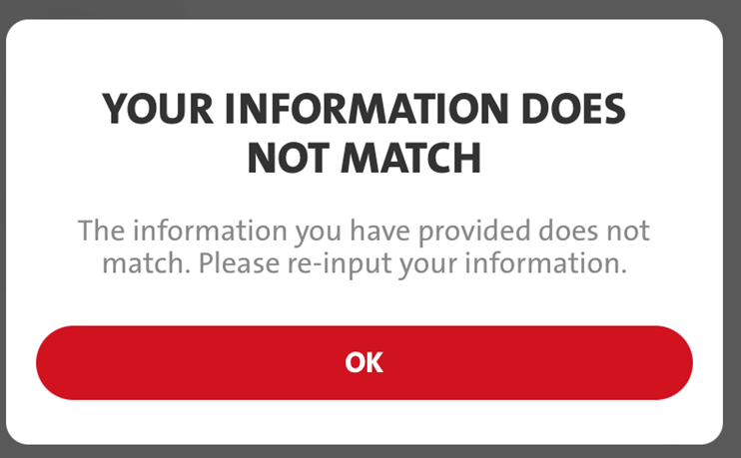
2. If the Organization ID, User ID, and Email Address are not match, then pop up message will appear:
EN
Title: YOUR INFORMATION DOES NOT MATCH
Message: The information you have provided does not match. Please re-input your information.
ID
Title: INFORMASI ANDA TIDAK SESUAI
Message: Informasi yang anda masukkan tidak sesuai. Silakan massukkan ulang informasi anda.

Slide 6
No | ENG | ID
1 | BLOCK MY USER | BLOK USER SAYA
2 | You may request to block access of your User ID temporarily if you: have lost your mobile phone have lost your security token suspect unauthorized access to your account | Anda dapat mengajukan blokir akses sementara atas ID Pengguna Anda jika: kehilangan telepon selular Anda kehilangan token Anda adanya kecurigaan akses tidak sah atas akun Anda
3 | Regain access Complete this form and email to clientservices@ocbcnisp.com or contact TANYA OCBC NISP at 1500-999/+62-21-26506300 (from overseas) and choose “Business Banking Customer”. | Mengembalikan akses Lengkapi form ini dan kirim ke clientservices@ocbcnisp.com atau hubungi TANYA OCBC NISP at 1500-999/+62-21-26506300 (dari luar negeri) dan pilih “Nasabah Bisnis”.
4 | I have read and agreed to the Terms and Conditions. | Saya telah membaca dan menyetujui Syarat dan Ketentuan.
5 | SUCCESS | SUKSES
6 | You have successfully blocked temporarily your access. | Anda telah berhasil memblokir sementara akses Anda.

