Slide 1
QC1295 – Block My User 1.0
Mobility Frontend | Mobility Backend | Omni
Click Block My User
Call RetrieveTnCv2
BE request Omni 3.11 ws URL: [api_endpoint]/others/v2/tnc
Omni response TnC Type to BE
Display Input Screen & Cache TnC
BE response TnC Type to FE
User Input data
Display Pop-Up Message
Yes
BE receives response from Omni.
BE returns error code S0014 to FE.
Click TnC & Close TnC.
Omni response to BE
Check S0014 code
Tick on TnC check box.
No
BE request Omni 3.14 ws URL: [api_endpoint]/user/block_myuser
Remark: Please do not send validation_Check
Only Send Mandatory parameters to omni
Click on Submit Button: Call Block Me WS.
Display Successful screen
Return to Landing Screen.
End

Slide 2
QC1295 – Block My User 1.1
Mobility Frontend | Mobility Backend | Omni
Click on form
Call document WS
BE request Omni 3.18 ws [api_endpoint]/others/document
Omni response data file base64
Display for download purpose
BE response data file base64 to FE
Click for download
Display input screen
End

Slide 3
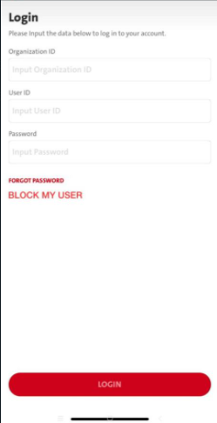
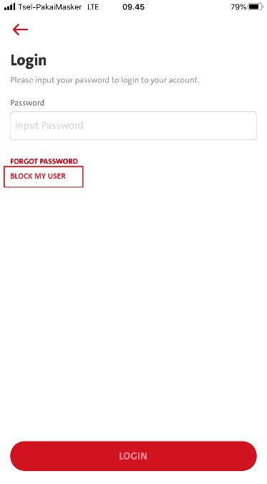
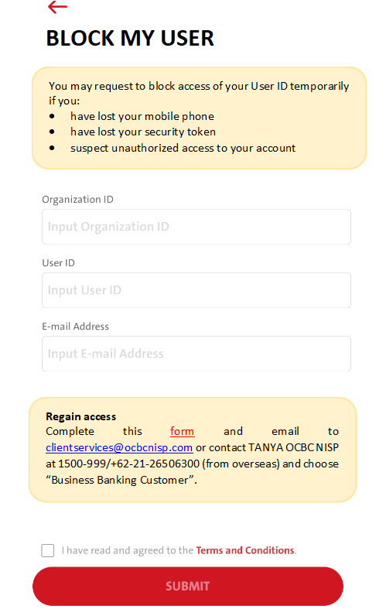
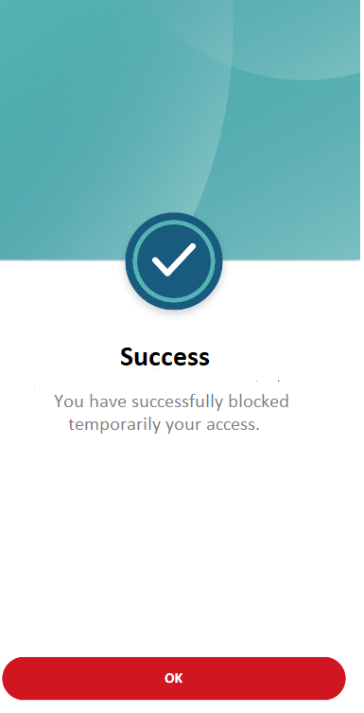
And
Login screen in unbound scenario
Login screen when finger-print or face ID authentication failure.

Slide 4
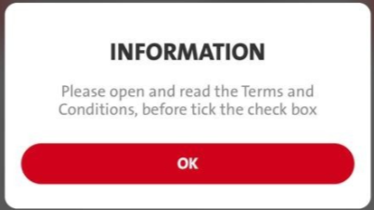
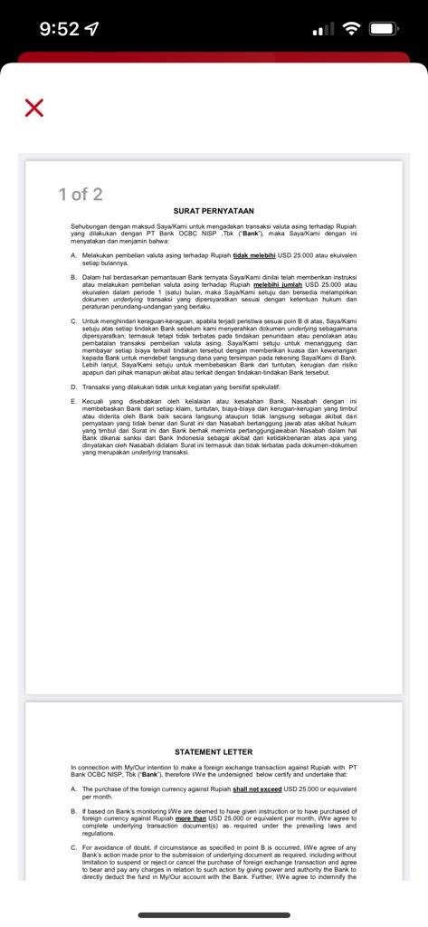
1.1
2
EN
INFORMATION
Please open and read the Terms & Condition, before tick the check box.
ID
INFORMASI
Silakan buka dan baca Syarat dan Ketentuan, sebelum klik check box.
form:
- FE call WS – doc path to download pdf
Pending Omni spec
Pending BE Spec
FE: RetrieveTnCv2
Disable checkbox before reading the TnC file
1.1 Popup box when clicking checkbox.
2. Click TnC file to read
3. Enable checkbox after reading TnC file.
Remark: Pending BE Spec updates for Spec 13.4 – tnc type : BLOCK
1 & 3
2
Click SUBMIT call - Omni Spec 3.14:- user/block_myuser . Pending BE for new service

Slide 5
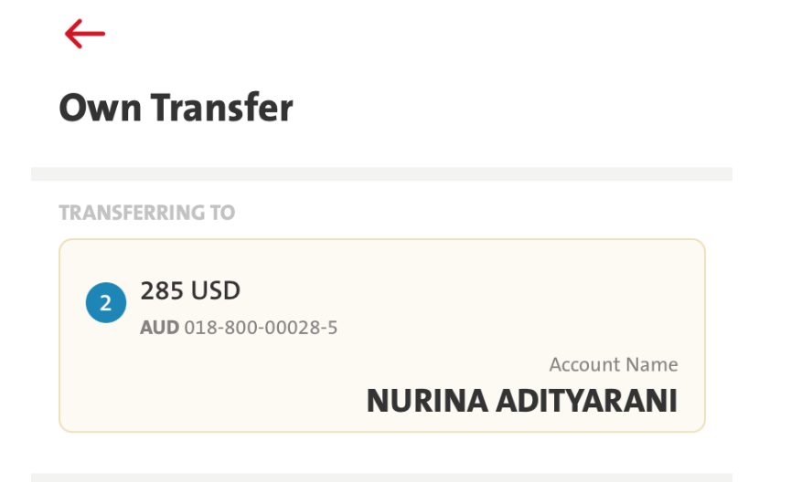
Please use the same shape & colour for the box with the box on Transferring to:
Use the destinated frame & color
Use the destinated frame & color

Slide 6
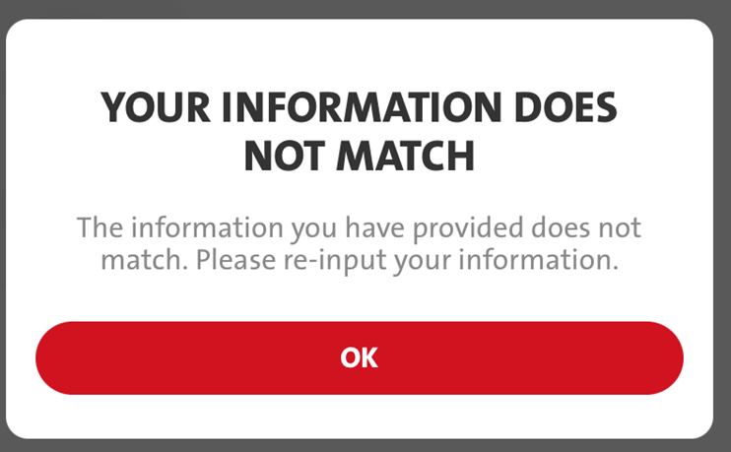
2. If the Organization ID, User ID, and Email Address are not match, then pop up message will appear:
EN
Title: YOUR INFORMATION DOES NOT MATCH
Message: The information you have provided does not match. Please re-input your information.
ID
Title: INFORMASI ANDA TIDAK SESUAI
Message: Informasi yang anda masukkan tidak sesuai. Silakan massukkan ulang informasi anda.

Slide 7
No | ENG | ID
1 | BLOCK MY USER | BLOK USER SAYA
2 | You may request to block access of your User ID temporarily if you: have lost your mobile phone have lost your security token suspect unauthorized access to your account | Anda dapat mengajukan blokir akses sementara atas ID Pengguna Anda jika: kehilangan telepon selular Anda kehilangan token Anda adanya kecurigaan akses tidak sah atas akun Anda
3 | Regain access Complete this form and email to clientservices@ocbcnisp.com or contact TANYA OCBC NISP at 1500-999/+62-21-26506300 (from overseas) and choose “Business Banking Customer”. | Mengembalikan akses Lengkapi form ini dan kirim ke clientservices@ocbcnisp.com atau hubungi TANYA OCBC NISP at 1500-999/+62-21-26506300 (dari luar negeri) dan pilih “Nasabah Bisnis”.
4 | I have read and agreed to the Terms and Conditions. | Saya telah membaca dan menyetujui Syarat dan Ketentuan.
5 | SUCCESS | SUKSES
6 | You have successfully blocked temporarily your access. | Anda telah berhasil memblokir sementara akses Anda.

