Slide 1
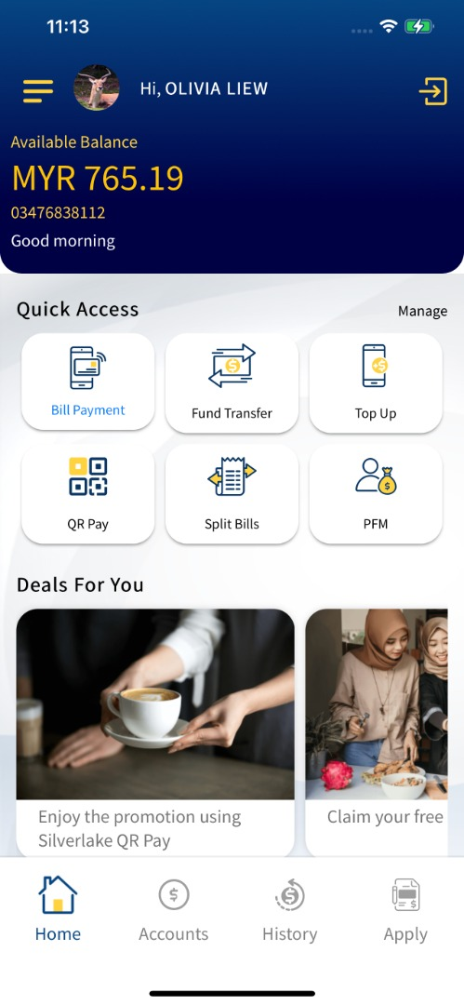
Enhancement 1
To apply the darker gradient at the bottom to give the biggest contrast

Slide 2
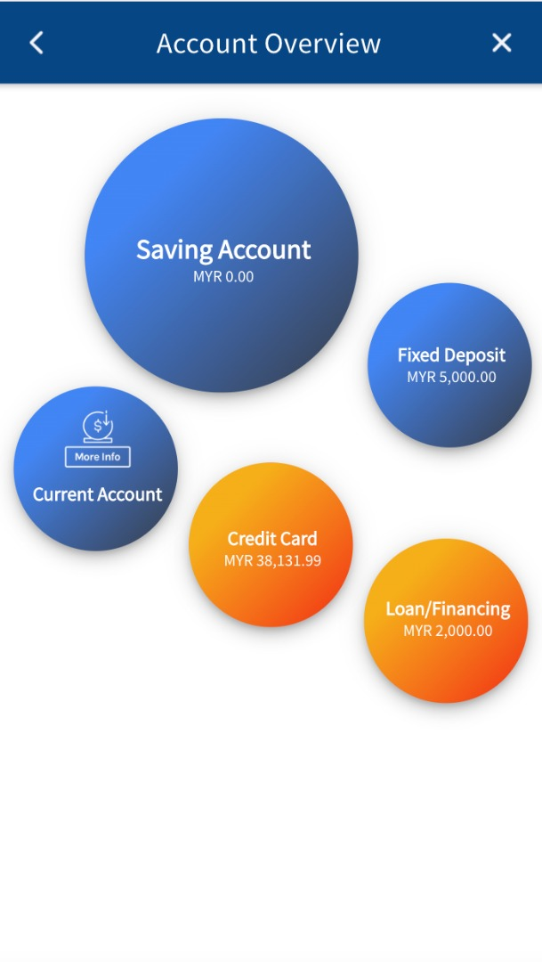
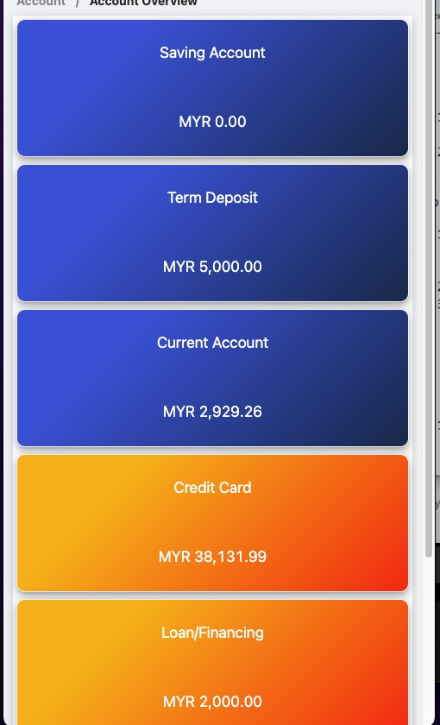
Enhancement 2
To have a link to allow users to switch between the bubble view and Grid view
To increase font size

Slide 3
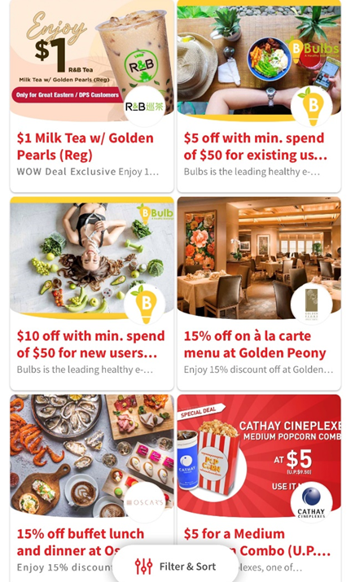
To be included in next revision as team is currently working on it

Slide 4
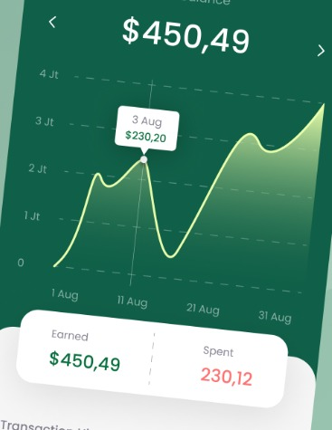
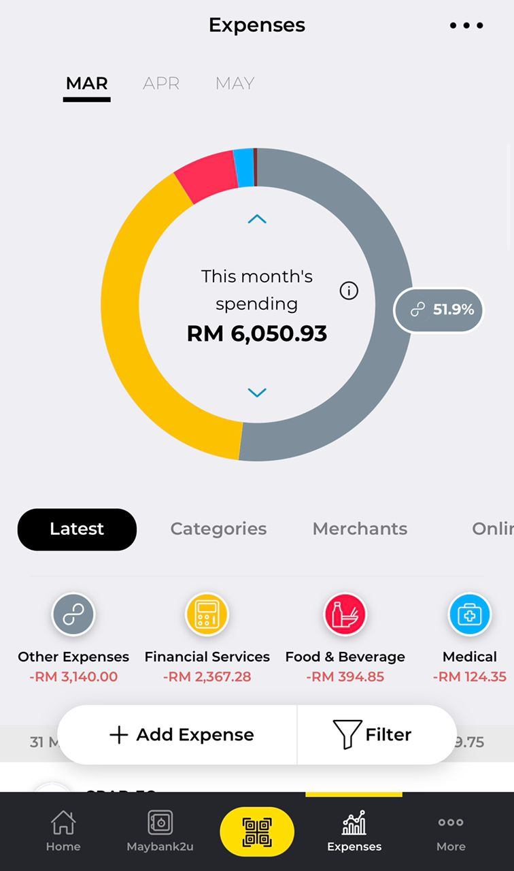
Proposed to have a breakdown display, apart from the current listing view to quickly allow users to see where does the expenses go or the frequency.
The proposed screens may look like these samples
Not to be included in this release

Slide 5
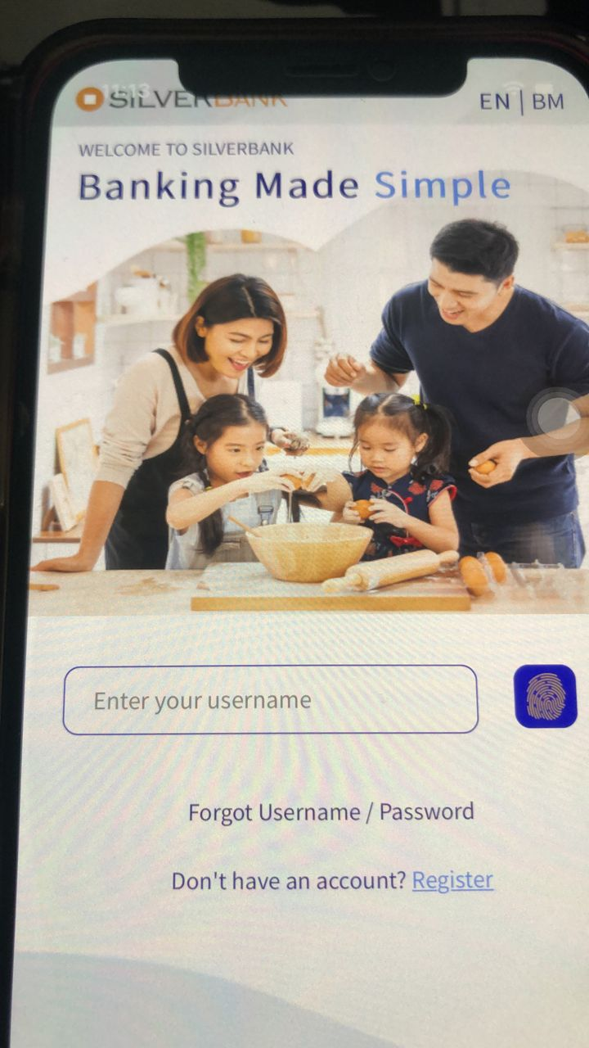
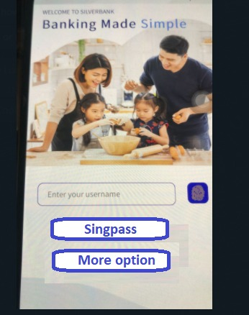
Enhancement 3
To have a ‘cleaner’ login page, proposed to change the Forgot user name/password to be a button.
Same as with the Login with Singpass

Slide 6
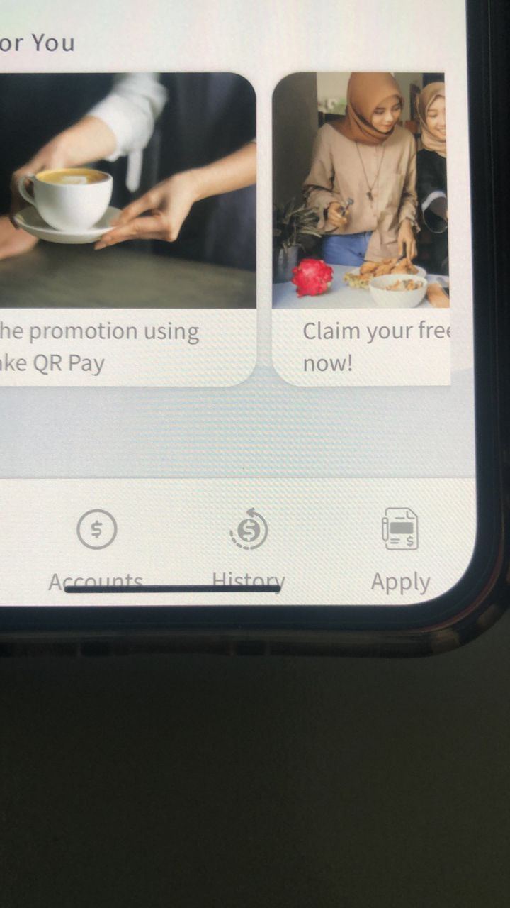
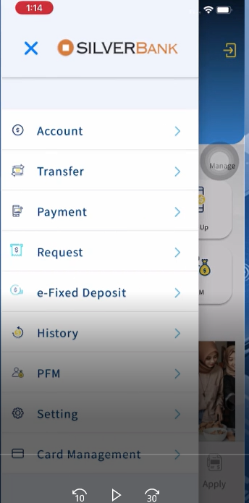
To improve legibility , the following pages would have the font increased by +2
Not to be included in this release

Slide 7
To amend the text on the User Onboarding :
Various applications such as credit cards, loans, savings as well as mobile banking has integration to eKYC for seamless application and onboarding

