Slide 1
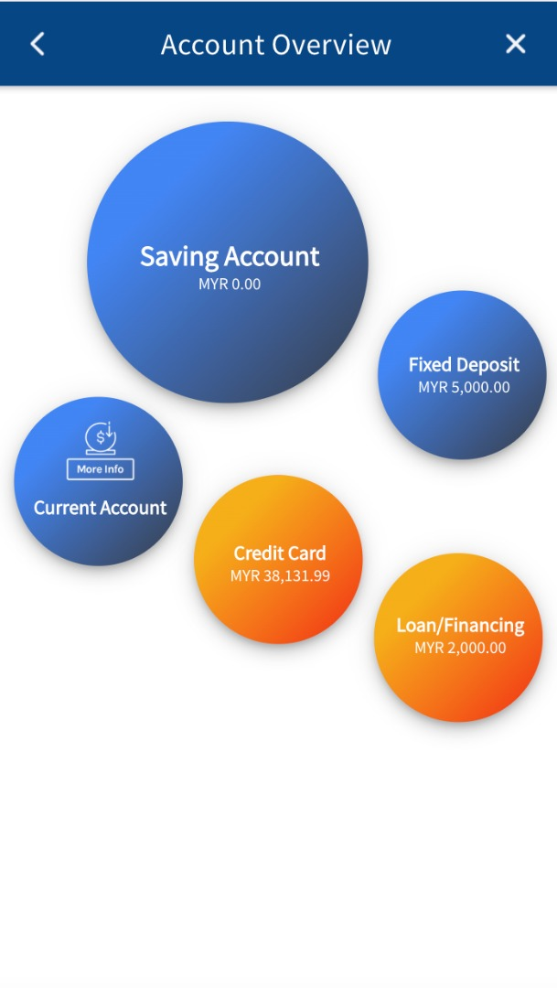
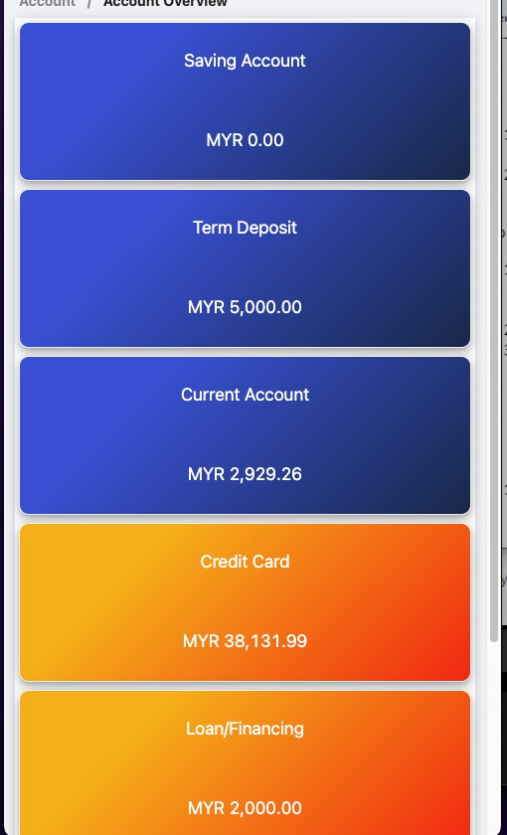
Enhancement 2
To have a link to allow users to switch between the bubble view and Grid view
To increase font size + 2
-

