Slide 1
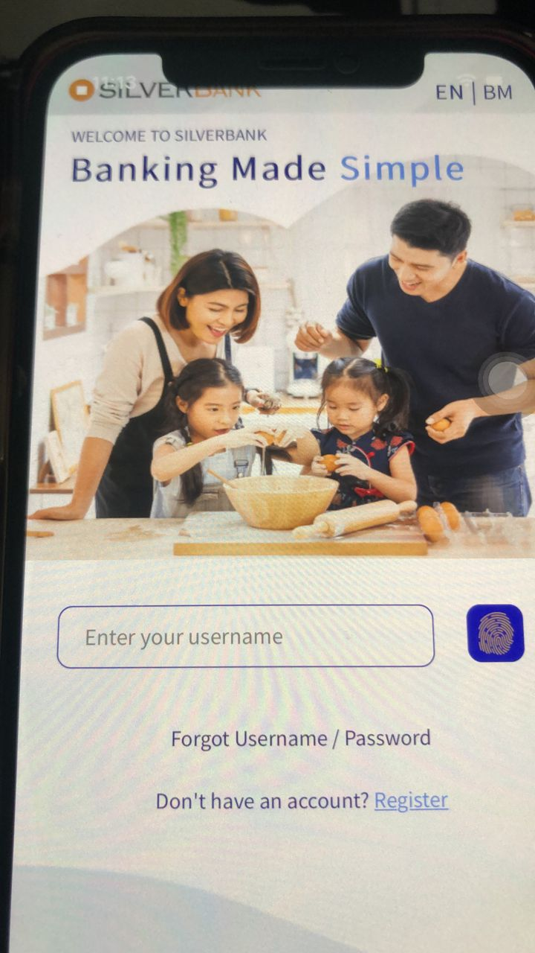
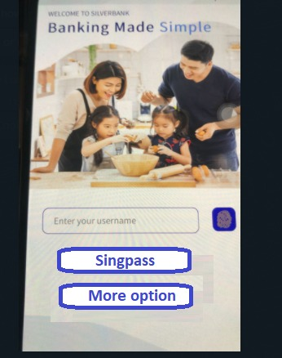
Enhancement 3
To have a ‘cleaner’ login page, proposed to change the Forgot user name/password to be a button.
Same as with the Login with Singpass

