Slide 1
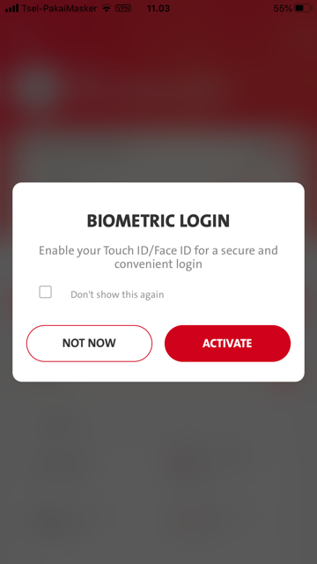
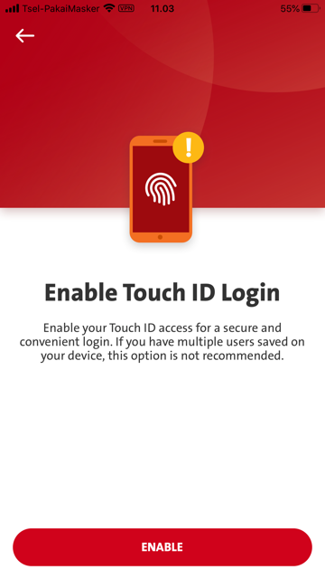
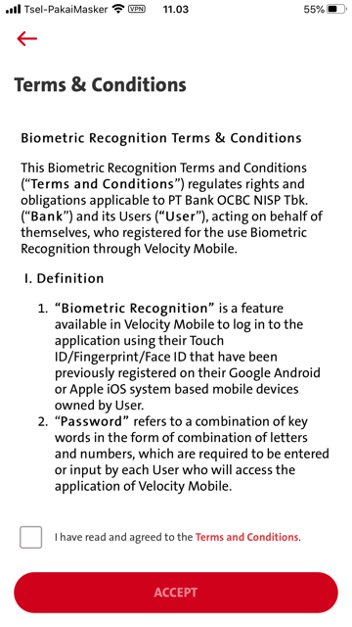
Biometric Enrollment:- Additional OPT in Biometric
Entry Point #1: Retrieve Dashboard - Biometric Setup (Bio-Login Popup)
Entry Point #2: Setting - Change Password – Logout – Login – Retrieve Dashboard – Biometric Setup (Bio-Login Popup)

Slide 2
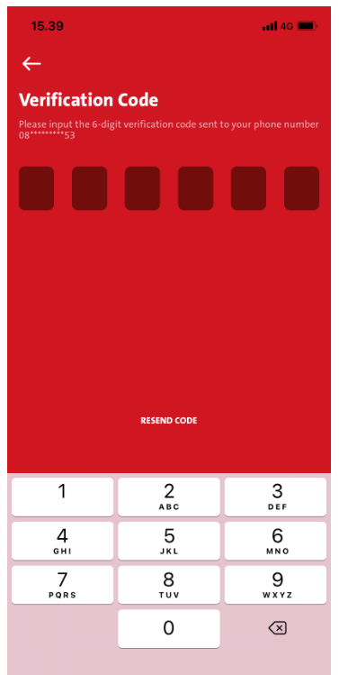
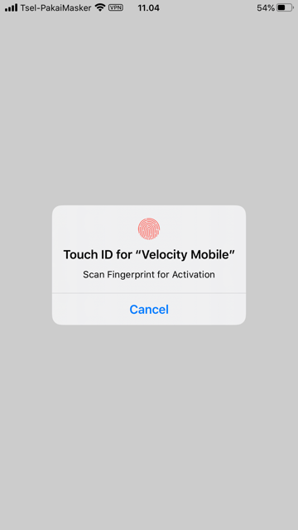
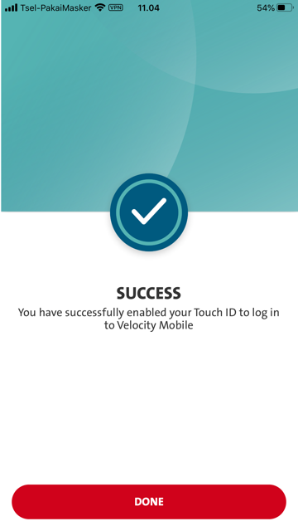
Biometric Enrollment:- Additional OPT in Biometric –Continue
NOTES
All copywriting refers to existing Verification Code screen (binding process or software token activation process)
Additional OTP:-
- Need to insert the OTP screen after

Slide 3
PerformVerifyPassword :- REQUEST
verify_pwd :- REQUEST
verify_pwd :- RESPONSE
PerformVerifyPassword :- RESPONSE
Need to insert the OTP screen:-
FE: OTPRequest :- REQUEST
BE: token/otp/request :- REQUEST
FE: token/otp/request :- RESPONSE
BE: OTPRequest :- RESPONSE
FE: OTPVerify :- REQUEST
BE: token/otp/verify :- REQUEST
Omni: token/otp/verify :- RESPONSE
OTPVerify :- RESPONSE
then call WS - PerformBiometricSetup :- REQUEST

Slide 4
iOS - QC Biometric Flow - Additional OTP
Need to have additional OTP screen in Biometric flow below:
Entry Point #1: Retrieve Dashboard - Biometric Setup (Bio-Login Popup)
Entry Point #2: Setting - Change Password – Logout – Login – Retrieve Dashboard – Biometric Setup (Bio-Login Popup)
Please refer to attached ppt document.

