Slide 1
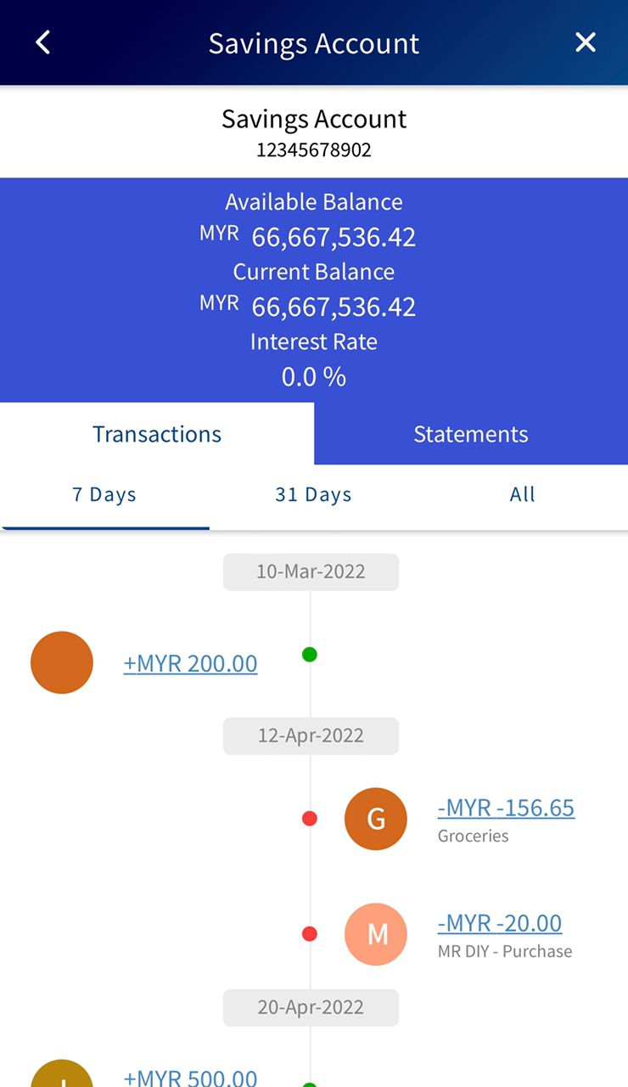
Add ‘Scheduled’ section at the highlighted part
Display all scheduled (recurring) transactions in the page
Remain the logic of the 7 days, 31 days. Display the transaction according the filter
Scheduled transaction history only display the scheduled/ recurring records, if the records already completed, it should display in the transaction tab instead and the record will be removed from the ‘Scheduled’

Slide 2
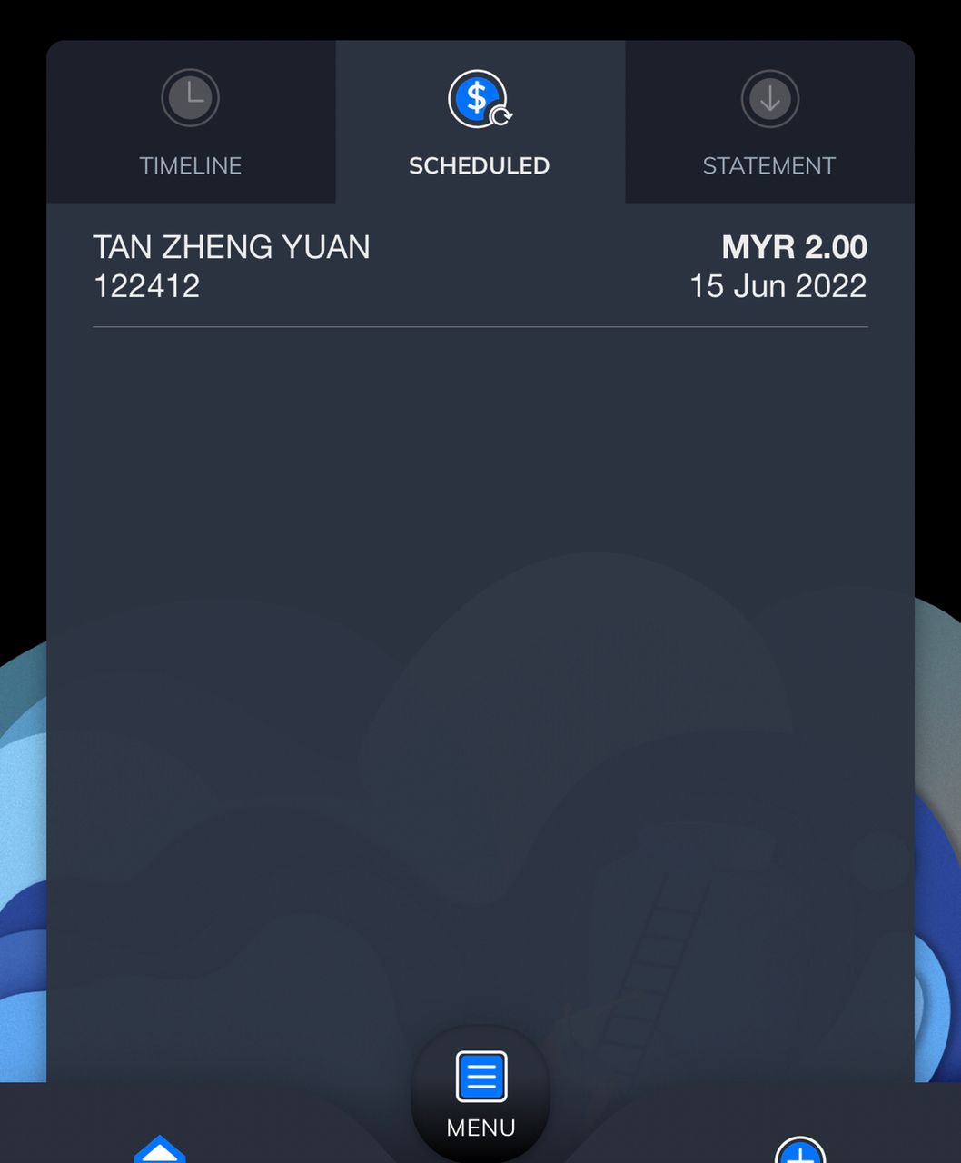
Sample screen for the scheduled transaction history
Display details for the respective records
<Beneficials name> <Amount>
<Scheduled date>

