Slide 1
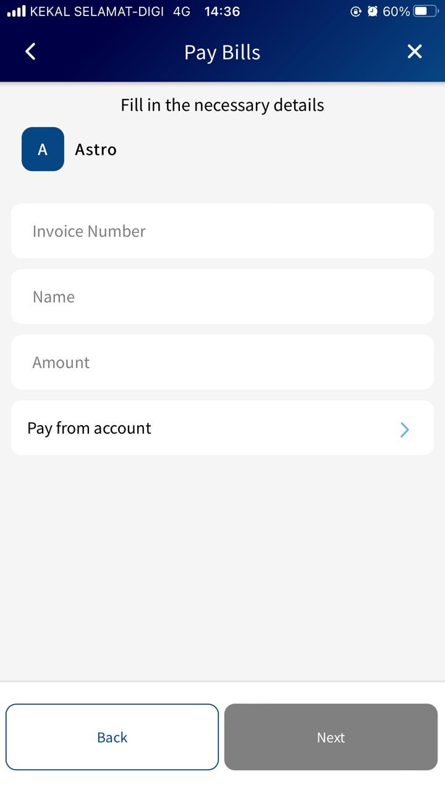
Display below selection in the highlighted area
Payment Date
Recurring Payment

Slide 2
Below are the logic for the Payment Date field
Payment Date
Display ‘Immediate Transfer’ by default, so the payment will be done immediately
This field will be date picker when user click on it
User are only allow to select today and future date, other than that will be disabled
Upon user selected on the date, display accordingly in the field with format DD-MMM-YYYY

Slide 3
Display below selection in the highlighted area
Recurring Payment
This selection is off by default
Upon the select is on, ‘Payment Date’ selection will be hidden from user and display below
Starting from
System select tomorrow’s date by default with format DD-MMM-YYYY
User allows to change the date but the earliest date is tomorrow, e.g. today = 13 Jun 2022, the earliest user allows to select = 14 Jun 2022
Repeat, below are the value will be display when user click on this field
Daily
Weekly
Every 2 Weeks
Monthly
Quarterly
Half-Yearly
Yearly
Number of time(s), the number of the recurring which will happen. E.g. 2, this action will run 2 times only
Final Transfer Date, this field is disabled and the value is generated by system. E.g. when user select repeat = Daily, start date = 14 Jun 2022 and number of time(s) = 2, thus the final transfer date generated by system = 15 Jun 2022

