Slide 1
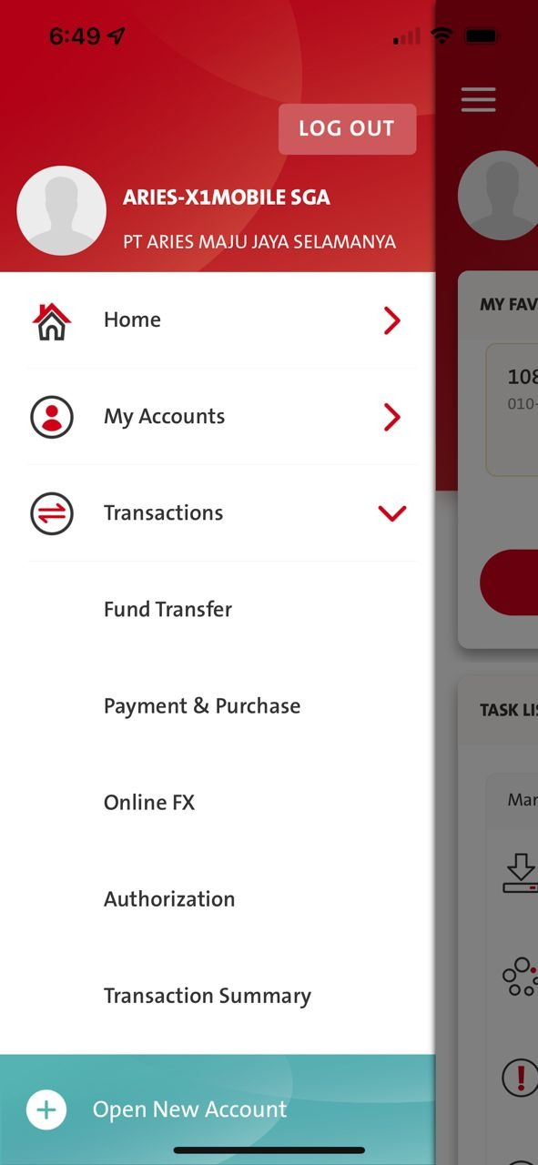
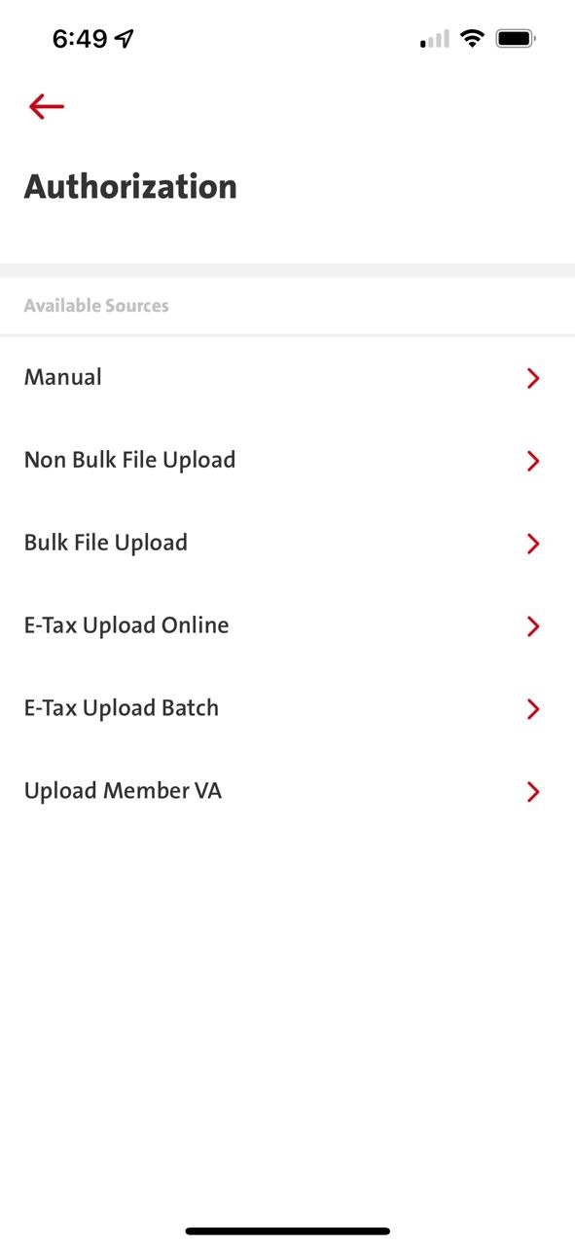
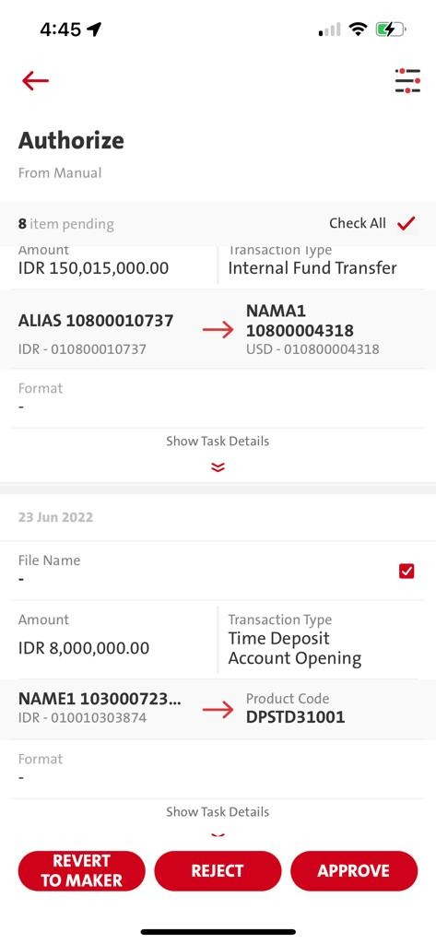
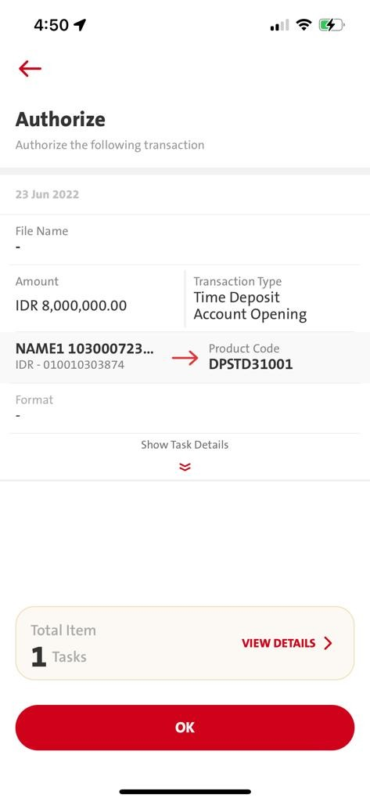
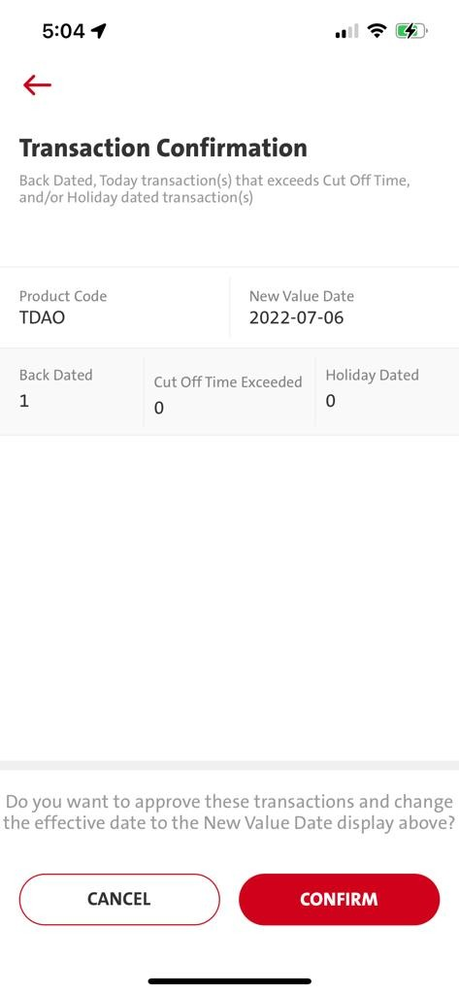
QC1303 – Pre-Authorization Screen Update (TDAO & TDAM Trx Screen)
Sub-menu - Manual – Authorization (Confirm button, calling pre_authorize)

Slide 2
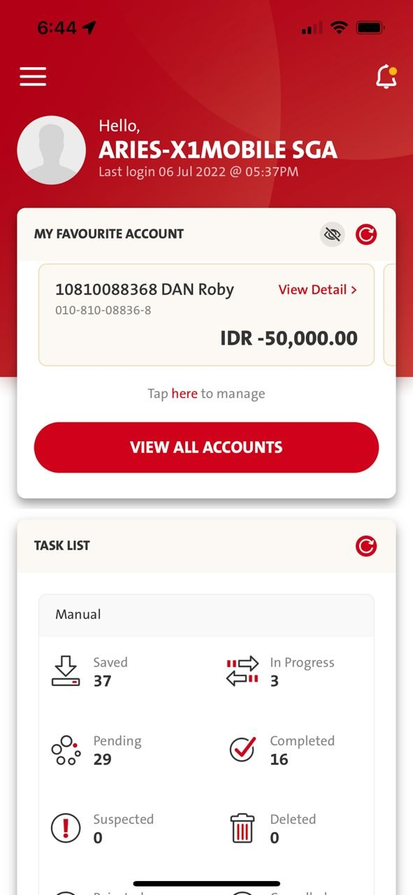
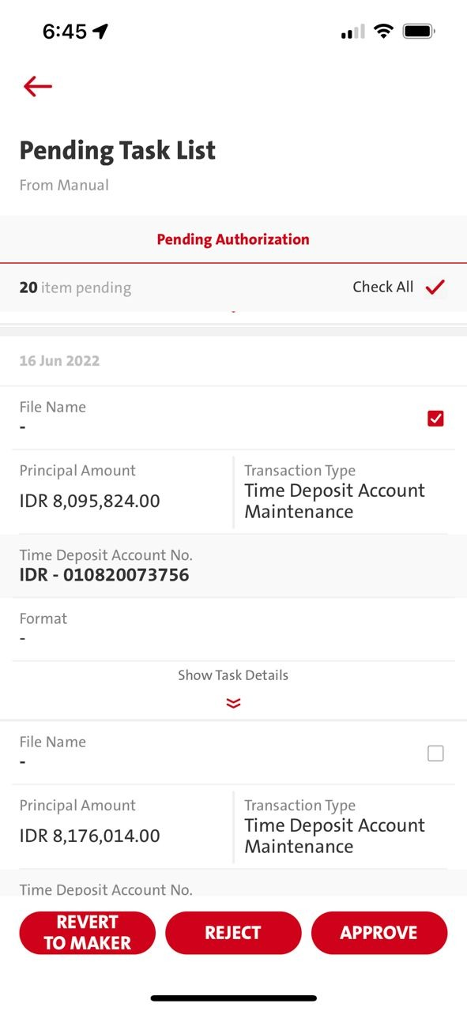
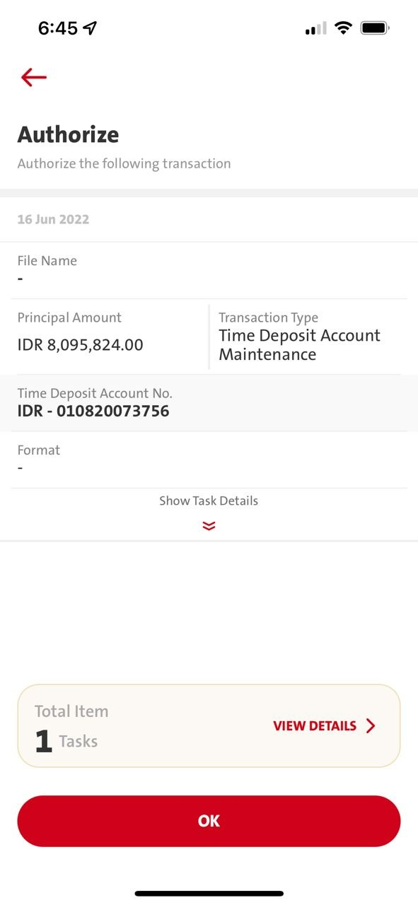

QC1303 – Pre-Authorization Screen Update (TDAO & TDAM Trx Screen)
Task List – Pending Task List - Manual – Authorization (Confirm button, when calling pre_authorize)

Slide 3
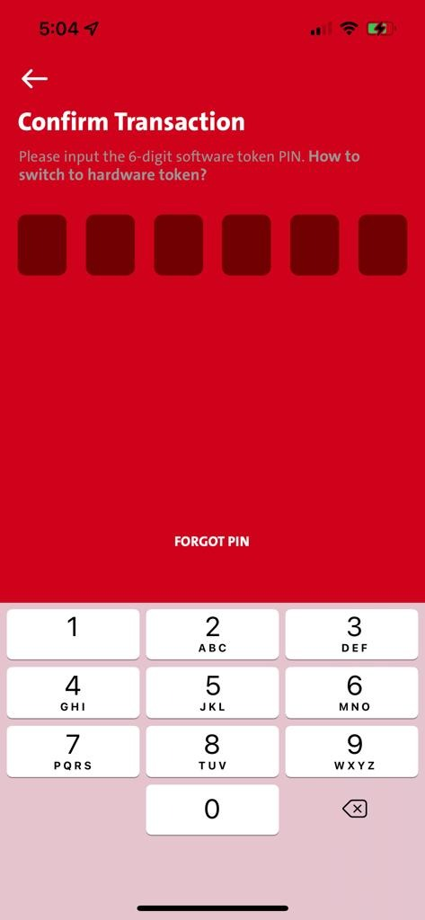
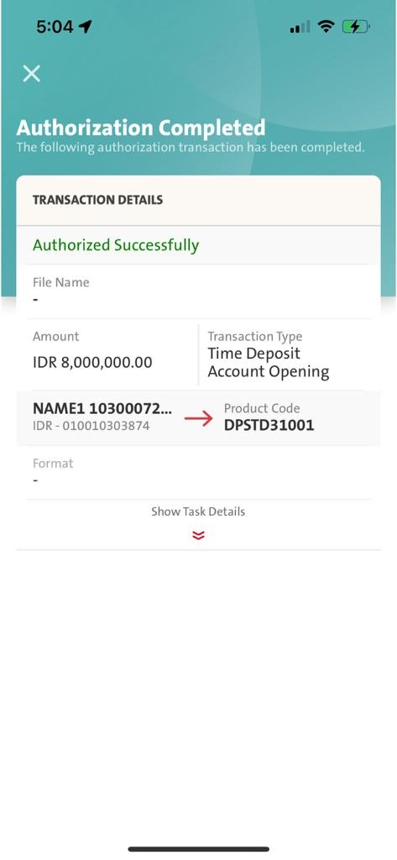
QC1303 – Pre-Authorization Screen Update TDAO & TDAM

Slide 4
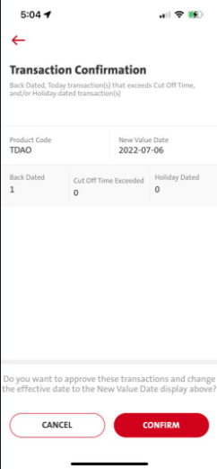
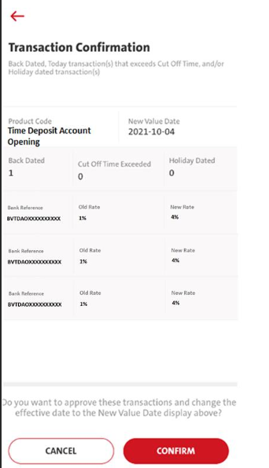
QC1303 – Pre-Authorization (TDAO & TDAM) Screen Update
Entry Point:-
1. Sub-menu - Manual – Authorization (Confirm button, when calling pre_authorize)
2. Task List – Pending Task List - Manual – Authorization (Confirm button, when calling pre_authorize)
Changes on Transaction Confirmation screen:- (On the left)
Applicable for Transaction Type:-
Time Deposit Account Opening (TDAO)
Time Deposit Account Maintenance (TDAM)
BE
authorization – Return 17.17 - List of Backdated Info.
Return 17.91 - TD rate Changes info to FE.
FE
- pre_authorize - Remain sending the same mandatory parameter to BE.

Slide 5
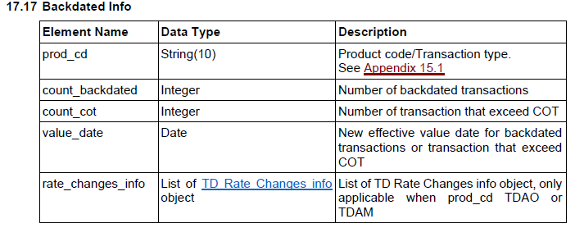
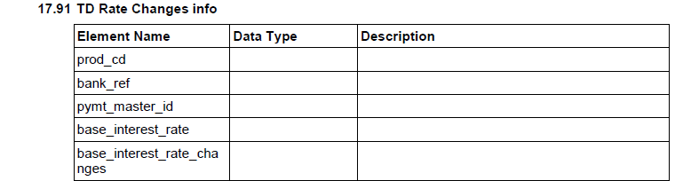
Pending Copywriting for ID language

