Slide 1
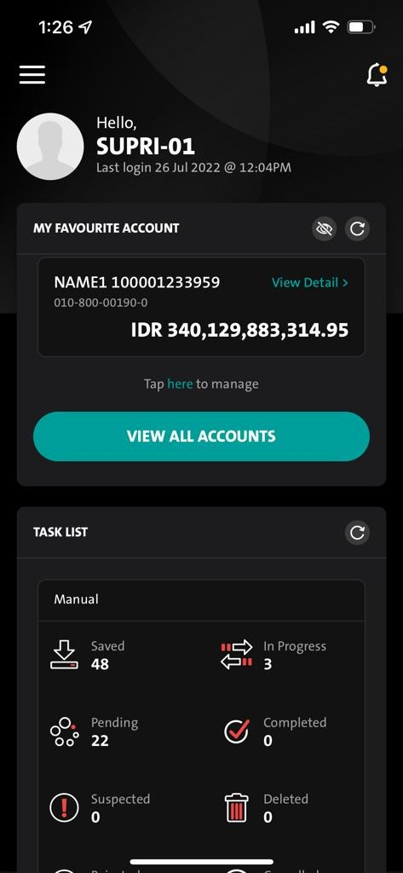
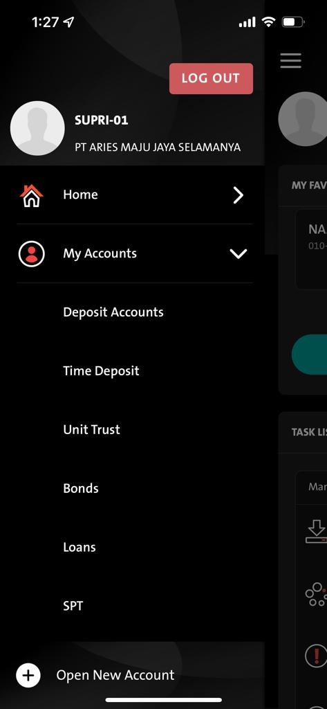
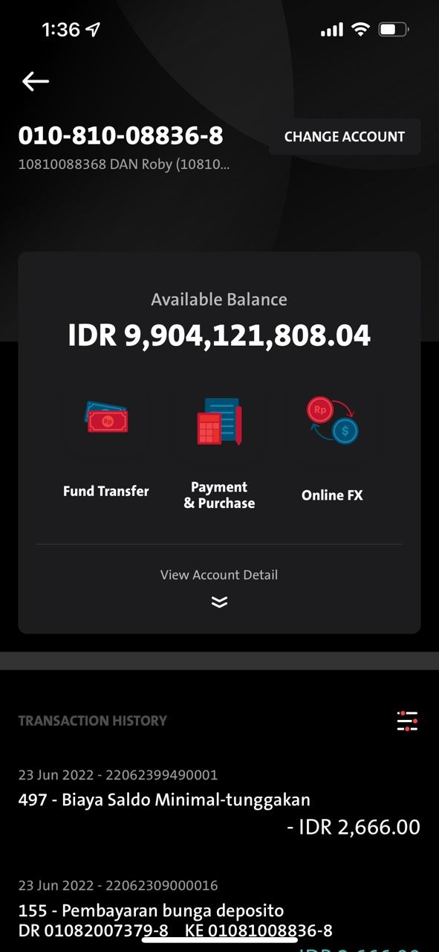
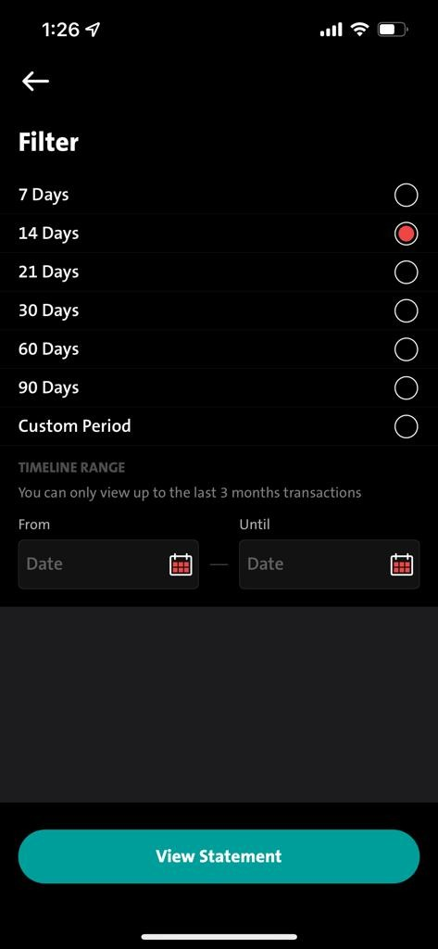
QC1314 – Deposit Account Statement Filtering
- After 90 Days:-
- Adding Days (120 Days – 150 Days – 180 Days) :
Entry #1
View All Account - Select source - Filter Icon - Filter Screen
Entry #2
Submenu - Select source - Filter Icon - Filter Screen
After 90 Days:-
ADD: 120 Days, 150 Days, 180 Days
Click on highlighted filter

