Slide 1
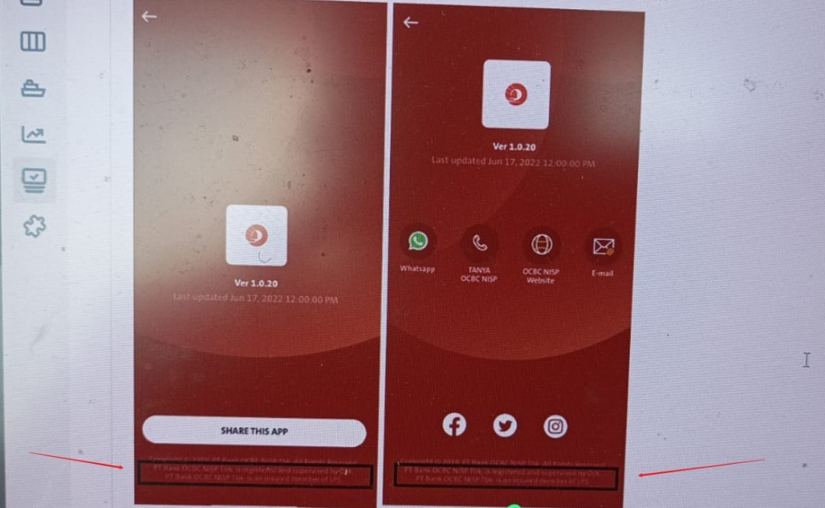
QC1315 – About Us – Copywriting update needed.
IND:
PT Bank OCBC NISP Tbk. berizin dan diawasi oleh Otoritas Jasa Keuangan dan merupakan peserta penjaminan Lembaga Penjamin Simpanan (LPS).
ENG:
PT Bank OCBC NISP Tbk. is licensed and supervised by the Financial Services Authority and the insured member of Indonesia Deposit Insurance Corporation (LPS).
2 Entry points:
Others – About Us
Submenu – Settings – Contact Us - About Us

