Slide 1
Account Management: Customer Account List ( Bancassurance ) – Deployment on 2022.09.09
Mobility Frontend | Mobility Backend | Omni
Access Side Menu
Display Account Management items by accessing MenuID 9503 for BancAssurance.
BE request Customer Account List respectively for BancAssurance with WS with WS 6.7 URL: [api_endpoint]/acct_mgmt/customer/account
Prod_cd:BANCAS
Omni response to BE with respective Customer Account List to BE.
Customer tap on 5. BancAssurance
FE request CustomerAccountList BE to get Account List
BE return customer Account List respectively to FE.
Display Customer Account List respectively.

Slide 2
Account Management: To view Customer Portfolio Data (Bancassurance) – Deployment on 2022.09.09
Mobility Frontend | Mobility Backend | Omni
Customer tap for Customer Account: 5. BancAssurance
BE request the respective Customer Portfolio Data from Omni by calling WS 6.10
[api_endpoint]/v2/acct_mgmt/portfolio/view
Prod_code
FE request the customerPortfolioDatav2 from BE.
Omni response respective Customer Portfolio Data to BE。
- Bancassurance Data
Code validation for screen display
BE response Customer Portfolio Data respectively to FE
- Bancassurance Data
Response “00000”
Response “O0115”
Display customer account information respectively based on BE response
Display Bancassurance Unavailable screen

Slide 3
Account Management: Customer Portfolio Download ( Bancassurance ) – Deployment on 2022.09.09
Mobility Frontend | Mobility Backend | Omni
Customer tap on PDF download button for 5. BancAssurance
BE request to retrieve Customer Portfolio & (SPT) Statement for respective Customer Portfolio Data from Omni by calling ws 6.8
WS URL: [api_endpoint]/acct_mgmt/portfolio/download
Omni response respective Customer Portfolio Statement and return to BE.
FE request to retrieve WS CustomerPortfolioDownload
Downloaded Customer Portfolio as BAU.
BE response Customer Portfolio in documentFile Data & return to FE.

Slide 4
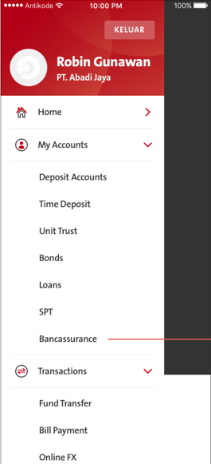
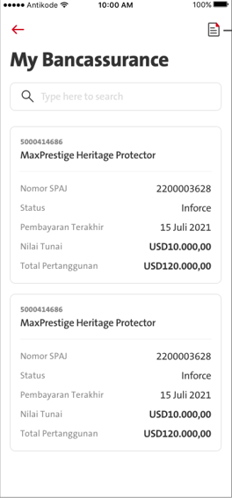
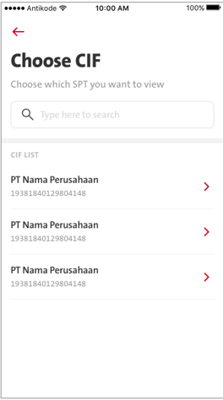
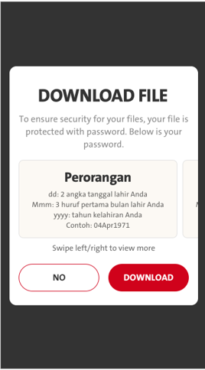
QC1304 BancAssurance
FE call - CustomerAccountList
FE call: CustomerPortfolioDownload
FE call: customerPortfolioDatav2
Menu ID 9503

Slide 5
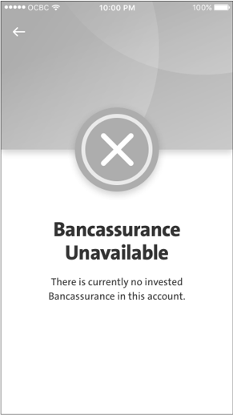
QC1304 BancAssurance
Fe validates if BE return omni.O0115

Slide 6
QC1304 BancAssurance - Mapping
customerName
customerNumber

Slide 7
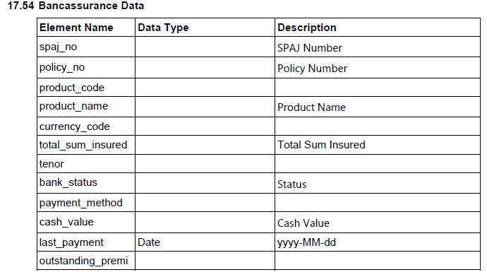
QC1304 BancAssurance - Mapping
2022.09.12
Please map policy_no and display value after SPAJ Number.
EN: Policy Number
ID: Nomor Polisi
2022.09.07
No need to map product_code
Please take out Home Part

Slide 8
QC1304 BancAssurance – Mapping Pending Copywriting
Pending Copywriting
Mandays
BE -
iOS - 3
Android – 3

