Slide 1
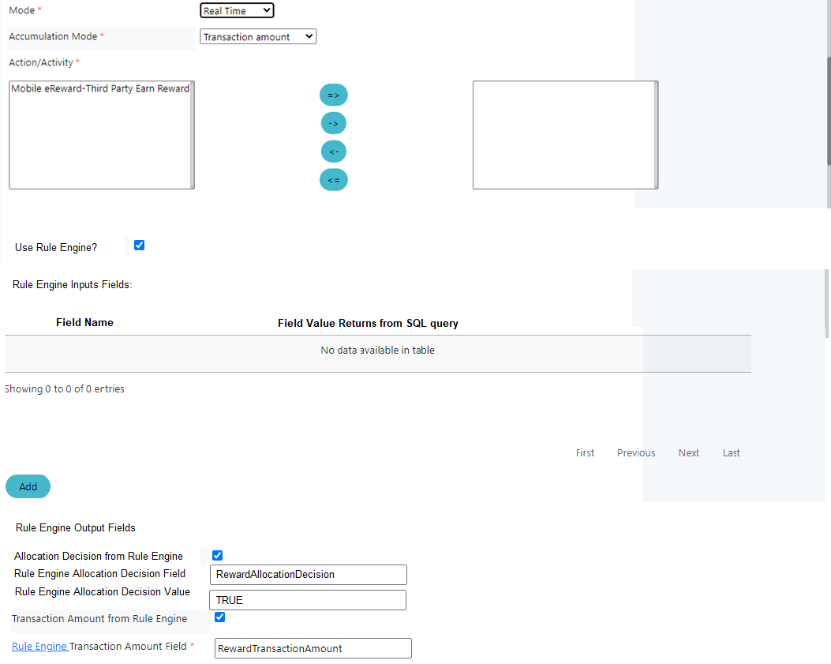
When Mode is Real Time and Accumulation Mode is Transaction Amount and Use Rule Engine is Checked
Store to
mleb_ereward. PRGRM_LLCTN_RULE_ENGINE_INPUT_FIELDS
Store to
mleb_ereward.program_allocation

Slide 2
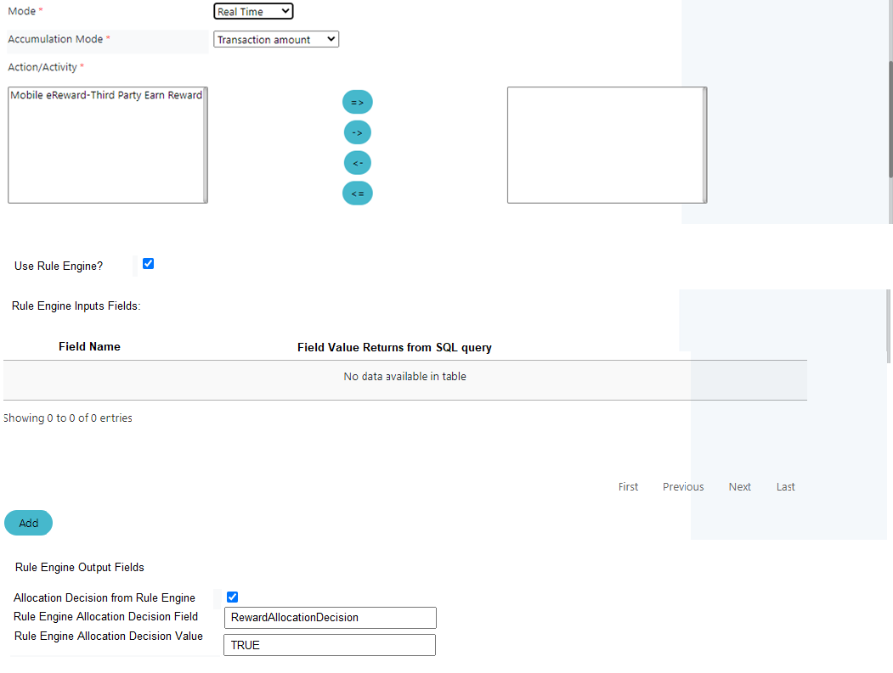
When Mode is Real Time and Accumulation Mode is not Transaction Amount and Use Rule Engine is Checked
Store to
mleb_ereward. PRGRM_LLCTN_RULE_ENGINE_INPUT_FIELDS
Store to
mleb_ereward.program_allocation

Slide 3
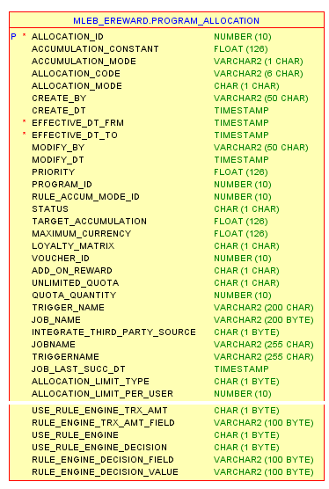
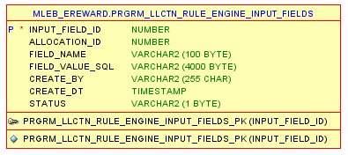
ERD

