Slide 1
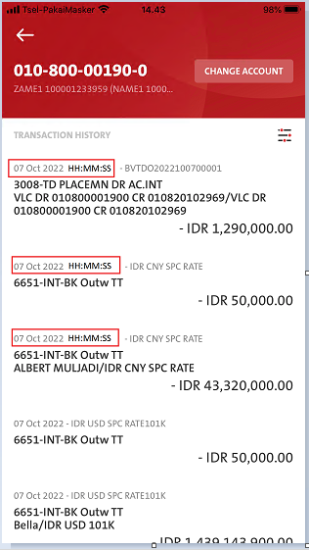
BE
in RetrieveAccountHistory :- RESPONSE - Please pass full time stamp to FE as below:
Current:
"trx_date": "2022-10-03",
Expected:- Please add Time Stamp for HH:MM:SS = 07 Oct 2022 13:05:09
"trx_date": "2022-09-20 13:50:09"
---------------------------------------------------------------------------------------------------------------------------------------------------
FE
In RetrieveAccountHistory :- RESPONSE - Please map full time stamp by with trx_date 07 Oct 2022 13:05:09
Entry point:
Dashboard – My Fav Acct – Select Fav Acct –List_statement
Dashboard – VIEW ALL ACCOUNT – Select any account
Sub-Menu - My Acct – Deposit Account – Select any account

