Slide 1
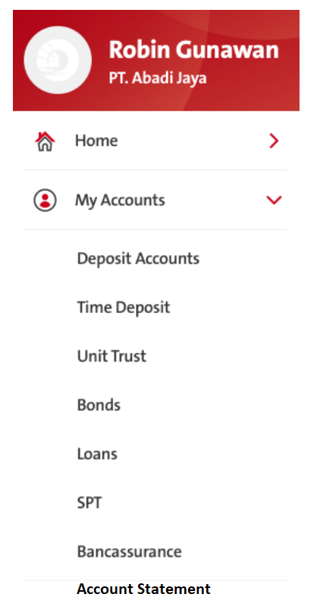
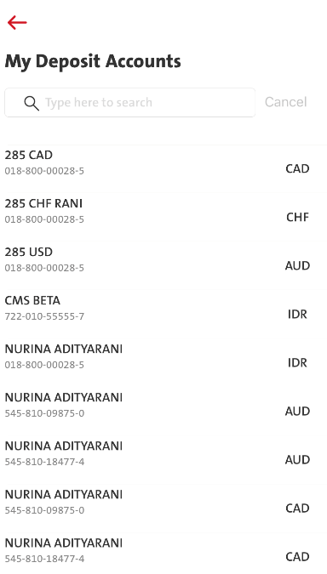
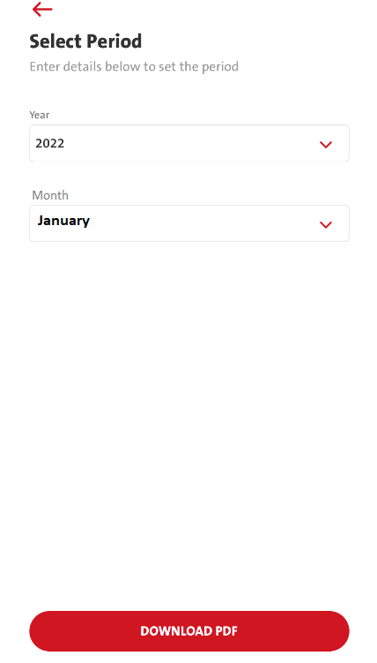
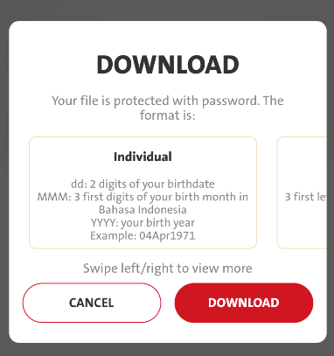
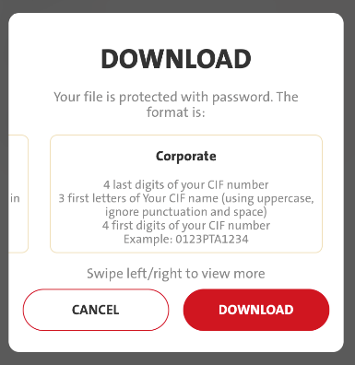
QC1317 - MY ACCOUNTS → Add New Product ‘Account Statement’

Slide 2
QC1317 - MY ACCOUNTS → Add New Product ‘Account Statement’
FE request RetrieveAccountList
FE needs to pass prod_cd = MSTMT to BE (Mandatory).
BE call 6.1 acct_mgmt./list
pass prod_cd = MSTMT to BE (Mandatory) to omni.
Pls also include below in the response to FE:
"minYear“ = Previous Year "minYear“ = 2021
"maxYear“ = Current Year "maxYear“ = 2022
COPYWRITING
EN
Account Statement
ID
Rekening Koran
BE & FE needs to cater menuID below:
Menu ID: 9302
Role Type: SB_STMTVWR

Slide 3
List of Accounts registered for prod_cd MSTMT will be displayed:
COPYWRITING
My Deposit Accounts = Rekening Simpanan Saya
EN:-
Cancel
ID:-
Batal
EN:-
Type here to search
ID:-
Ketik di sini untuk pencarian

Slide 4
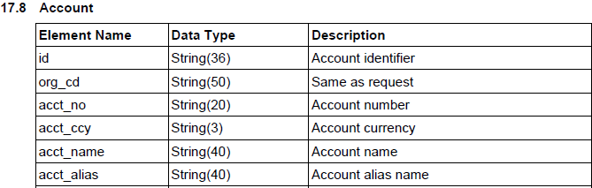
Mapping
for account name - display with condition
if acct_alias is not null will display acct_alias
if acct_alias = null, display acct_name

Slide 5
Select period:
EN:-
Select Period
ID:-
Pilih Periode
FE
Dropdown for YEAR display:-
Two years available. (BE)
Display only the Current Year & Previous Year.
Example:
Current Year = 2022
Previous Year = 2021
EN:-
Enter details below to set the period
ID:-
Masukkan detil berikut untuk mengatur periode
EN:-
Year
ID:-
Tahun
FE
Dropdown for MONTH display
Display 12 months in dropdown.
Only Previous month(s) will be displayed with color (UNTIL Last Month).
Current Month GREYOUT (as current month statement as it is not ready yet).
Current month & months in the future will be GREYOUT.
Example: It will be like Jan - Dec but (Oct - Dec) will be greyout or not able to select
EN:-
Month
ID:-
Bulan
EN:-
Download PDF
ID:-
Unduh PDF

Slide 6
Pop up download information will be displayed:
COPYWRITING ENGLISH
DOWNLOAD
Your file is protected with password. The format is:
Individual
dd: 2 digits of Your birth date
MMM: the first 3 (three) letters of Your birth month in Bahasa Indonesia
YYYY: Your birth year
Example: 04Apr1971
Corporate
the last 4 digits of Your account number
the first 3 letters of Your account name (using uppercase, ignore punctuation and space)
the first 4 digits of Your account number
Example: 1900PTA0108
COPYWRITING BAHASA
UNDUH
File anda dilindungi oleh kata sandi. Berikut adalah formatnya:
Perorangan
dd: 2 angka tanggal lahir Anda
MMM: 3 huruf pertama bulan lahir Anda dalam Bahasa Indonesia
YYYY: tahun kelahiran Anda
Contoh: 04Apr1971
Perusahaan
4 angka terakhir nomor rekening Anda
3 huruf pertama nama rekening Anda (menggunakan huruf kapital, tanda baca dan spasi diabaikan)
4 angka pertama nomor rekening Anda
Contoh: 1900PTA0108
FE Call – Pending BE Spec
BE call Omni Spec 6.4 - acct_mgmt/estatement/download
Notes:
The screen flow design may follow “SPT”.
Finish download
Back to the Select Period screen

