Slide 1
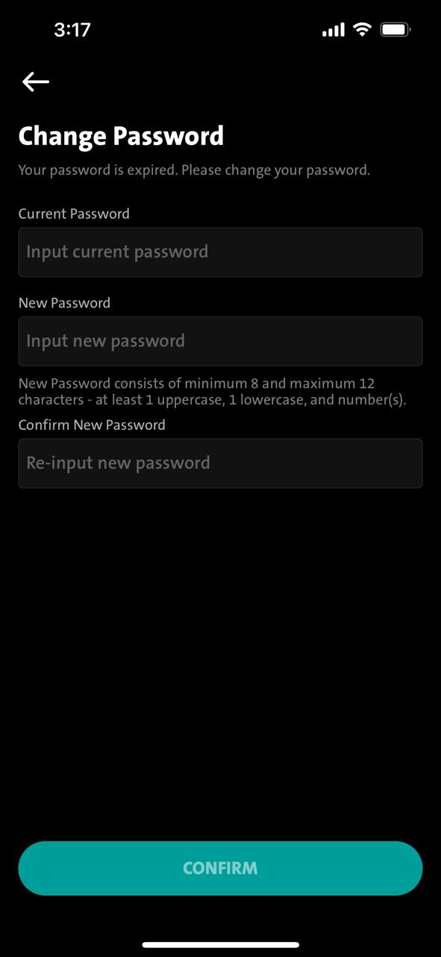
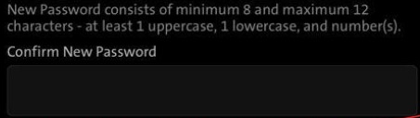
Prod - QC1324 (add validation & call 1 WS)
A.
Add validation for repeated password (old & new) on change password module
Submenu – Settings – Change Password
We need to have validation on the new password against the old password.
- Validation on the new password field, it must not be the same as Current password field.
If newly entered password is the same as current password,
please display under new password field in red
EN: Password cannot be same with old password
ID: Kata sandi tidak dapat same dengan kata sandi yang lama
Remark: if validation is matched,
Pls consider to lower this portion
in order to display the new
copy writing in red.
Password cannot be same with old password
B.
Please call PerformVerifyPassword at submit button
Call PerformVerifyPassword by passing BE the same parameters (pString, cString & random_number)
BE return success response, continue to call PerformChangePassword – Existing.

