Slide 1
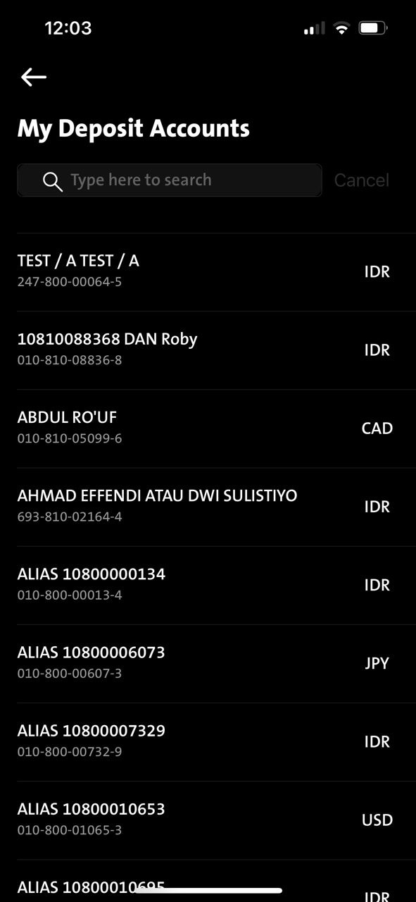
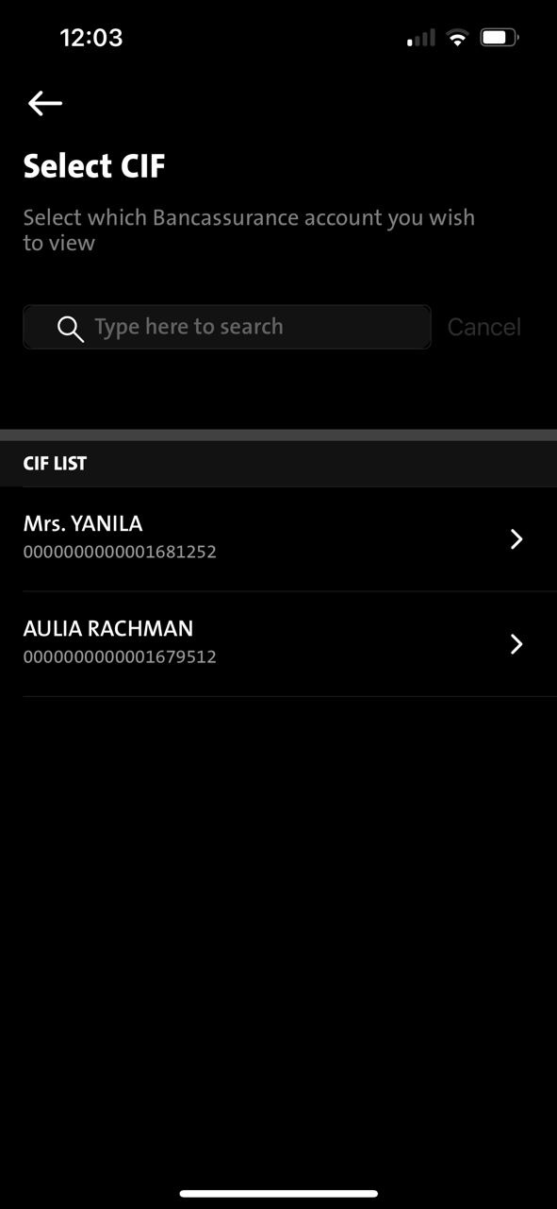
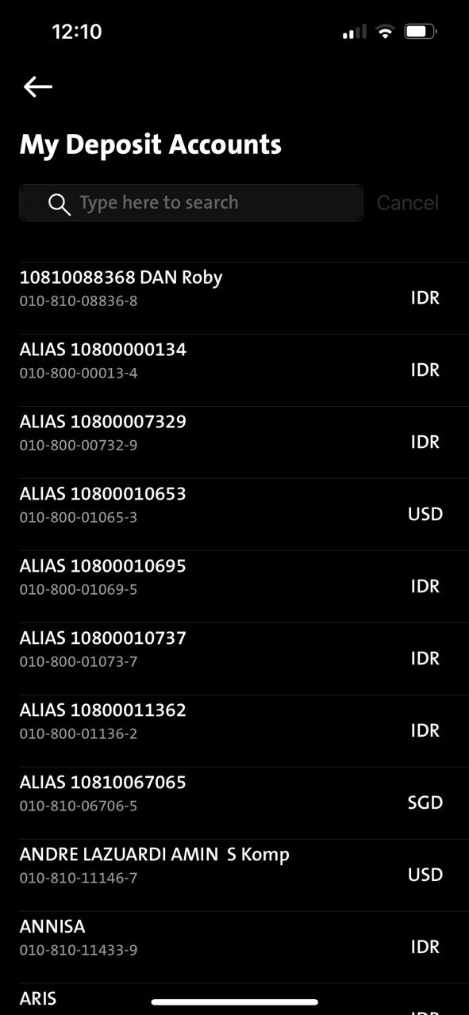
iOS - Cancel button – need to apply ID language = Batal
Currently iOS goes by native button which can only display in EN = Cancel, and this Cancel copywriting can only be changed from native language setting.
Need your assistance to look up others related button for this fix.
Account statement
Bancassurance
My account – Deposit account
There are more

