Slide 1
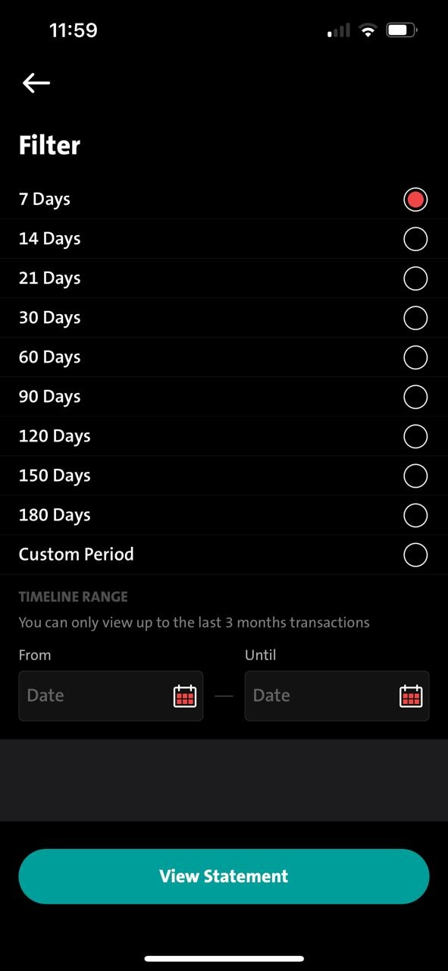
iOS & Android
Copywriting changes: Please apply copywriting below to mentioned entries points: -
ENG: You can only view up to the last 6 months transactions IND: Anda hanya dapat melihat transaksi 6 bulan terakhir
Entry point:
Dashboard – My Fav Acct – Select Fav Acct – Click Filter
Dashboard – VIEW ALL ACCOUNT – Select any account – Click Filter
Sub-Menu - My Acct – Deposit Account – Select any account - Click Filter

