Slide 1
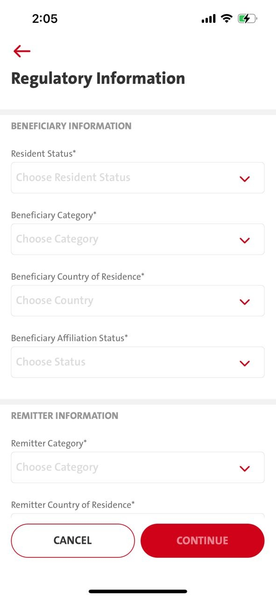
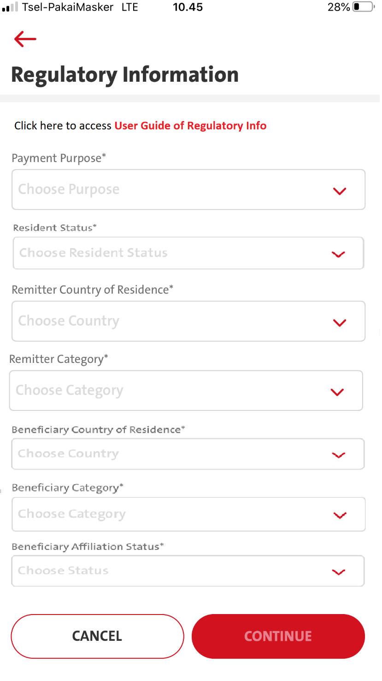
Entry point
1. Transaction – Telegraphic – Transfer to a new bene – Regulatory information screen
2. Transaction – Telegraphic – Select Fav bene – Regulatory information screen
3. Transaction – Manage Saved Bene - Telegraphic - Transfer to a new bene - Regulatory information screen
4. Transaction – Manage Saved Bene - Telegraphic – Select Fav Bene – Click Fund Transfer button - Regulatory information screen
5. Admin - Sav Bene – Fund Transfer button - Regulatory information screen

Slide 2
QC1326 - Menu Transaction - Telegraphic Transfer - Regulatory Info
FE:
1. Takeout Remitter & Beneficiary Information Panel ( follow attachment)
2. In Regulatory Info screen - There will be
Please change field sequence a below :
Payment Purpose
Resident Status
Remitter Country of Residence
Remitter Category
Beneficiary Country of Residence
Beneficiary Category
Beneficiary Affiliation Status
3. Add disclaimer info for Regulatory Information (copywriting from @nurina)
Replace with – Able to click on User Guide of Regulatory Info
- when clicking User Guide of Regulatory Info will export pdf/csv file LLD Mapping -
Copywriting
En : User Guide of Regulatory Info
ID : Panduan Lalu Lintas Devisa
BE:
- Pls refer to 13.18 others/document (Pending BE Spec for FE to call for Exporting)

Slide 3
FE - TransactionFundTransferStep1 Request
BE - TransactionFundTransferStep1 :- RESPONSE
FE – will get all the necessaries listing from Step1 response by BE to display for each field.
BE
Payment Purpose - call .. lld/payment_purpose – omni Spec 13.19
Resident Status – MLEB call others/regulatory – 13.9
Remitter Country of Residence - call ..lld/Remitter Country Of Residence omni Spec 13.22
Remitter Category - call .. lld/remitter_category omni Spec 13.23
Beneficiary Country of Residence - call .. lld/beneficiary_country_of_resd omni Spec 13.21
Beneficiary Category - call .. lld/beneficiary_category omni Spec 13.20
Beneficiary Affiliation Status - call .. lld/beneficiary_affiliation omni Spec 13.24

