Slide 1
Check data occupation, sumber dana and last education dropdown
EN and ID

Slide 2
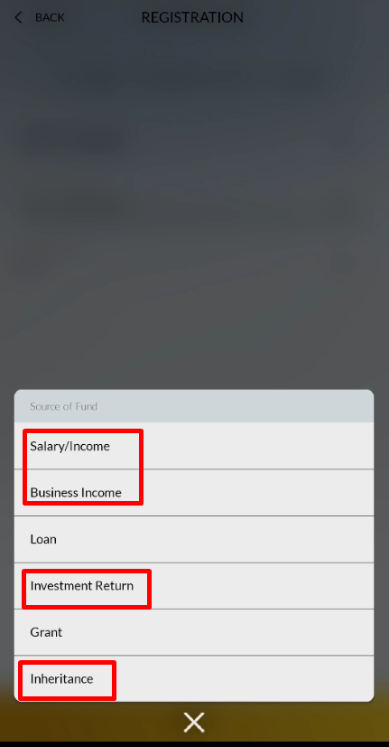
Sumber Dana / Source of Fund
Wrong in EN version
Should be like this
Gaji = Salary
Hasil Usaha = Business Profit
Pinjaman = Loan
Hasil Investasi = Investment Profit
Hibah = Grant
Warisan = Inheritage

Slide 3
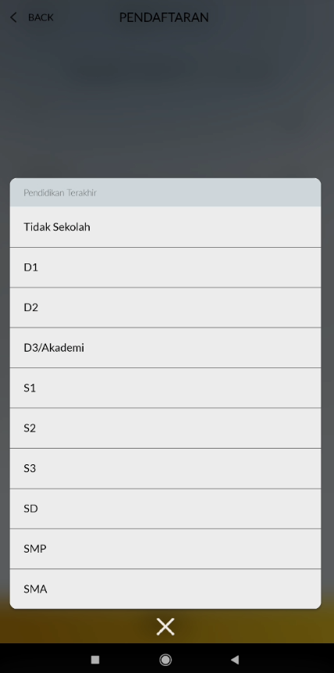
Pendidikan terakhir / Last Education
Wrong for EN version
Tidak Sekolah = No Education
D1 = D1
D2 = D2
D3/Akademi =D3 / Associate Degree
S1 = Bachelor Degree
S2 = Master Degree
S3 = Doctral Degree
SD = Elementary School
SMA = Junior High School
SMP = High School

Slide 4
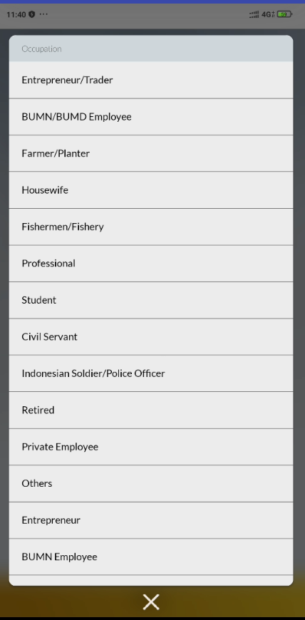
Perkerjaan / Occupation
For Bahasa Pegawai Negeri Sipil should be there Pegawai Negeri Sipil (PNS)
For Version EN and ID need information for other because just there like this
Occupation
Entrepreneur/ Trader
BUMN/BUMD Employee
Farmer/Planter
Housewife
Fishermen/Fishery
Professional
Student
Civil Servant
Indonesian Soldier/Police Officer
Retired
- Private Employee
- Others
- Entrepreneur
- BUMN Employee
- Nun
- BUMD Employee
- Researcher
- Indonesian Soldier
- Indonesian Police Officer
- Trading

Slide 5
Not there in Screen wording Emas Pegadaian V11-1

Slide 6
Not there in Screen wording Emas Pegadaian V11-1

Slide 7
Not there in Screen wording Emas Pegadaian V11-1

Slide 8
Not there in Screen wording Emas Pegadaian V11-1

Slide 9
Not there in Screen wording Emas Pegadaian V11-1

Slide 10
Not there in Screen wording Emas Pegadaian V11-1

