Slide 1
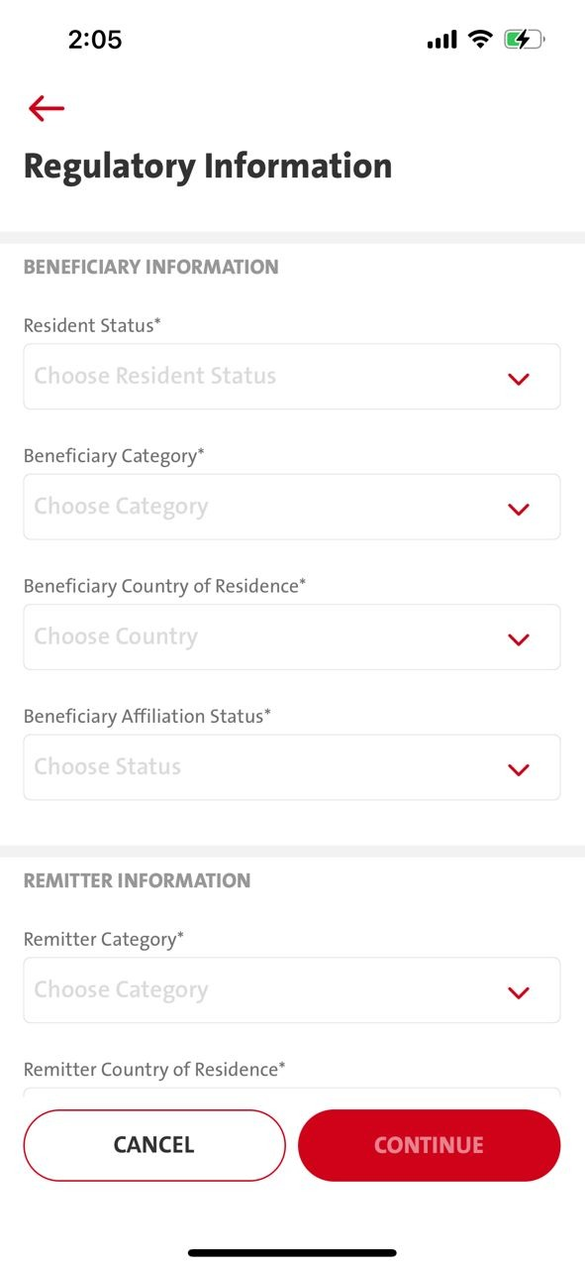
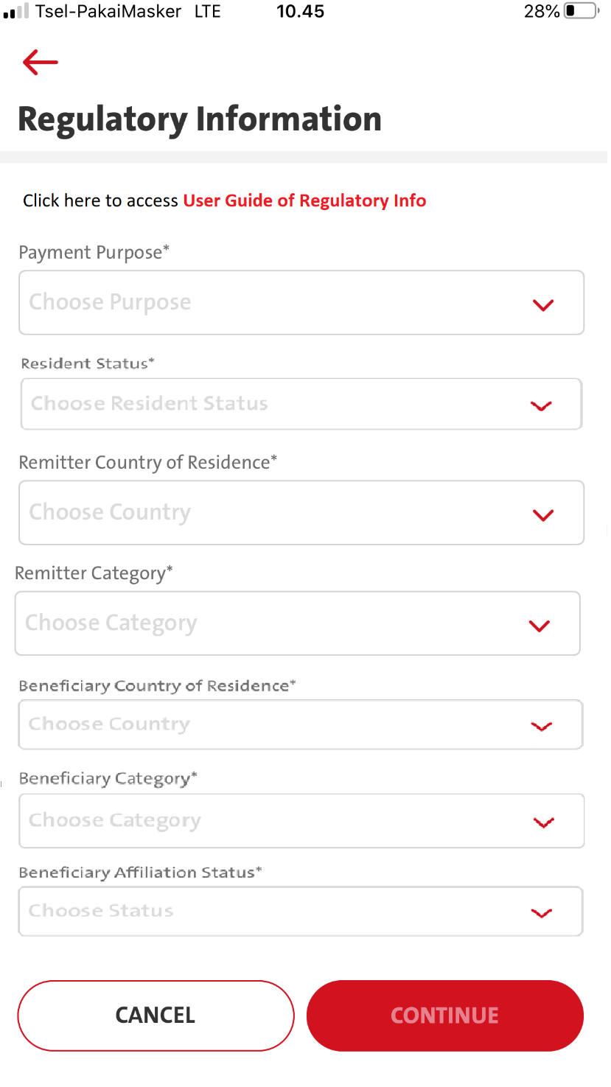
Entry point
1. Transaction – Telegraphic – Transfer to a new bene – Regulatory information screen
2. Transaction – Telegraphic – Select Fav bene – Regulatory information screen
3. Transaction – Manage Saved Bene - Telegraphic - Transfer to a new bene - Regulatory information screen
4. Transaction – Manage Saved Bene - Telegraphic – Select Fav Bene – Click Fund Transfer button - Regulatory information screen
5. Admin - Sav Bene – Fund Transfer button - Regulatory information screen

Slide 2
QC1326 - Menu Transaction - Telegraphic Transfer - Regulatory Info
FE:
1. Takeout Remitter & Beneficiary Information Panel ( follow attachment)
2. In Regulatory Info screen - There will be
Please change field sequence a below :
Payment Purpose
Resident Status
Remitter Country of Residence
Remitter Category
Beneficiary Country of Residence
Beneficiary Category
Beneficiary Affiliation Status
3. Add disclaimer info for Regulatory Information (copywriting from @nurina)
Replace with – Able to click on User Guide of Regulatory Info
- when clicking User Guide of Regulatory Info will export pdf/csv file LLD Mapping -
Copywriting
En : User Guide of Regulatory Info
ID : Panduan Lalu Lintas Devisa
BE:
- Pls refer to 13.18 others/document (Pending BE Spec for FE to call for Exporting)

Slide 3
FE - TransactionFundTransferStep1 Request
BE - TransactionFundTransferStep1 :- RESPONSE
FE – will get all the necessaries listing from Step1 response by BE to display for each field.
BE
Payment Purpose - call .. lld/payment_purpose – omni Spec 13.19
Resident Status – MLEB call others/regulatory – 13.9
Remitter Country of Residence - call ..lld/Remitter Country Of Residence omni Spec 13.22
Remitter Category - call .. lld/remitter_category omni Spec 13.23
Beneficiary Country of Residence - call .. lld/beneficiary_country_of_resd omni Spec 13.21
Beneficiary Category - call .. lld/beneficiary_category omni Spec 13.20
Beneficiary Affiliation Status - call .. lld/beneficiary_affiliation omni Spec 13.24

Slide 4
Changes on 2022.12.02
FE - TransactionFundTransferStep1 Request
BE - TransactionFundTransferStep1 :- RESPONSE (BE willresponse Payment purpose list & Resident Status list)
FE – will need to call the rest of the field (based on BE spec) for each field, and pass in the necessary value to call to BE for the next field. (5 new WSs in total to be called)
BE
Payment Purpose - call .. lld/payment_purpose – omni Spec 13.19
Resident Status – MLEB call others/regulatory – 13.9
Remitter Country of Residence - call ..lld/Remitter Country Of Residence omni Spec 13.22
Remitter Category - call .. lld/remitter_category omni Spec 13.23
Beneficiary Country of Residence - call .. lld/beneficiary_country_of_resd omni Spec 13.21
Beneficiary Category - call .. lld/beneficiary_category omni Spec 13.20
Beneficiary Affiliation Status - call .. lld/beneficiary_affiliation omni Spec 13.24

Slide 5
2022.12.08 updates - Fields sequence changes – Please follow below fields sequence arrangement.
1. [Payment purpose] - no dependency (13.19)
2. [Residence status] - no dependency (13.9)
5. [Bene Country of Residency] - no dependency
6. [Bene category] - no dependency
3. [Remitter country of Residence]
- cannot be called first - cos the request parameters have the dependency of BeneCategory code (13.20) & BeneCountry Code(13.21)
- User need to select the bene category, we can only send the specific parameter for the list Remitter country of residence.
- If we call bene category first, the field checking sequence will not be in orders.
4. [Remitter category] has the dependency on BeneCountry COde (13.21), Beneficiary category (13.20), and remitter country code (13.22).---(Should be called after Bene country of residence & Bene category)
7. [Bene Affiliate] - no dependency

