Slide 1
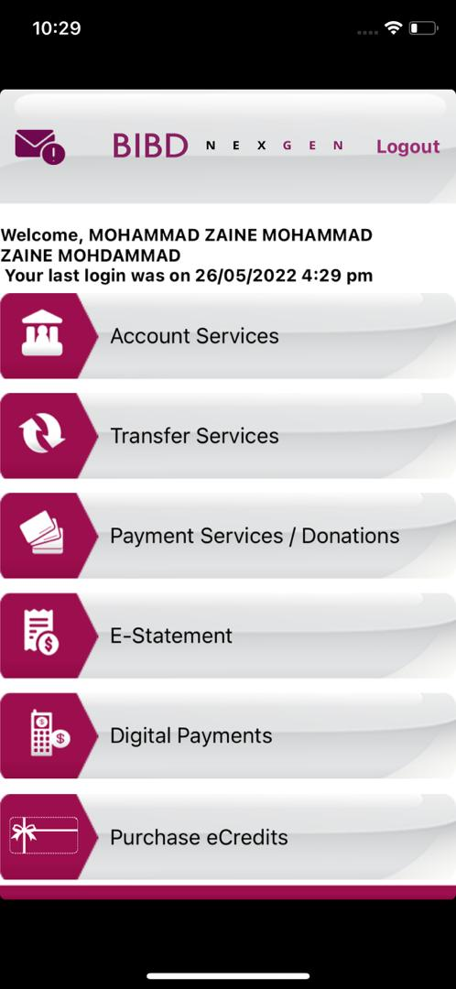
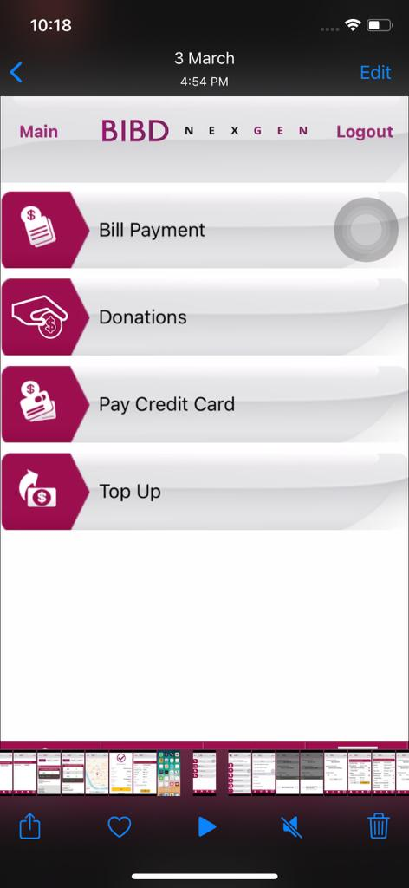

Sub Menu Screen for E-Statement
New screen to have sub-menu
Account / Credit Card
E-Statement
Refer slide 2
BIBDS E-Statement
Refer slide 3

Slide 2
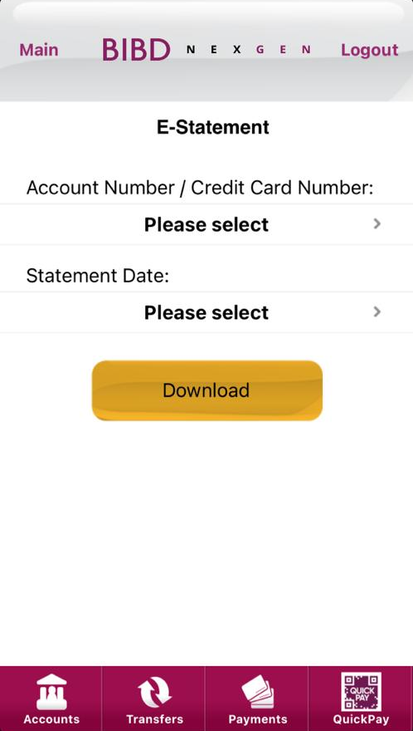
Account / Credit Card E-Statement screen (from BCR1028)
Sub-menu screen
e-Statement from BCR1028
Account / Credit Card
E-Statement
BIBDS E-Statement

Slide 3
BIBDS E-Statement screen (BCR1073)
Sub-menu screen
New Screen and New Web Service
No enrollment require
Able to view list Portfolio ID belong to the CIF based on “Activate” records only that store in IB DB table ‘EBANK_PORTFOLIO’
The option box text
- “No Portfolio ID” if no portfolio found in IB DB
- “Please select” if account/s available
Format Account Number
- Based on records in IB DB
Account / Credit Card
E-Statement
BIBDS E-Statement
Portfolio ID:
BIBDS E-Statement
Statement Date unclickable until customer select Portfolio ID
After customer select Portfolio ID, then retrieve Statement Date from OmniDoc table and display the list of Statement Date based on limit as per BAU RIB
Error customer select Statement Date before select Portfolio ID
“Please select Portfolio ID first”
The option box text
“No Statement Date” if empty/no date return
“Please select” if date/s available
Format Statement Date
YYYY-MM-DD (Descending order standardize as Account / Credit Card E-Statement)
When user click Download button, MIB FE request pdf e-statement and store/download the pdf file to device storage (same flow standardize as Account / Credit Card E-Statement)
Error if click Download without select Acc number
“Please select Portfolio ID first”
Error if click Download without select Statement Date
“Please select Statement Date”

