Slide 1
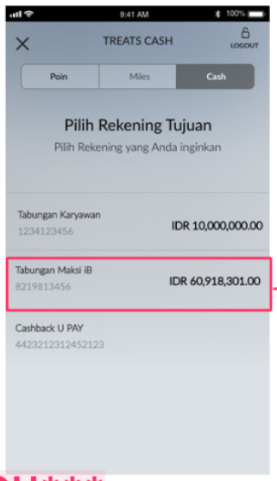
Total Treats balance is 0 or the total treats balance less than min_redemption
Warning: Insufficient balance. Need to have [min_redemption] to proceed.

Slide 2
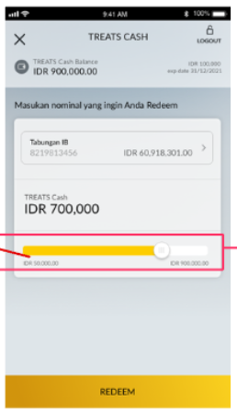
Total Treats balance is more than min_redemption
treats_total
expire_value
/treats/treatsDetail
expire_date
{ "responseCode": "00", "descErrorCode": "SUKSES", "descErrorCodeEN": "SUCCEED", "responseData": { "treats_total": 8000, "expire_date": "2023-01-26", "expire_value": 8000, "minimum_availability": 4000, "minimum_redemption": 2000, "multiply_per_redemption": 1000, "miles_rate": null } }
minimum_redemption
treats_total

Slide 3
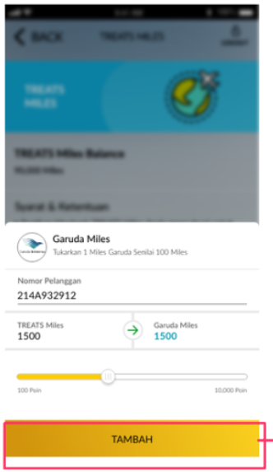
Total Treats balance is 0 or the total treats balance less than min_redemption
/treats/treatsDetail
{ "responseCode": "00", "descErrorCode": "SUKSES", "descErrorCodeEN": "SUCCEED", "responseData": { "treats_total": 19, "expire_date": "2022-11-03", "expire_value": 0, "minimum_availability": 100, "minimum_redemption": 20, "multiply_per_redemption": 100, "miles_rate": [ { "partner_id": 1, "partner_name": "GARUDA MILES", "partner_rate": "1.30" “partner_desc”: “Garuda Indonesia Miles”, “partner_image”: “https://loyalty.maybank.com/images/miles/garuda.jpg” }, ] } }
partner_name
Tukarkan [minimum_redemption] TREATS Miles dengan [minimum_redemption*partner_rate][partner_name]
TREATS Miles user input*partner_rate
0
0
Disable Tambah button

Slide 4
Total Treats balance is more than min_redemption
/treats/treatsDetail
{ "responseCode": "00", "descErrorCode": "SUKSES", "descErrorCodeEN": "SUCCEED", "responseData": { "treats_total": 0, "expire_date": "2022-11-03", "expire_value": 0, "minimum_availability": 100, "minimum_redemption": 100, "multiply_per_redemption": 100, "miles_rate": [ { "partner_id": 1, "partner_name": "GARUDA MILES", "partner_rate": "1.30" “partner_desc”: “Garuda Indonesia Miles”, “partner_image”: “https://loyalty.maybank.com/images/miles/garuda.jpg” }, ] } }
partner_name
Tukarkan [minimum_redemption] TREATS Miles dengan [minimum_redemption*partner_rate][partner_name]
TREATS Miles user input*partner_rate
minimum_redemption
treats_total

Slide 5
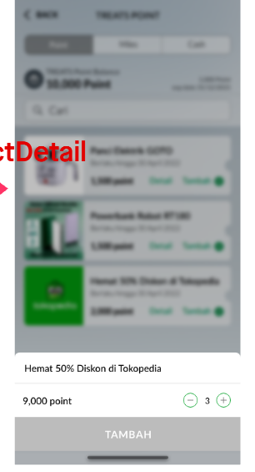
Total Treats balance is 0 or the total treats balance less than point
0
0
Disable Tambah button

Slide 6
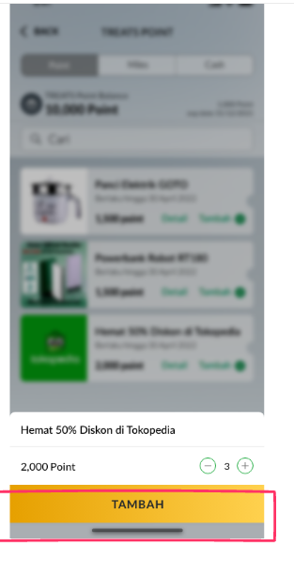
Total Treats balance is more than point
{
"responseCode": "00",
"descErrorCode": "SUKSES",
"descErrorCodeEN": "SUCCEED",
"responseData": {
"treats_total": 1000000,
"expire_date": "2023-02-12",
"expire_value": 1000000,
"minimum_availability": 100,
"minimum_redemption": 100,
"multiply_per_redemption": 100,
"miles_rate": null,
"product_list": [
{
"id": 49,
"merchant": "maybank",
"brand": "brand x",
"type": "evoucher",
"category_name": "MEC00250",
"sku": "voucher-digital-modena-experience-rp.250.000-20221104143418-493100",
"name": "Voucher Digital Modena Experience Rp.250.000",
"description_id": "Voucher Digital Modena Experience Rp.250.000",
"description_en": "Voucher Digital Modena Experience Rp.250.000",
"images": "1667547229_KFC logo.png",
"terms_id": "Product TnC",
"terms_en": "Product TnC",
"point": 11180,
"weight": null,
"quantity": “10",
"status": "1"
},
The max quantity to be added is based on quantity param

