Slide 1
OCBC Velocity Mobile Banking
Primary Device Approval Process Flow &
Device Management

Slide 2
Device Perform Login Overview
Velocity Mobile | MLEB | OMNI
App Launch
Base on deviceID & CIF (customer profile) return below information:
- IsBinded = [True; False]
- Device Binding Status [Active/Pending, (Rejected)]
- Device Level (Primary/Secondary)
- Recorder GrantAccess TimeStamp
Call BE RetrieveSecInfo
Binding Status IsBinded = False
Check Response
Binding Status = ACTIVE
IsBinded = True
Display Prelogin Landing Screen without orgName & OrgID
Display Prelogin Landing Screen with orgName & OrgID
Binding Status = PENDING
IsBinded = True
Display Prelogin Landing Screen without orgName & OrgID
1
2
3

Slide 3
Common Device Perform Login – Sync Device
Velocity Mobile | MLEB | OMNI
Perform BAU Login
Request Performlogin & Authenticate
Response Performlogin & authentication login information.
Response success necessary info
Isbinded = false/ True (common Request – not limited for new device)
- Request omni 3.9 for device synchronization – use CIF profile to search from device list if there is any (if empty – omni will sync)
-- 17.94 pass everything; Exclude device_alias & push_token & push_token_type)
Continue BAU flow
Response successful synchronization
Successfully Synced

Slide 4
NEW Device Perform Login & Device Binding Flow
Velocity Mobile | MLEB | OMNI
1
Perform BAU Login
Request Performlogin & Authenticate
7
Response success info
- Isbinded = false
- CIF profile if tight to other device ID that pending approval from device list. [check with BE to enhance in performLogin]
- Check Device limit if reaches max binding [Yes/ No]
Response Performlogin & authentication login information.
Yes = Other Device in Pending Status
No = No Other Device in pending Status
Yes = Reach limit
No = Not Reach Limit
Isbinded = false/ True (common Request – not limited for new device)
- Request omni 3.9 for device synchronization – use CIF profile to search from device list if there is any (if empty – omni will sync)
- 17.94 pass everything; Exclude device_alias & push_token & push_token_type)
Response successful synchronization
Display Exception screen Unable to bind (no screen provided)?
Successfully
Synced
Perform binding - RequestDeviceTAC BAU flow
Omni verify successfully
Request verification
Response successful & Validate:
- Device Level: Primary/ Secondary
If secondary
If Primary
If secondary
If Primary
Secondary Push
5
Request for Primary device update – Omni 3.8
- Pass A: Add
- Is_Primary: Y
Perform SWT BAU with OTPVerify
Continue BAU flow
Add New for Primary device
Display Exception
Need to approve 2nd device before proceed for 3rd device binding.
(no screen provided)?
Display “Check Your Primary Device” for approval.
4
Send Push to Primary
Receives Successful Response
Response Successfully added

Slide 5
Secondary Device Perform Login

Slide 6
Secondary Perform Login - Device in Active Status
Velocity Mobile | MLEB | OMNI
3
Response below:
- IsBinded = True
- Device Binding Status (Active)
- Device Level (Secondary)
Display Prelogin Screen for Device Performlogin [BAU FLOW]
Redirect to Dashboard

Slide 7
Secondary Perform Login – Device in Pending Status - Pending Approval from Primary Device
Velocity Mobile | MLEB | OMNI
2
Base on deviceID and CIF return below information:
- IsBinded = [True, False]
- Device Binding Status [Pending, Active]
- Device Level [Secondary]
Perform Login
Active
Isbinded = True
Isbinded = False
(Reject/ Expired)
Pending
Isbinded = True
Prompt to display “Please check your primary device for approval.
7
Redirect to Dashboard

Slide 8
Primary Device Approval

Slide 9
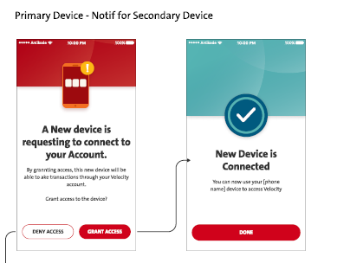
Primary Perform Login & Device Approval - Request Approval on Primary Device
Velocity Mobile | MLEB | OMNI
3
Response below:
- IsBinded = True
- Device Binding Status (Active)
- Device Level (Primary)
- Device List for approval (Pending device list (BE needs to enhance in performLogin – check with BE)
Perform BAU Login flow
Response successfully update device info
Checking device list if there is
a device pending for approval
Update below for 2nd device: (Need a ws between FE & BE) then request 3.8 omni
- Device Information – Device ID
- Device level = Secondary
- Binding Status (Active)
- Action_cd (Add = A)
- Is_primary= N
- Recorded Grant Access TimeStamp
Yes
No
Not Expired
Continue BAU login.
Prompt to display “New device would like to get connected“.
Expired
What to display when this is expired - omni
Yes – Approve
Update Reject/ Expired with info below: (Need a ws between FE & BE)
- Device Information – Device ID
- IsBinded = False
- Device Level (Secondary)
- Update in Mleb table
No – Reject
Primary Device – Display Dashboard.
Response to primary updated to FE
5
Send Push Notification to all binded devices after approval.

Slide 10
Device Management

Slide 11
Device Management Continue
Velocity Mobile | MLEB | OMNI
13
Access
Bound Device
Request list of device - Use current DeviceCIFEnquiry
Request list of binded devices
Response list of binded devices
Display list of device, with additional information & label
- Manage Device button
- Primary, or Secondary
Response list of binded devices with device level (Primary/Secondary) Last login date & time stamp.
Current Device = Primary
Current Device = Secondary
Click Manage Device
on Primary
Click Manage Device
on Secondary
Display option to proceed Unbind or Switch before current primary gets to unbind.
Click Manage Device
on Primary
Click Manage Device on “Own” Secondary
Prompt exception: “You’re not allowed to unbind “Primary Device””
Display for Unbind Confirmation
Prompt exception “Need to Login primary Device to unbind Primary
Click Manage Device on “Other” Secondary
12
11
Prompt exception “Unable to unbind Other Secondary”
Click Manage Device
(only 1 device = Primary)
Continue unbind BAU

Slide 12
Device Management End
Velocity Mobile | MLEB | OMNI
11
Unbind
Switch to Primary
Display for Switching Confirmation
12
Click Switch button
RequestDeviceTAC – Continue BAU Flow
Input PIN & request OTPVerify
Request verification
Response Omni verification successfully
Call MLEB for Primary Device Switching need ws (FE&BE)
Response successful
Update the specific Secondary Device to Primary, and Existing Primary Device to Secondary
Action_cd: U
primary: Y
Response successful updates
13
Display Acknowledgement
Response update successfully

Slide 13
Push Notification

Slide 14
Push Notification 4 - Primary Device Binding Successful
Velocity Mobile | MLEB | Firebase | Omni
4
Trigger for push notification
Request Push Notification for Primary Device
Push Notification BAU Flow Request Firebase
Send Push Notification
Primary device receives Push Notification
Click notification on Primary device for approval purpose.
Launch app automatically

Slide 15
Push Notification 5 - Secondary Device Binding For Primary Device Approval
Velocity Mobile | MLEB | Firebase | Omni
5
Request Push Notification for Primary Device
Trigger for push notification
Push Notification BAU Flow Request Firebase to send notification to all binded devices.
Subject & message content to binded Device ID
Send Push Notification
All binded devices receive Push Notification
Click notification on binded device for
There’s a device wants to be connected.
Launch app automatically

Slide 16
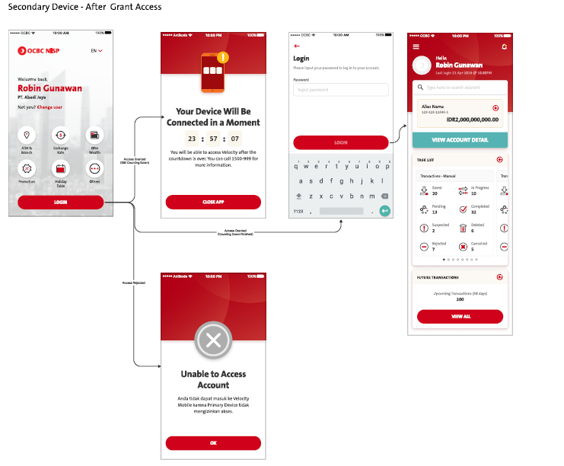
Pls proceed
FE may check below to determine the need for calling 2nd retrieveSecinfo by clicking Login Button during 1st retrieveSecInfo response by BE
During 1st RetrieveSecInfo Response by BE, FE check: below to display landing with orgID &UsrName. With below parameters, FE will make Login button available to call 2nd RetrieveSecINfo.
"deviceLevel": "SECONDARY",
"bindingStatus": "PENDING“
Isbinded: “True”,
FE - At Login button, when calling 2nd RetrieveSecInfo request, FE needs to pass in Parameter primaryActionFlag=Y, BE will return,
if approved (will return isBinded = True, Binding Status: Active, DateBind, Device Level.)
If Rejected (will return IsBinded = False, Primary Action: Rejected , deviceLevel: Secondary.) FE to display Account Unable to access screen
If BE not returning Primary Action: Rejected, shall display TIMER.

Slide 17
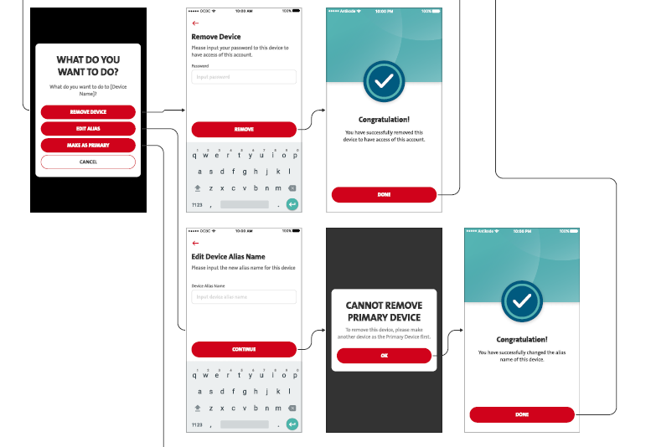
CONFIRMED BY OCBC
Current Device: Primary Device
– Edit Alias should be as BAU.
- We will not include the highlighted screen as the screen in the middle should be as BAU confirmation screen then acknowledgement screen.
- FE does not include this screen, shall take off the highlighted screen.

Slide 18
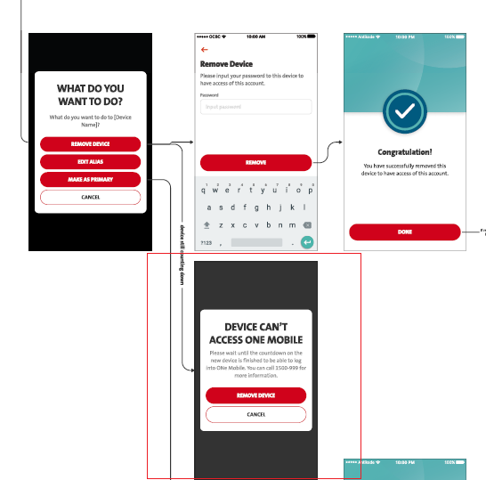
CONFRIMED BY OCBC
Current Device: Secondary Device
This flow indicates Secondary device already approved by primary device which is activated, otherwise it won’t be able to access to settings.
Therefore, the highlighted screen should be invalid.
FE does not include this screen, shall take off the highlighted screen.

Slide 19
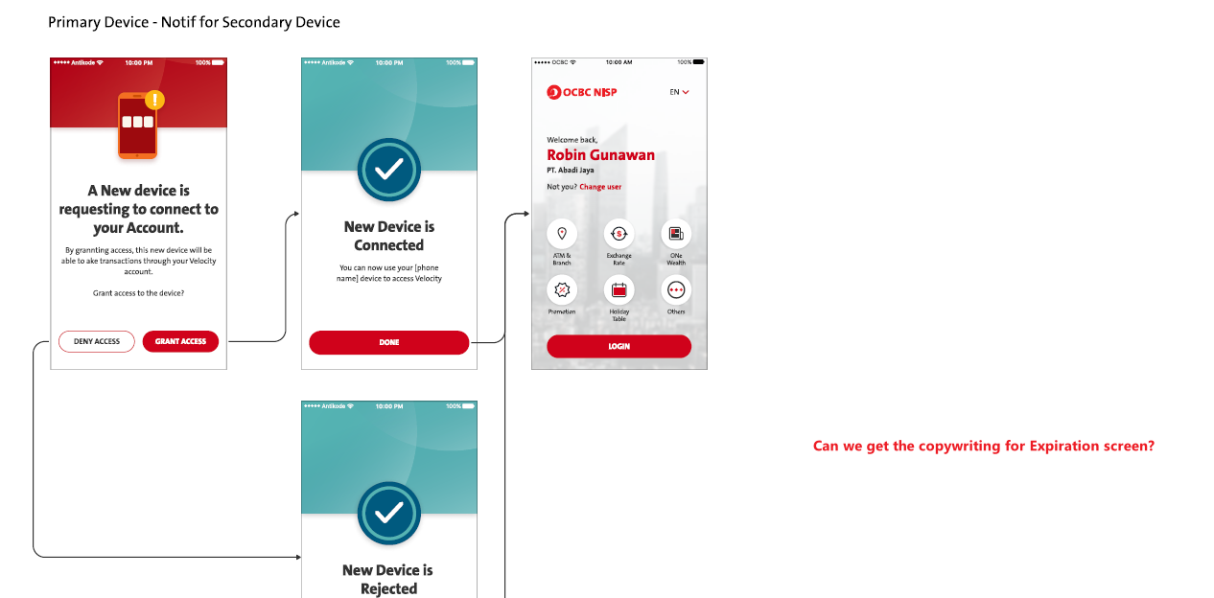
CONFIRMED BY OCBC
From slide #9:- BE returns code below for FE to display “Expired screen”
statusCode : FE checks on this error code
MCB.1000125 to display below ---
Copywriting – Pending OCBC
Sorry, binding approval for new device binding
process is expired
Remark:
FE needs to assist for drawing another similar screen for expiration screen but pending Copywriting.

Slide 20
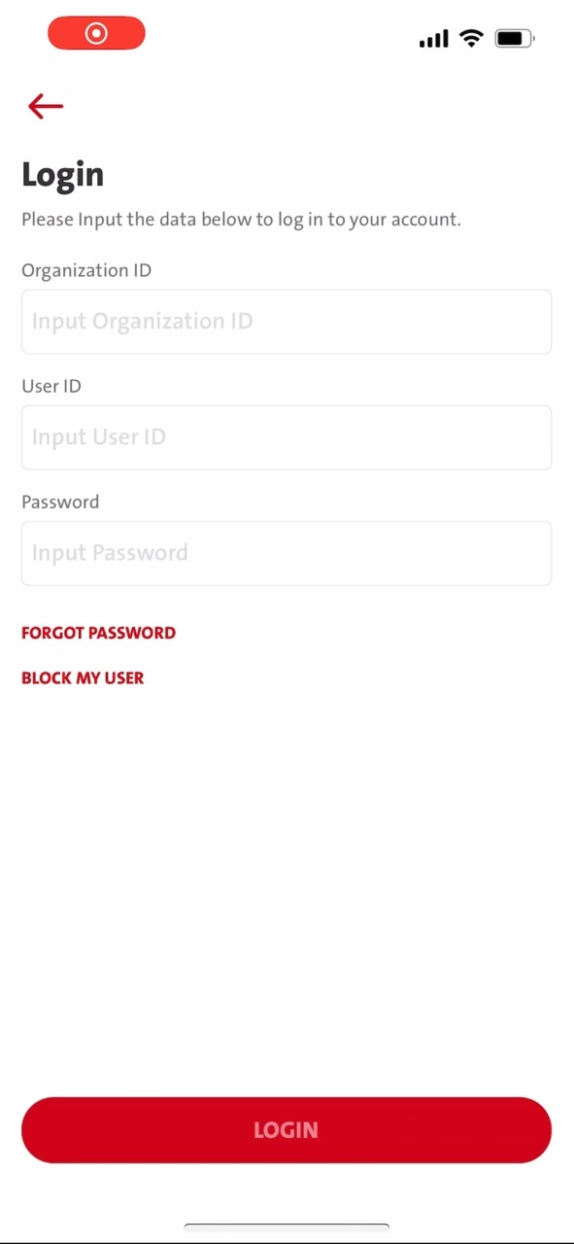
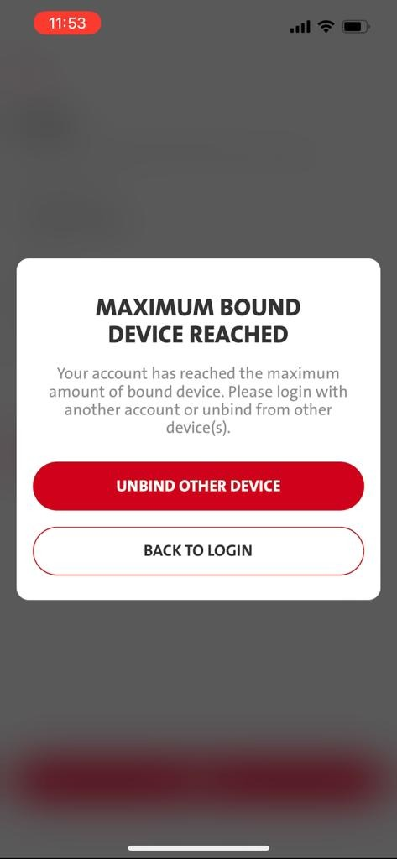
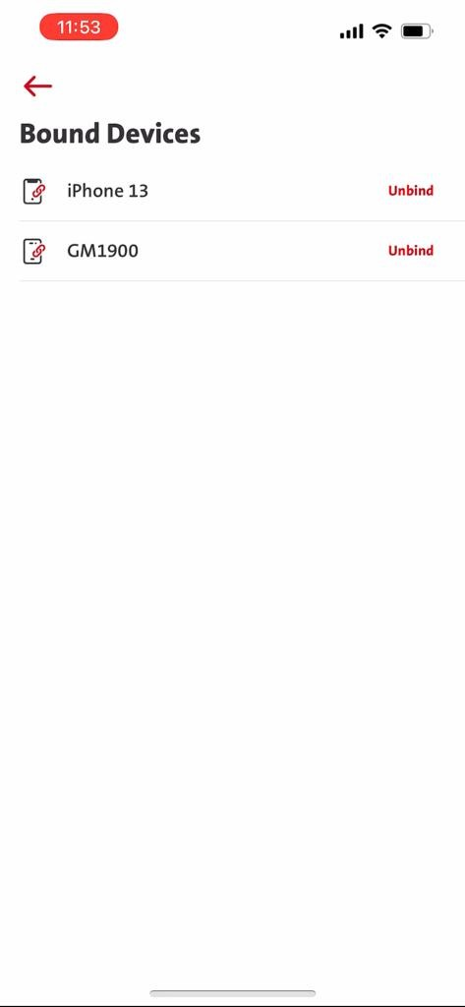
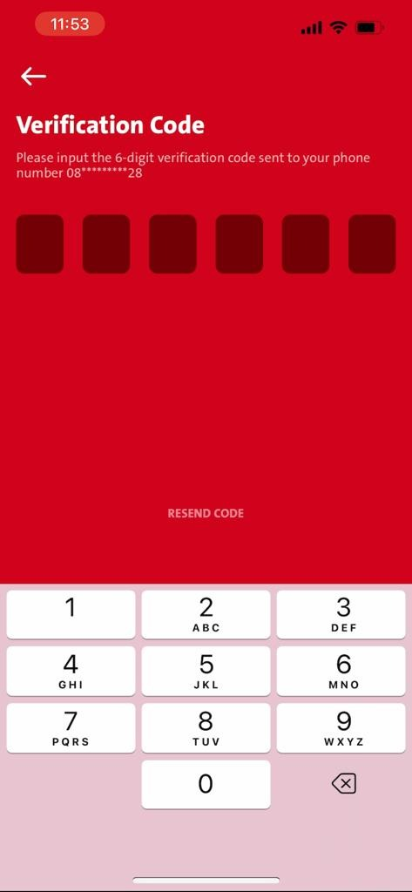
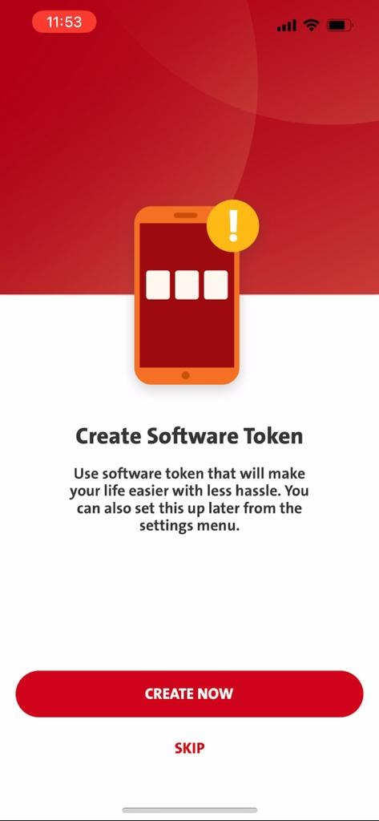
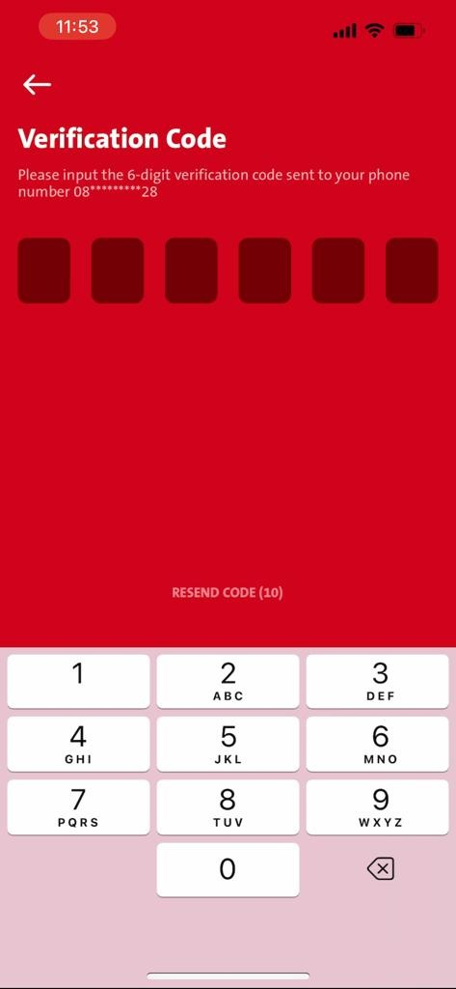
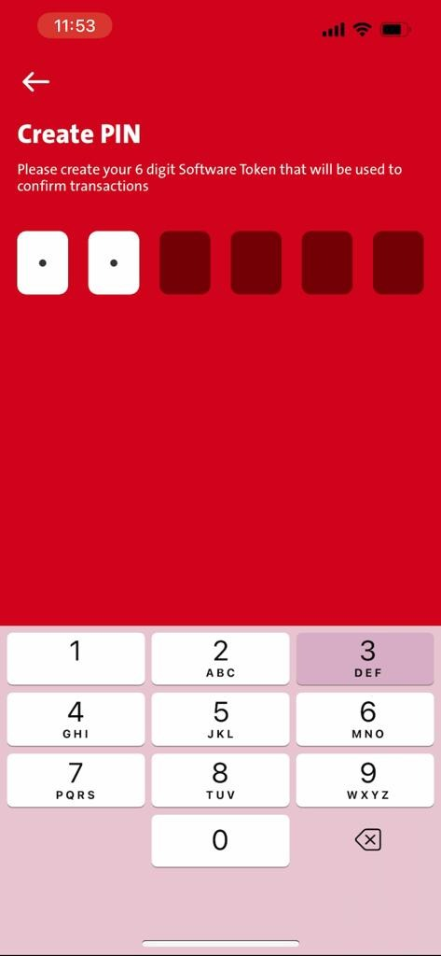
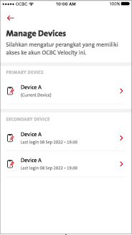
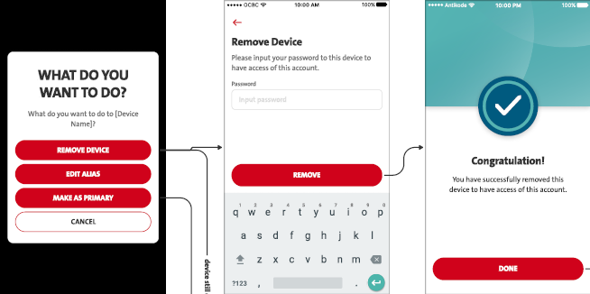
CONFIRMED BY OCBC
BAU
Display New Enhancement
Using 3rd device to bind when maximum limit has reached.
3rd device is considered as other Secondary device which is becoming the current device in secondary device level.
Able to unbind existing secondary device.
Unable to unbind Existing Primary device.
Remark:
On the Device Management screen, it will not display of the Edit Alias & Make AS PRIMARY button.
The screen above after clicking secondary-
it will not display Edit Alias button
it will not display make as primary here. ONLY Display Remove Device - This is because the 2ndary device has to be removed fisrt then the 3rd device can become the 2ndary device.

Slide 21
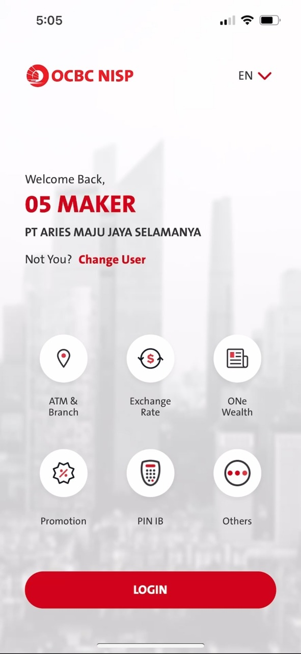
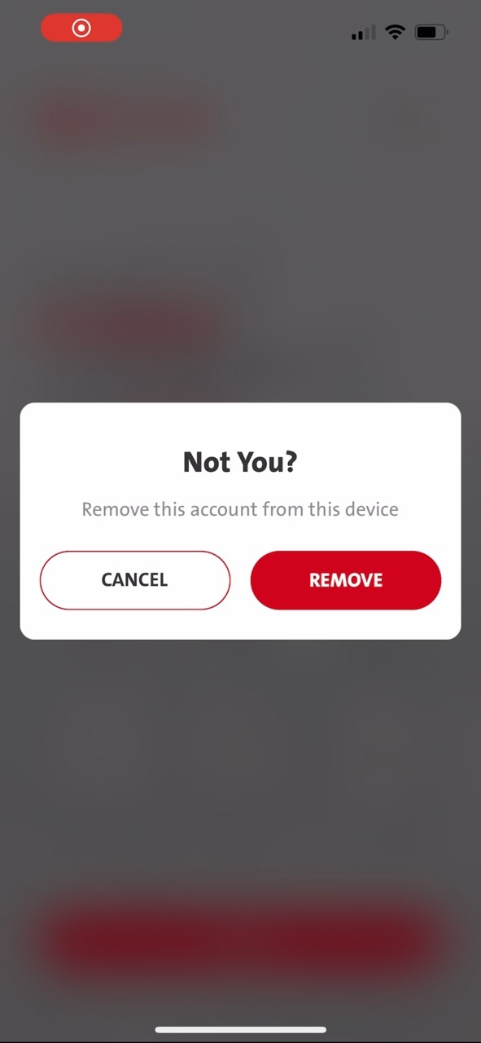
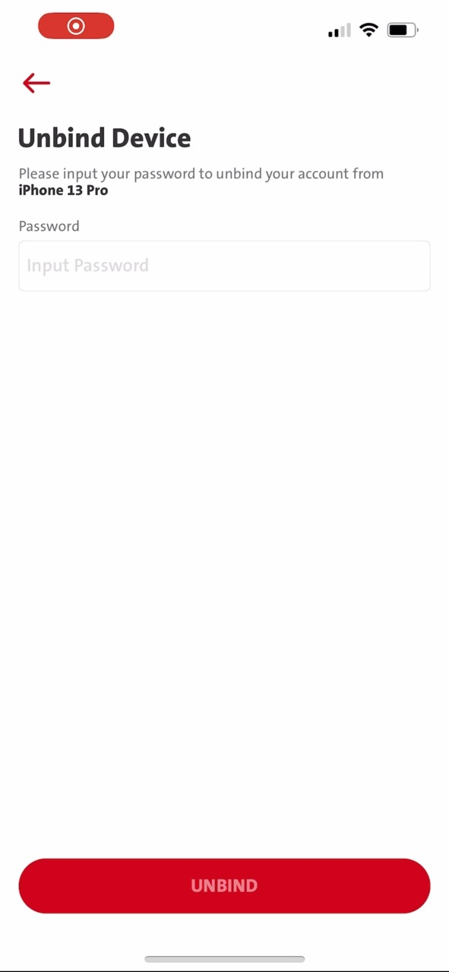
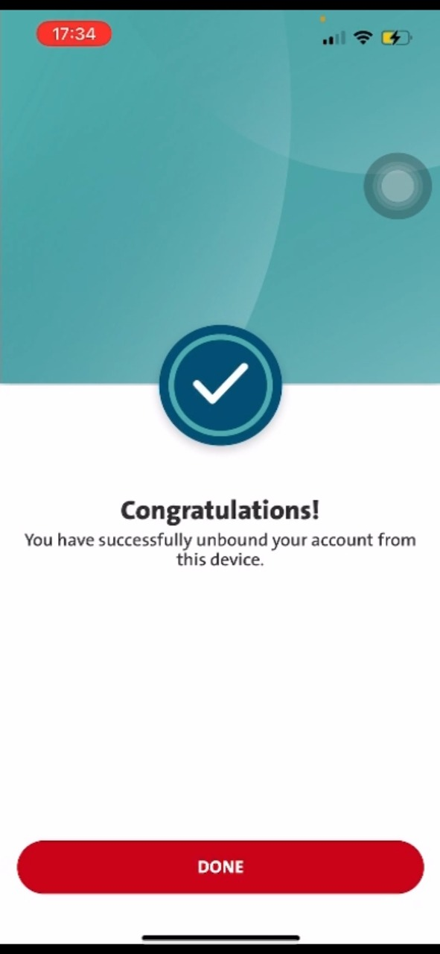
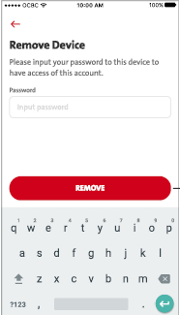
Pending OCBC confirmation - Unsent
“Change User” from Landing Screen – When it is binded.
When there’s only Primary device is binded, which has not reached the Maximum Device limit of 2.
Primary device will able to unbind itself.
Display New Enhancement
From Change user:- Landing Screen when is binded
FE needs to replace the new screen then BAU

Slide 22
Pending OCBC confirmation - Unsent
“Change User” from Landing Screen – When it is binded.
When Secondary device is binded, while Primary device is binded.
Secondary device will able to unbind itself.
Display New Enhancement
From Change user:- Landing Screen when is binded
When Secondary device binding – Pending Approval – Click Change user – Display Not You – Display Remove Device – after input password – click unbind (Remove) – hit MLEB error 114
This is because the secondary Device hasn’t been approved yet.

Slide 23
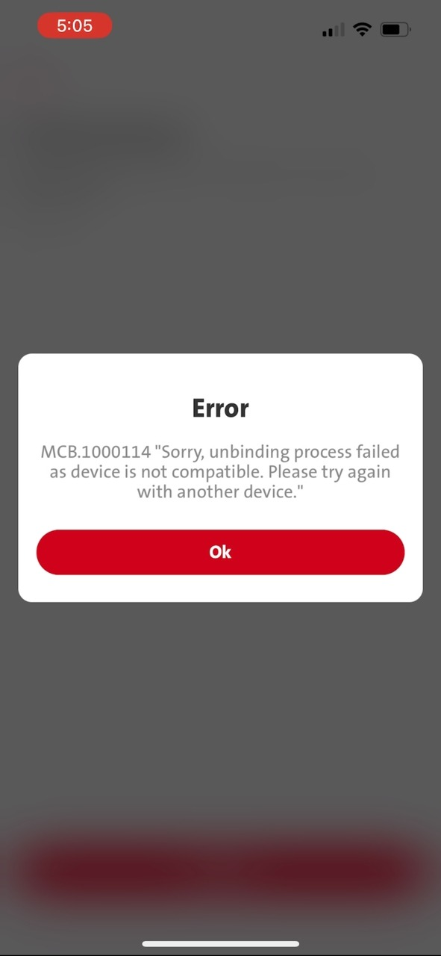
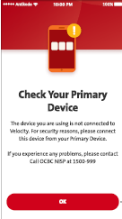
Pending OCBC confirmation – Unsent - - -- - - - - - -
“Change User” from Landing Screen – When it is binded WIHTOUT Approval.
When there’s only Secondary device is binded, while pending Primary Device Approval.
Secondary device will NOT able to unbind itself.
Display New Enhancement
From Change user:- Landing Screen when is binded
When Secondary device binding – Pending Approval – Click Change user – Display Not You – Display Remove Device – after input password – click unbind (Remove) – hit MLEB error 114
This is because the secondary Device hasn’t been approved yet.
FE needs to check 1000114 from BE response and display “Check Your Primary Device ” screen.

