Slide 1
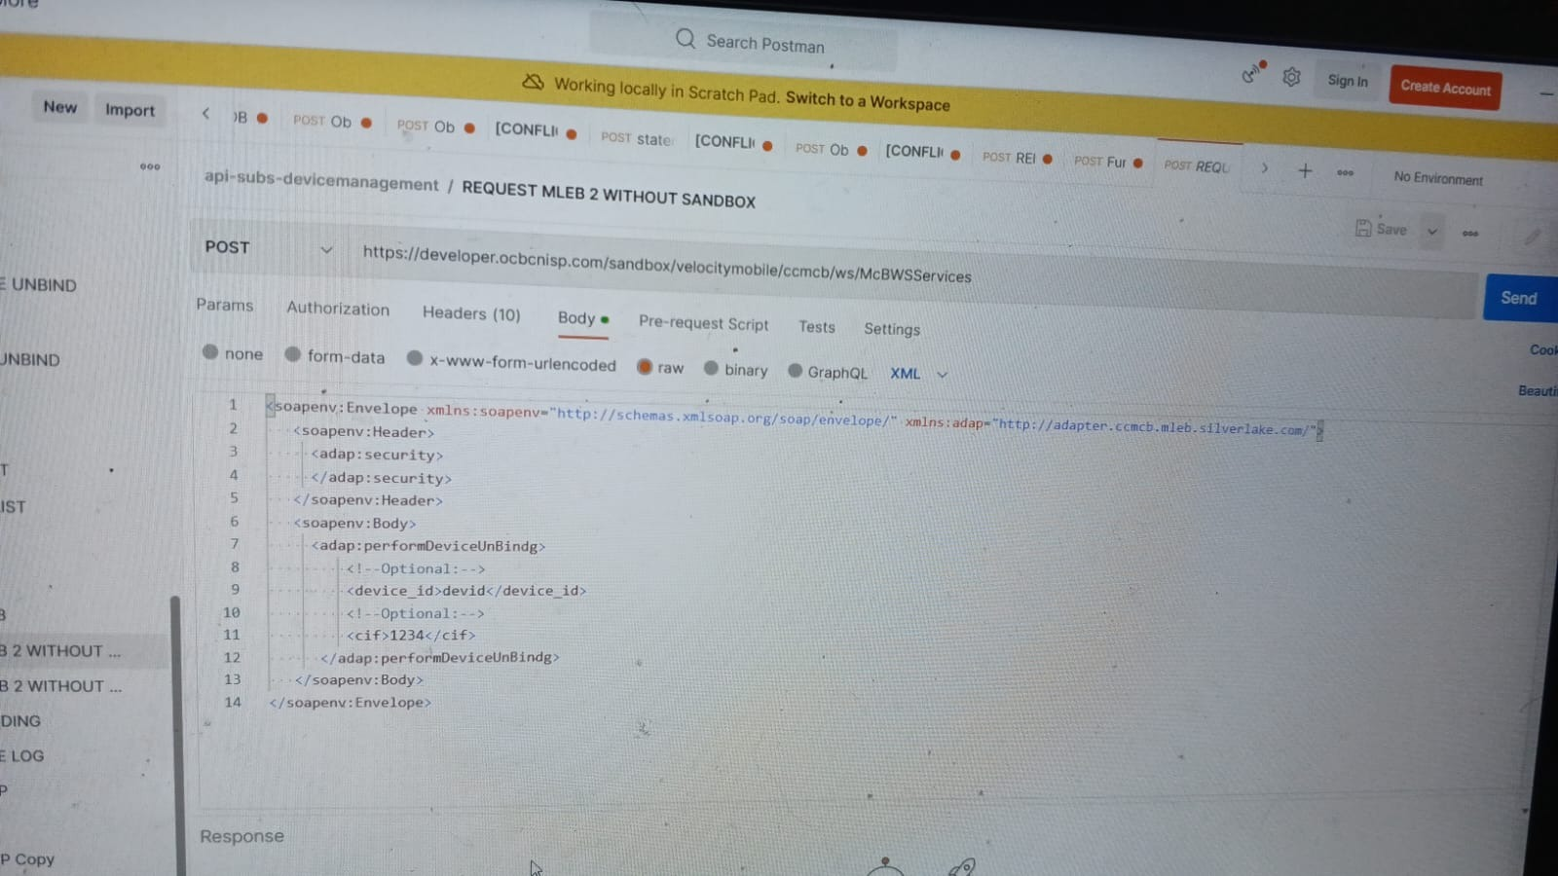

Slide 2
Mleb will need to enhance this particular unbind ws and process behind the scene.
There is no extra parameter for Omni to pass in cos Mleb will check in the db if this device is primary/2ndary.
So, the dev id Omni passes in is the device id that Omni wants to unbind; mleb will check if this is the (Primary/ 2ndary) - if primary, mleb will switch secondary over to become Primary.
then Omni will be able to unbind.
After unbinded - BE will need to call omni - user/device and passing
-action U
-is_primary : Y

