Slide 1
OCBC Velocity Mobile Banking
Primary Device Approval Process Flow &
Device Management

Slide 2
Device Perform Login Overview
Velocity Mobile | MLEB | OMNI
App Launch
Base on deviceID & CIF (customer profile) return below information:
- IsBinded = [True; False]
- Device Binding Status [Active/Pending, (Rejected)]
- Device Level (Primary/Secondary)
- Recorder GrantAccess TimeStamp
Call BE RetrieveSecInfo
Binding Status IsBinded = False
Check Response
Binding Status = ACTIVE
IsBinded = True
Display Prelogin Landing Screen without orgName & OrgID
Display Prelogin Landing Screen with orgName & OrgID
Binding Status = PENDING
IsBinded = True
Display Prelogin Landing Screen without orgName & OrgID
1
2
3

Slide 3
Common Device Perform Login – Sync Device
Velocity Mobile | MLEB | OMNI
Perform BAU Login
Request Performlogin & Authenticate
Response Performlogin & authentication login information.
Response success necessary info
Isbinded = false/ True (common Request – not limited for new device)
- Request omni 3.9 for device synchronization – use CIF profile to search from device list if there is any (if empty – omni will sync)
-- 17.94 pass everything; Exclude device_alias & push_token & push_token_type)
Continue BAU flow
Response successful synchronization
Successfully Synced

Slide 4
NEW Device Perform Login & Device Binding Flow
Velocity Mobile | MLEB | OMNI
1
Perform BAU Login
Request Performlogin & Authenticate
7
Response success info
- Isbinded = false
- CIF profile if tight to other device ID that pending approval from device list. [check with BE to enhance in performLogin]
- Check Device limit if reaches max binding [Yes/ No]
Response Performlogin & authentication login information.
Yes = Other Device in Pending Status
No = No Other Device in pending Status
Yes = Reach limit
No = Not Reach Limit
Isbinded = false/ True (common Request – not limited for new device)
- Request omni 3.9 for device synchronization – use CIF profile to search from device list if there is any (if empty – omni will sync)
- 17.94 pass everything; Exclude device_alias & push_token & push_token_type)
Response successful synchronization
Display Exception screen Unable to bind (no screen provided)?
Successfully
Synced
Perform binding - RequestDeviceTAC BAU flow
Omni verify successfully
Request verification
Response successful & Validate:
- Device Level: Primary/ Secondary
If secondary
If Primary
If secondary
If Primary
Secondary Push
5
Request for Primary device update – Omni 3.8
- Pass A: Add
- Is_Primary: Y
Perform SWT BAU with OTPVerify
Continue BAU flow
Add New for Primary device
Display Exception
Need to approve 2nd device before proceed for 3rd device binding.
(no screen provided)?
Display “Check Your Primary Device” for approval.
4
Send Push to Primary
Receives Successful Response
Response Successfully added

Slide 5
Secondary Device Perform Login

Slide 6
Secondary Perform Login - Device in Active Status
Velocity Mobile | MLEB | OMNI
3
Response below:
- IsBinded = True
- Device Binding Status (Active)
- Device Level (Secondary)
Display Prelogin Screen for Device Performlogin [BAU FLOW]
Redirect to Dashboard

Slide 7
Secondary Perform Login – Device in Pending Status - Pending Approval from Primary Device
Velocity Mobile | MLEB | OMNI
2
Base on deviceID and CIF return below information:
- IsBinded = [True, False]
- Device Binding Status [Pending, Active]
- Device Level [Secondary]
Perform Login
Active
Isbinded = True
Isbinded = False
(Reject/ Expired)
Pending
Isbinded = True
Prompt to display “Please check your primary device for approval.
7
Redirect to Dashboard

Slide 8
Primary Device Approval

Slide 9
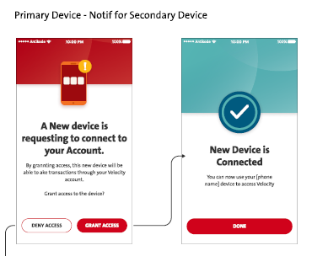
Primary Perform Login & Device Approval - Request Approval on Primary Device
Velocity Mobile | MLEB | OMNI
3
Response below:
- IsBinded = True
- Device Binding Status (Active)
- Device Level (Primary)
- Device List for approval (Pending device list (BE needs to enhance in performLogin – check with BE)
Perform BAU Login flow
Response successfully update device info
Checking device list if there is
a device pending for approval
Update below for 2nd device: (Need a ws between FE & BE) then request 3.8 omni
- Device Information – Device ID
- Device level = Secondary
- Binding Status (Active)
- Action_cd (Add = A)
- Is_primary= N
- Recorded Grant Access TimeStamp
Yes
No
Not Expired
Continue BAU login.
Prompt to display “New device would like to get connected“.
Expired
What to display when this is expired - omni
Yes – Approve
Update Reject/ Expired with info below: (Need a ws between FE & BE)
- Device Information – Device ID
- IsBinded = False
- Device Level (Secondary)
- Update in Mleb table
No – Reject
Primary Device – Display Dashboard.
Response to primary updated to FE
5
Send Push Notification to all binded devices after approval.

Slide 10
Device Management

Slide 11
Device Management Continue
Velocity Mobile | MLEB | OMNI
13
Access
Bound Device
Request list of device - Use current DeviceCIFEnquiry
Request list of binded devices
Response list of binded devices
Display list of device, with additional information & label
- Manage Device button
- Primary, or Secondary
Response list of binded devices with device level (Primary/Secondary) Last login date & time stamp.
Current Device = Primary
Current Device = Secondary
Click Manage Device
on Primary
Click Manage Device
on Secondary
Display option to proceed Unbind or Switch before current primary gets to unbind.
Click Manage Device
on Primary
Click Manage Device on “Own” Secondary
Prompt exception: “You’re not allowed to unbind “Primary Device””
Display for Unbind Confirmation
Prompt exception “Need to Login primary Device to unbind Primary
Click Manage Device on “Other” Secondary
12
11
Prompt exception “Unable to unbind Other Secondary”
Click Manage Device
(only 1 device = Primary)
Continue unbind BAU

Slide 12
Device Management End
Velocity Mobile | MLEB | OMNI
11
Unbind
Switch to Primary
Display for Switching Confirmation
12
Click Switch button
RequestDeviceTAC – Continue BAU Flow
Input PIN & request OTPVerify
Request verification
Response Omni verification successfully
Call MLEB for Primary Device Switching need ws (FE&BE)
Response successful
Update the specific Secondary Device to Primary, and Existing Primary Device to Secondary
Action_cd: U
primary: Y
Response successful updates
13
Display Acknowledgement
Response update successfully

Slide 13
Push Notification

Slide 14
Push Notification 4 - Primary Device Binding Successful
Velocity Mobile | MLEB | Firebase | Omni
4
Trigger for push notification
Request Push Notification for Primary Device
Push Notification BAU Flow Request Firebase
Send Push Notification
Primary device receives Push Notification
Click notification on Primary device for approval purpose.
Launch app automatically

Slide 15
Push Notification 5 - Secondary Device Binding For Primary Device Approval
Velocity Mobile | MLEB | Firebase | Omni
5
Request Push Notification for Primary Device
Trigger for push notification
Push Notification BAU Flow Request Firebase to send notification to all binded devices.
Subject & message content to binded Device ID
Send Push Notification
All binded devices receive Push Notification
Click notification on binded device for
There’s a device wants to be connected.
Launch app automatically

Slide 16
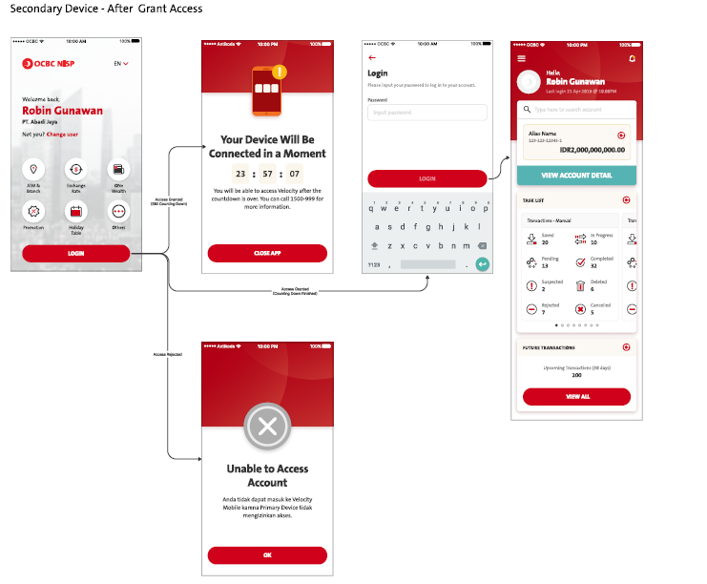
Pls proceed
iOS – tested good
Android – Tested good
FE may check below to determine the need for calling 2nd retrieveSecinfo by clicking Login Button during 1st retrieveSecInfo response by BE
During 1st RetrieveSecInfo Response by BE, FE check: below to display landing with orgID &UsrName. With below parameters, FE will make Login button available to call 2nd RetrieveSecINfo.
"deviceLevel": "SECONDARY",
"bindingStatus": "PENDING“
Isbinded: “True”,
FE - At Login button, when calling 2nd RetrieveSecInfo request, FE needs to pass in Parameter primaryActionFlag=Y, BE will return,
if approved (will return isBinded = True, Binding Status: Active, DateBind, Device Level.)
If Rejected (will return IsBinded = False, Primary Action: Rejected , deviceLevel: Secondary.) FE to display Account Unable to access screen
If BE not returning Primary Action: Rejected, shall display TIMER.
BE created TimeLeft Parameter slide #25
BE - Fixed
When (Android) secondary = current device - switching to Primary
iOS Primary = display TIMER during login (Proven)
--- if the cooling period is long enough.. After the swith, (the 2ndary become Primary scenario) will always display timer
When (iOS) secondary = current device - switching to Primary
Android Primary = display TIMER during login (Proven)
When (iOS) secondary = current device - switching to Primary
iOS Primary = display TIMER during login (Proven)
Fixed:
BE will make changes in order to avoid TIMER displaying constantly after switching one device: (2ndary become Primary), the (Primary become 2ndary) and keep displaying TIMER

Slide 17




After DENY - If user REMAINS ON “CHECK YOUR PRIMARY” screen after newly binding process
“CHECK YOUR PRIMARY” Screen – Click OK button – Needs to call RetrieveSecInfo - need to pass primaryActionFlag=Y
FE checks
IsBinded = False
Primary Action: Rejected
deviceLevel: Secondary
To display “UNABLE TO ACCESS ACCOUNT” screen
After Approval - If user REMAINS ON “CHECK YOUR PRIMARY” screen after newly binding process
“CHECK YOUR PRIMARY” Screen – Click OK button – Needs to call RetrieveSecInfo - need to pass primaryActionFlag=Y
FE checks
"deviceLevel": "SECONDARY",
"bindingStatus": "PENDING“
Isbinded: “True”,
“approvalCountdown”: 6343473
To display TIMER
iOS – tested good
Android – Tested good
Not yet APPROVE/ DENY - If user REMAINS ON “CHECK YOUR PRIMARY” screen after newly binding process [Existing]
“CHECK YOUR PRIMARY” Screen – Click OK button – Needs to call RetrieveSecInfo - need to pass primaryActionFlag=Y
FE checks
"deviceLevel": "SECONDARY",
"bindingStatus": "PENDING“
Isbinded: “True”,
Go back and display Landing screen with OrgName & OrgID

Slide 18

If remaining on Check Primary screen
1.
iOS -
After Primary approval in 5 minutes (before expire)
click OK button – return to Prelogin screen with display
Click Login button – Display Timer
Android
After Primary approval
Click OK button – display
2. iOS
After Primary deny
Click OK button – return to Prelogin screen without displaying orgID OrgName.
Click Login Button – Display Login credential Input screen
Android –
After Primary deny
Click OK button – Display Unable to Access Account” screen.
For this Scenario – Android will follow iOS.

Slide 19
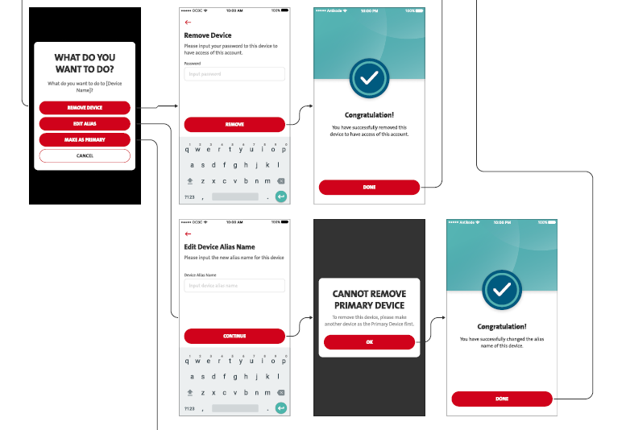
CONFIRMED BY OCBC
Current Device: Primary Device
– Edit Alias should be as BAU.
- Will not include the highlighted screen as the screen in the middle should be as BAU confirmation screen then acknowledgement screen.
- FE does not include this screen, shall take off the highlighted screen.
iOS – tested good
Android – Tested good

Slide 20
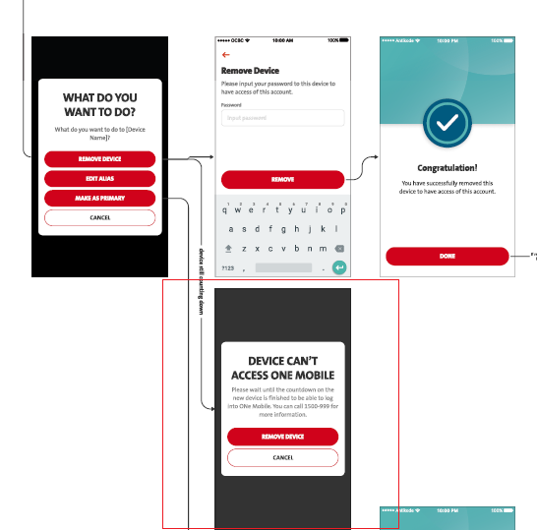
CONFIRMED BY OCBC
iOS – tested good
Android – tested good
Current Device: Secondary Device
This flow indicates Secondary device already approved by primary device which is activated, otherwise it won’t be able to access to settings.
Therefore, the highlighted screen should be invalid.
FE does not include this screen, shall take off the highlighted screen.

Slide 21
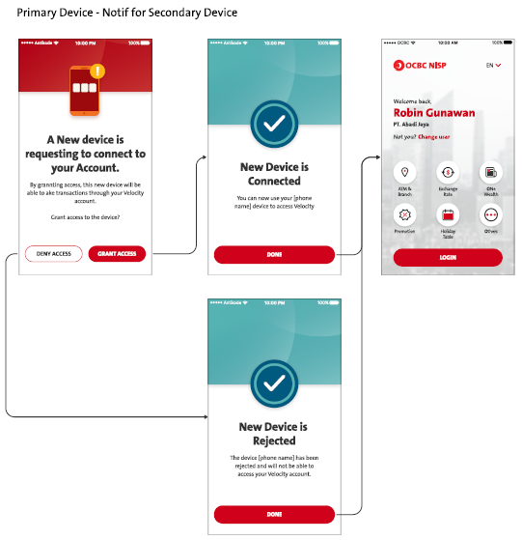
CONFIRMED BY OCBC
iOS – tested good
Android – Tested good
From slide #9:- BE returns code below for FE to display “Expired screen”
When Primary device did not approve/ reject after 5 minutes.
After performlogin,
- Display “A New Device” screen after login
- Click Deny/ Grant Access (calling PeformDeviceBindingUpdate)
BE will return the MCB.1000125
Copywriting – Pending OCBC
Remark:
FE needs to assist for drawing another similar screen for expiration screen but pending Copywriting.

Slide 22
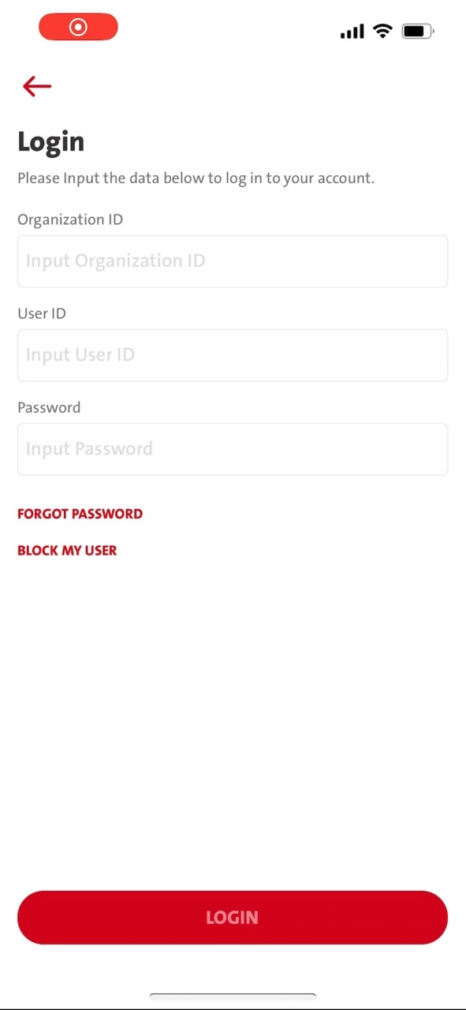
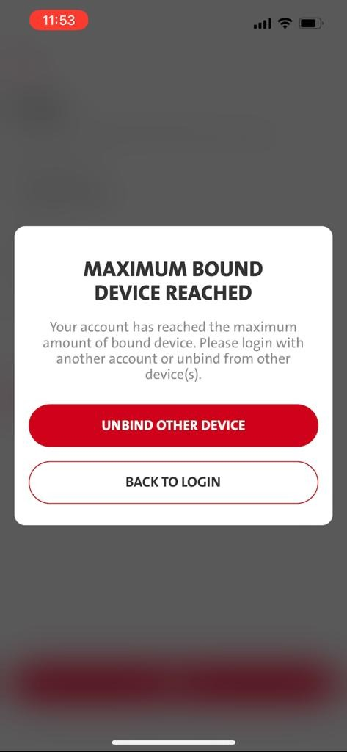
CONFIRMED BY OCBC
iOS – tested good
Android – Tested good
Only change the button to become
- Hide/ remove the Unbind Button
Display “Back To Login” Button Only.
Possible to adjust the message
Using 3rd device to bind when maximum limit has reached.
Based on the new enhancement, this 3rd device is unable to unbind any binded device when Primary device & 2ndary device are fully binded.
- After login, when Primary device & 2ndary device are fully binded, will prompt the original as above.

Slide 23
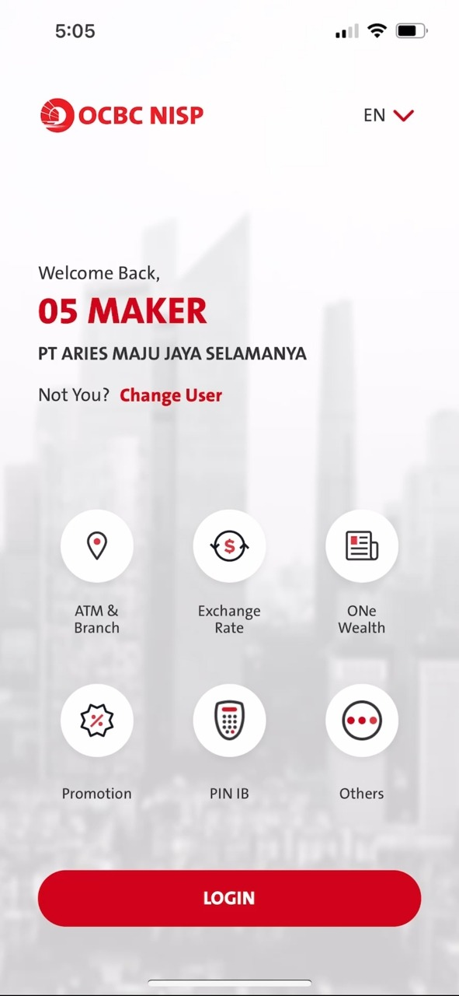
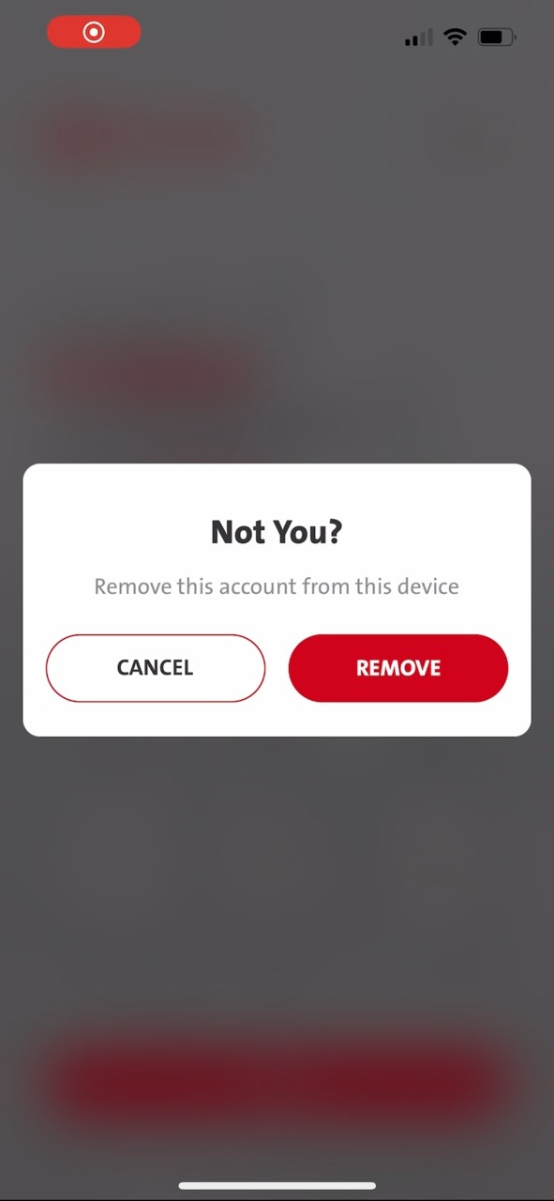
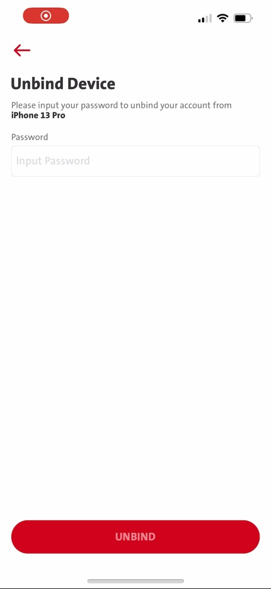
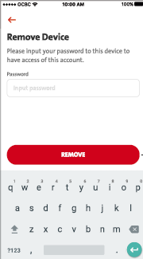
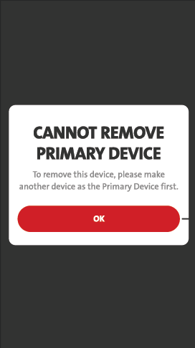
CONFIRMED BY OCBC
iOS – tested good
Android – Tested good
“Change User” from Landing Screen
- When Primary device is binded, while Secondary device is binded (with Active/ Pending Status).
- Primary device will NOT able to unbind itself.
Display New Enhancement
- FE clicks Remove Button & need to pass in approvalUnbindFlag = ‘Y’ for DeviceCIFUnbindAck & DeviceCIFUnbindAckOpen during request
- BE will return Error code: MCB.1000126 in DeviceCIFUnbindAckOpen Response
FE may display “CANNOT REMOVE PRIMARY DEVICE” screen.
Because when there are 2 devices binded concurrently, Primary device will not able to unbind itself.

Slide 24
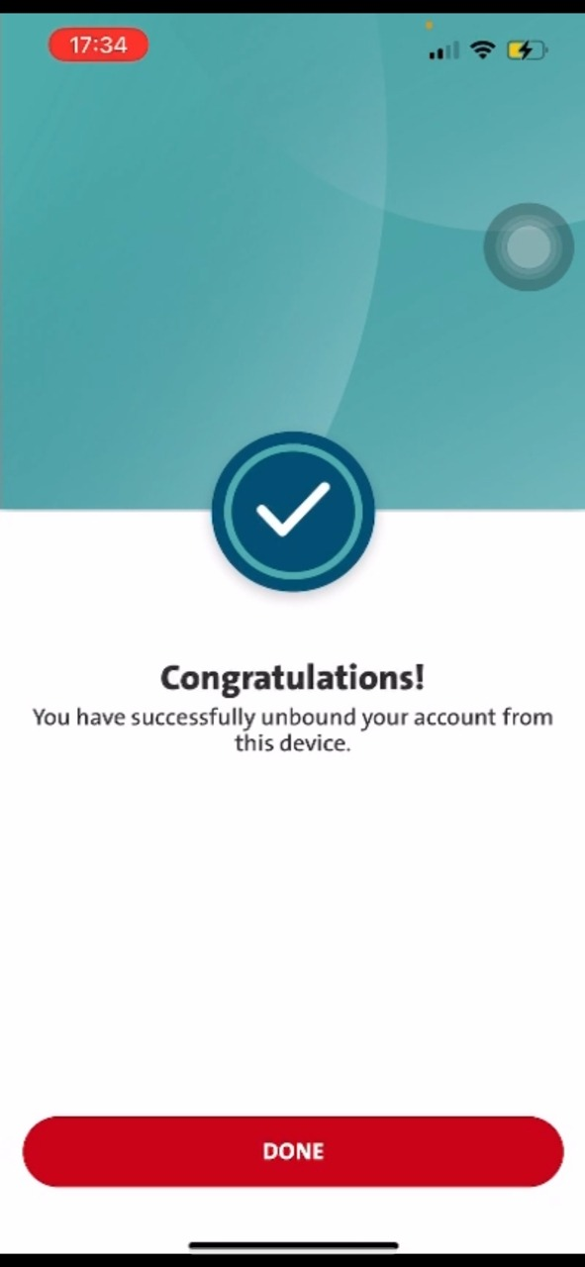
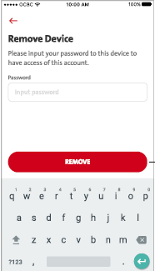
CONFIRMED BY OCBC
“Change User” from Landing Screen
- When there’s only Primary device is binded, which has not reached the Maximum Device limit of 2.
- Primary device is able to unbind itself.
iOS – tested good
Android – raised to android -
Display New Enhancement

Slide 25
CONFIRMED BY OCBC
“Change User” from Landing Screen.
When Secondary device is binded, while Primary device is binded.
Secondary cannot unbind Primary device. (Pls refer process flow slide #11)
Secondary device is able to unbind itself when Status is Active.
iOS – tested good
Android – tested good
Display New Enhancement

Slide 26
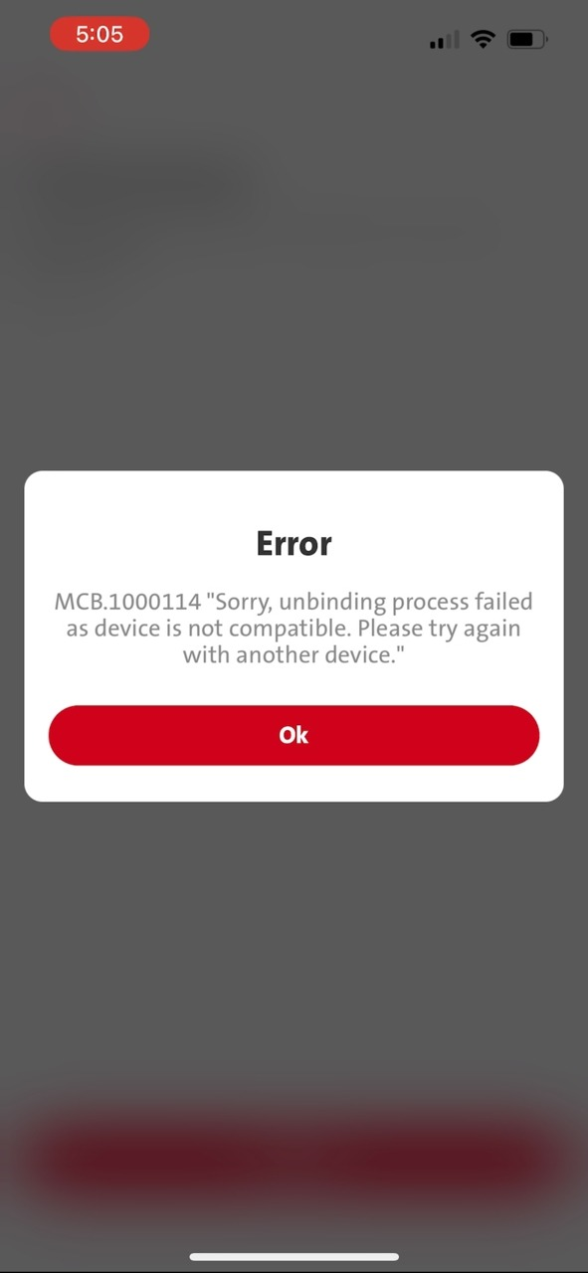
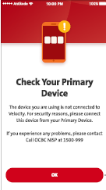
CONFIRMED BY OCBC
iOS – Tested good
Android – Tested good
“Change User” from Landing Screen
- When Secondary device is binded, while pending Primary Device Approval.
- Secondary device is NOT able to unbind itself when it is binded WIHTOUT/ BEFORE Approval while status is Pending
Display New Enhancement
From Change user:- Landing Screen when is binded
When Secondary device binding – Pending Approval – Click Change user – Display Not You – Display Remove Device – after input password – click unbind (Remove) – hit MLEB error 114
This is because the secondary Device hasn’t been approved yet- In Pending Status
FE needs to check 1000114 from BE response and display “Check Your Primary Device ” screen.

Slide 27
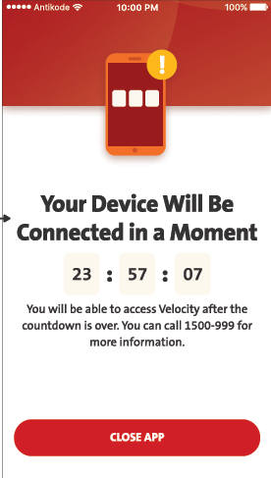
BE Fixed
BE needs to assist to provide a the calculated time left for countdown.
- dateBind + 23:59:59h (Cooling period) - current date time = countdown FOR FE to map in order to display on Timer countdown.
For UAT, please make it for 5 minutes for testing purpose.
FE should map for Timer display with "approvalCountdown” will be in milliseconda.

Slide 28
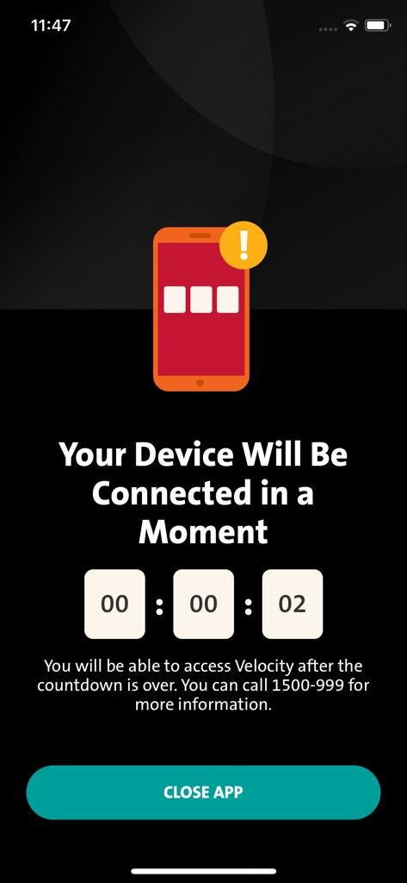
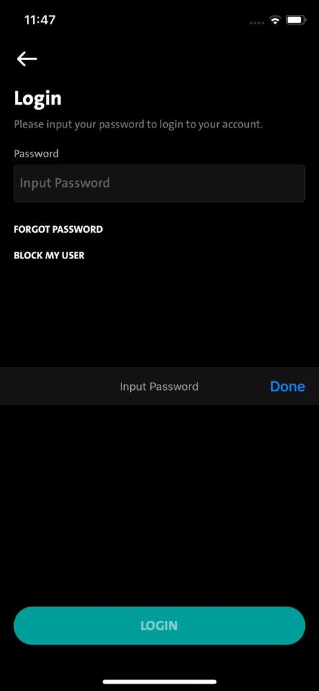
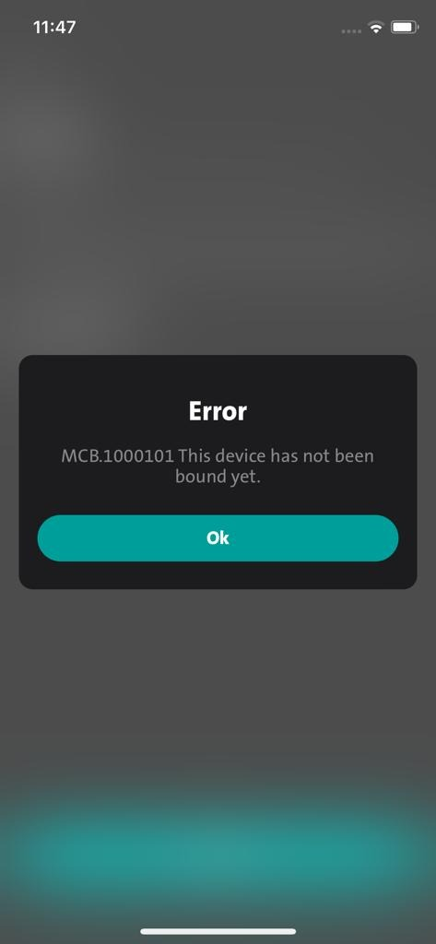
Pending OCBC confirmation
iOS –
Android –
Scenario:- THIS ONLY HAPPEN WHEN COOLING PERIOD IS SHORTER
Secondary Device – After Grant Access – After primary approval but Primary Device removed secondary [from settings – Manage Devices]
Remark: Original Logic:-
When Primary device is binded, while Secondary device is binded (with Active status – after approval).
Primary device will ABLE to unbind Secondary device from Settings - Manage Devices.
Steps:
1. Secondary device display ongoing countdown – remain on countdown screen
2. Primary device perform Remove from “Manage devices” (Able to remove cos already approved by primary device, which secondary status has become Active.
Primary steps:
- IF Primary device already approved
- Primary device removed secondary (from Settings – Manage Devices)
Result:-
1. Secondary Steps:
- Secondary remain on Countdown screen > login password screen > [BE will return MCB.1000101 This device has not been bound yet.]
- Suggest to display popup with copywriting to indicate that this device has not been bound.
2. Secondary relaunch/ open the apps > Need to rebind again at pre-login screen. {No screen needed}

Slide 29
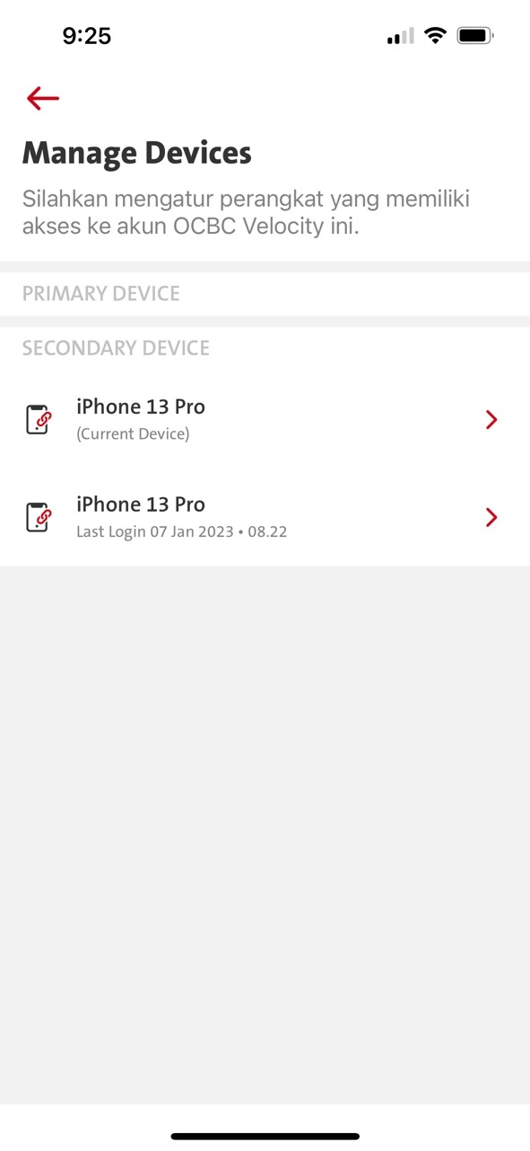
For record.. (this could happen after deployment)
Tried once scenario #1:
New apps binded – android; Old apps binded - iOS New apps installed on top old apps on iOS..
Based on what seng loong said today.. his android was binded as in new apps yesterday. However, this morning around 4am.. I was checking iOS issue using old apps and binded using the same profile. And realized this issue just now after I woke up.
Need to Log from
Check binded date/ time for SGL_1 (New Apps) Android – valid?
Check binded date/ time for SGL_1 (Old Apps) – iOS - valid?
Check binded date/ time for SGL_1 (New install on top of old apps – iOS – valid?
What logic caused the display of 2 Primary?
2023.01.08 – This scenario is about replacing (Install/ forceUpdates) the [Binded new apps] on top of [Binded old apps].
When New Apps available (does it mean to include when New Apps installed on top of OLD Apps) in store, THE EXISTING binded devices in [OLD Apps] will (device level will kick in) automatically become primary/ secondary device. – (If this is valid, this mentioned scenario suppose be displaying on:- Android [New Apps]; {after installed the New Apps on top of Old Apps}
1st issue: howcome Android is not in the display and Android did not unbind at the moment – this is the conflict.
2nd issue: why it displayed both iOS phone but why it would be 2 same device – 1 device (OLD) – 1 device (NEW)
Switched over both mentioned devices. Success to switch.
If deviceID are the same, is it possible if we can avoid this scenario happening in this situation?
What is the current logic with new apps/ services if new apps replace on the old apps? Suppose
Wouldn’t same deviceID shall now be present on the screen as mentioned? Cos both Android [New Apps] & iOS were

Slide 30
Old apps can use until the new apps is in store. Once the new is in store. Cannot use the old apps anymore. Which means unbind won’t happened from the old app over the new apps.
By right - When new apps already in store, old apps should not able to unbind profile from new apps. Because this old apps needs to force update to the new one.
One scenario is that when new apps is being force update in progress (force updates come in progress, force updates goes by batches) – which means some of the old apps are still not yet updated (which could happen when my iOS has already been force updated but my android has not – which means my android is still using old apps. ).
So, it could happen that one user is using the old apps & new apps at the same time –it comes to a scenario when new apps already binded then Old apps perform unbind – Able to unbind?
---------------------------------------------------------------------------
2023.01.09
1. NEW package to bind – Android - Primary
2. New Package to bind – Android – (Approve by Primary)
3. OLD package to bind – iOS (1.0.10 – UAT with push,appli, TT)
- Unbind maximum device (Unbind Primary #1) – check bound device screen – How many device – 2 devices
- Install NEW package on top of iOS – check Manage Devices screen – How many device – 2 devices (but 2 secondary devices)
>>> by right, the existing secondary device is supposed to become Primary device when there is an force update/ installation of NEW apps on top of the OLD Apps.
>>> by right, the existing Primary will be still Primary device when there is an force update/ installation of NEW apps on top of the OLD Apps.
2023.01.09 – After Fixed – Result as below:
Unbind maximum device (Unbind Primary #1) – check bound device screen – How many device – 2 devices
Installed NEW package on top of iOS – display timer (when hitting maximum and unbind, and the same time, will bind thru after )
- Install NEW package on top of iOS – check Manage Devices screen – How many device – 2 devices (but 2 secondary devices)
1. Android binded new package - Primary2. iOS 13 binded New Package - Secondary3. iOS 13 Pro [[[1.0.3]]] binded OLD package using Production profile - (UAT package point to Production) - (this package pointing at production is replacing the existing UAT apps) - (Usually, the uat package that point to production will be installed individually instead of replacing the current UAT package)4. Installed NEW UAT package - secondary - noticed there are 2 iphone

