Slide 1
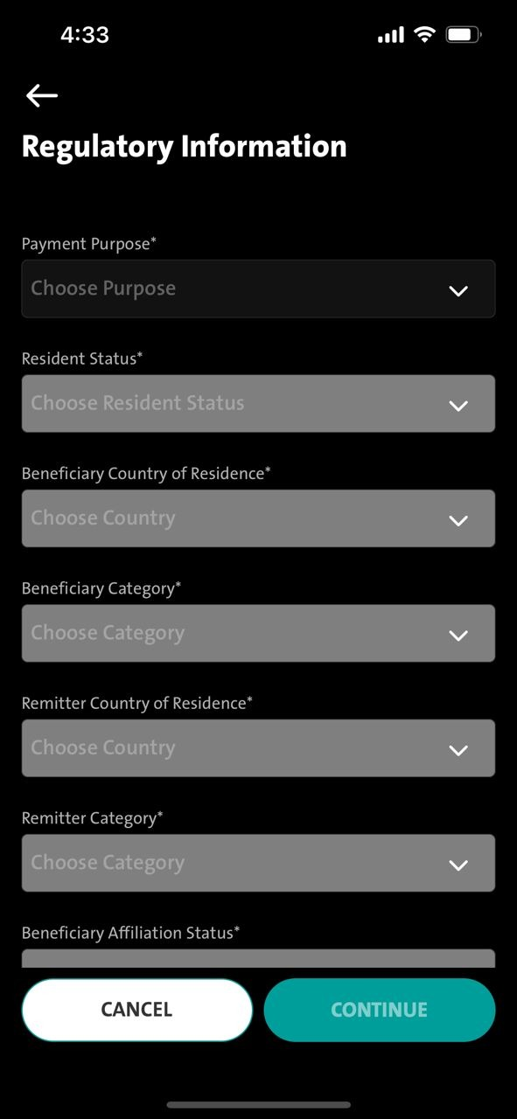
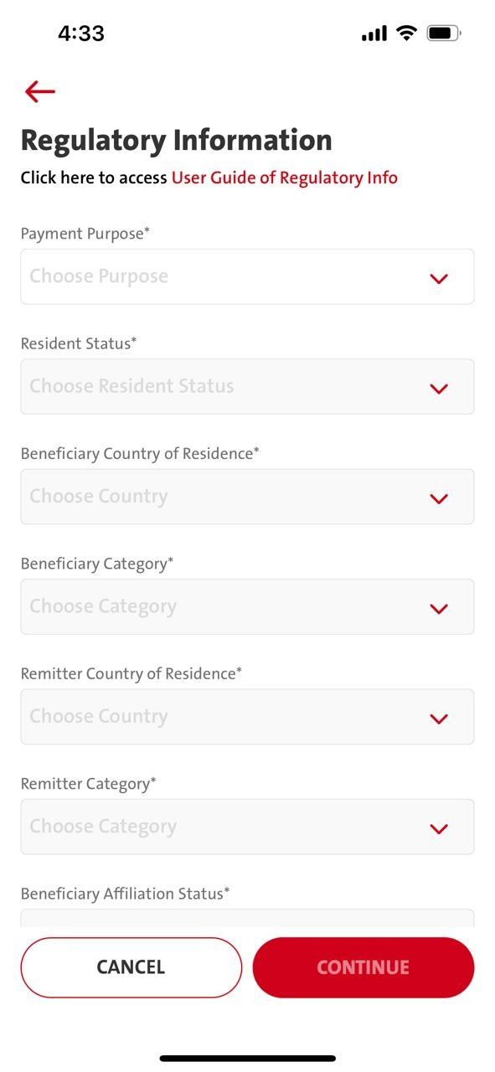
Issue
Missing copywriting for Darkmode
Please follow LightMOde
Copywriting
En : Cilck here to access User Guide of Regulatory Info
ID : Klik di sini untuk akses Panduan Lalu Lintas Devisa

