Slide 1
QC1333 - Mandatory Fields (IP Address) Needs to be added - FE
There will be a mandatory field for IP address
FE needs to pass in IP address parameter during each WS request.
Ultimately BE will include in header to pass it over to omni.
FE can pass in as below:
Alternative IP: FE may choose anyone of below to pass in to BE. FE needs to add IP value to request body not header, and the key param for this value is the ip address.
Local IP (Android OS 11 and above may not able to get due to device security reason)
IP Gateway – Android -
IP ISP – FE to use.
Proxy IP – iOS
Remark:
IP address still pending on decision whether which one to use. Will update again after we provide the sample IP as mentioned above.
***** OCBC decided to use ISP IP address.
15.6 maintenance/submit - FE – TimeDepositAccountMaintenanceSubmit – Tested good
15.4 opening/submit - FE – TimeDepositAccountOpeningAcknowledgement Tested good
10.15 payment/submit
FE – PaymentSubmit Tested good
FE – PaymentConfirmSubmit Tested good
10.12 fundstransfer/submit
FE – transactionFundTransferSubmit
FE – transactionFundTransferConfirmSubmit
3.3 user/authenticate
FE - PerformLoginv2Tested good

Slide 2
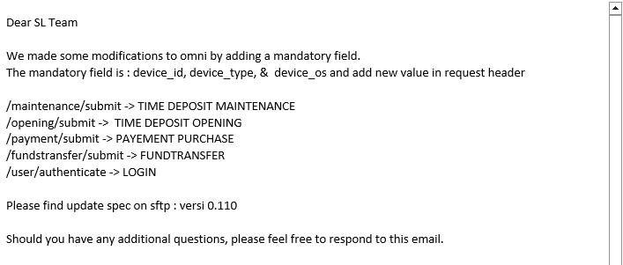
QC1333 - Mandatory Fields Needs to Be added - BE

Slide 3
QC1333 - Mandatory Fields – IP Address needs to be added for every single WS Part #2
How many WSs do we have for Velocity Mobile? ---- BE already been added into BE Spec (below link) including the OLD Web services. https://docs.google.com/spreadsheets/d/1PXPeI7OE41Kla_MVub0XA_z5z0z5j1_WMq_ZDoTIQWQ/edit#gid=1546121701
Please pass the IP in soapenv header request for every web services. {Please take out IP:Paremeter}
Total 153 WS request would need to be included.
FE – may refer to the link above or the text document as attached.
Effort
iOS - 1
Android - 1
2. Get a sample soapenv header request with IP address?

