Slide 1
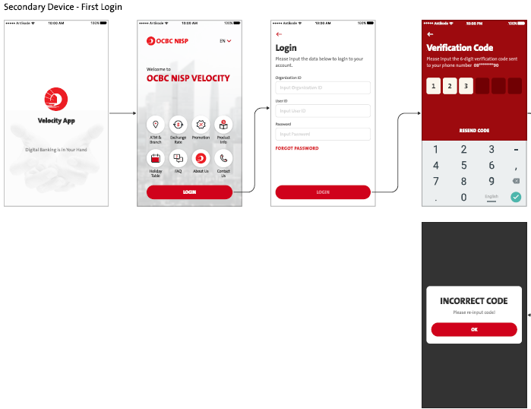
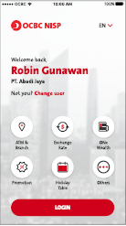
Current Secondary screen flow – Will need to change
Take out the highlighted screens – Pls refer to Slide #2

Slide 2
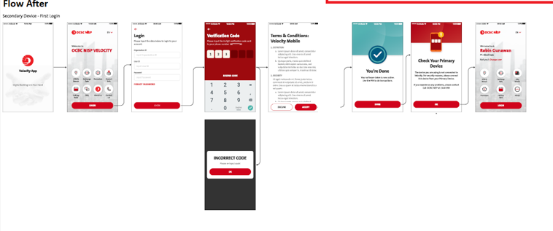
Confirmed by OCBC – Secondary Screen flow

Slide 3
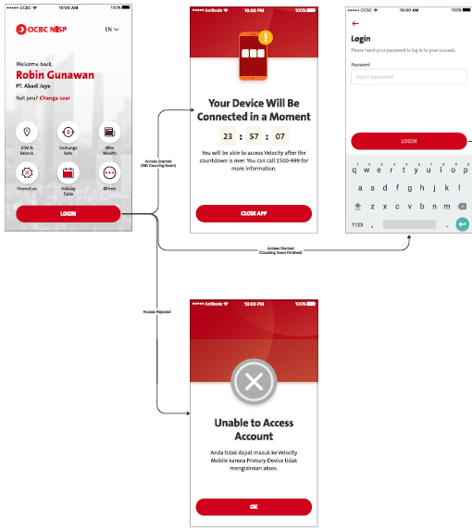
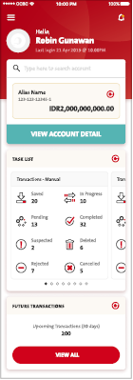
Replace here

