Slide 1
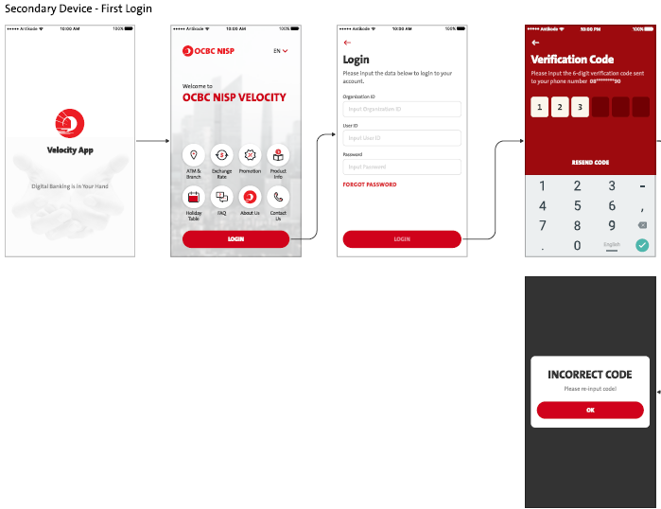
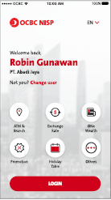
Current Secondary perform Login screen flow – Will need to change
Take out the highlighted screens – Pls refer to Slide #2

Slide 2
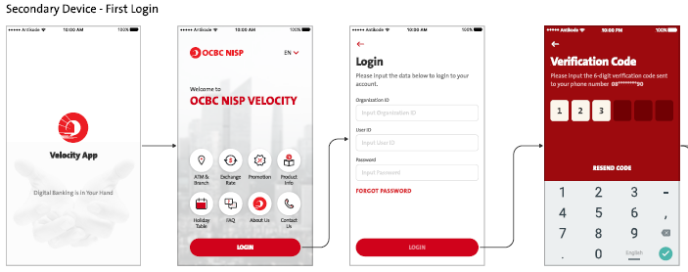
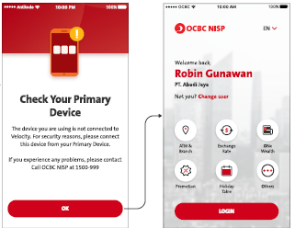
Result of display - Confirmed by OCBC – Secondary Screen flow

Slide 3
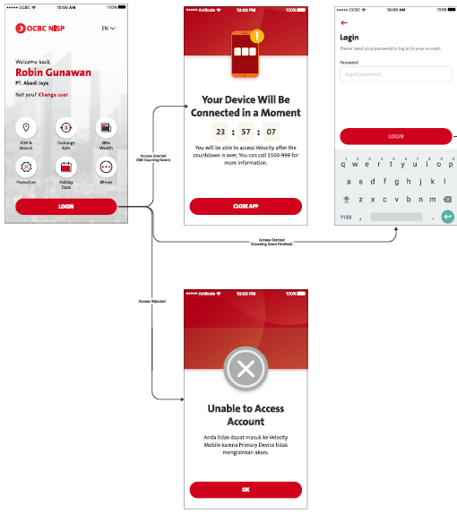
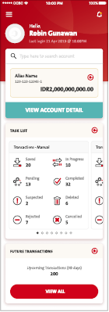
2ndary device login flow – After Primary device approval
Software Token Enrollment screens will replace here

