Slide 1
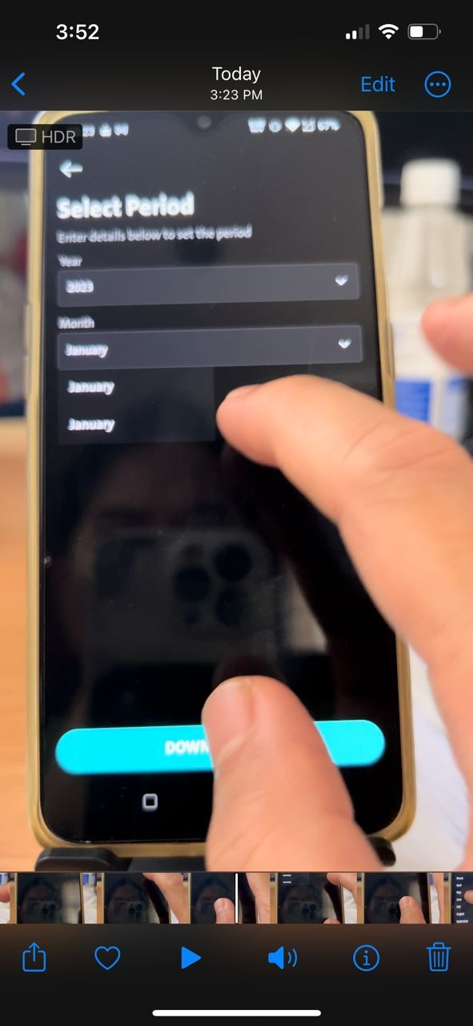
QC 1330 – Account Statement – Invalid
Invalid period parameter value passing to BE.
Period : 202300
The parameter value should be 202301 right if choosing January.
clicking download PDF button - will call estatementdownload
for the display of month in the Year of 2023
- display Jan & Februay
when it gets to next month - March
- display Jan Feb March

