Slide 1
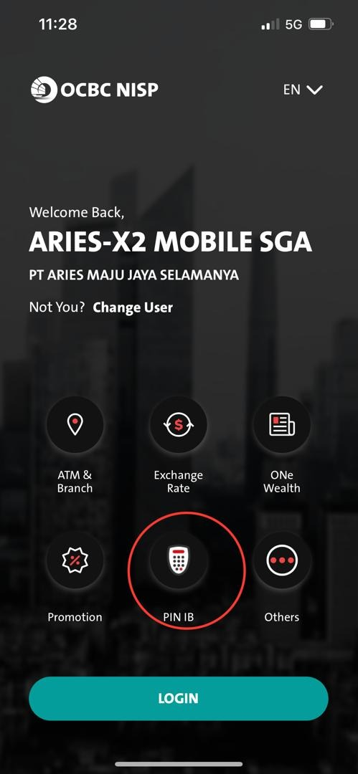
QC1341 CR – 2nd layer checking for PIN IB For display purpose
QC1341 – Checking for PIN IB for display purpose
PIN IB – FE currently checking for display based on VM.0025 if it is returned in menu_access_list under RetrieveSecInfo response
BE - Omni Spec 4.1 Customer Token Inquiry – Token Omni 18.5 – Device 18.94 – Check Device ID in the response of Token/Inquiry :-
If Omni response/ return with a device ID
BE needs to check on DB if such Device ID is matched with the current device ID
If the DeviceID is MATCHED with the current Device ID – BE will return a FLAG under RetreieveSecInfo response to FE
If the DeviceID is Null or UNMATCHED with the current Device ID – BE will return a FLAG under RetreieveSecInfo response to FE
FE – will have another layer of checking the FLAG to determine the display of PIN IB when BE returns FLAG below from menu_access_list under RetrieveSec response:-
If PinIB = Y - [ Display PIN IB on landing screen]
If PinIB = N - [Disappear/ OFF PIN IB from landing screen]

