Slide 2
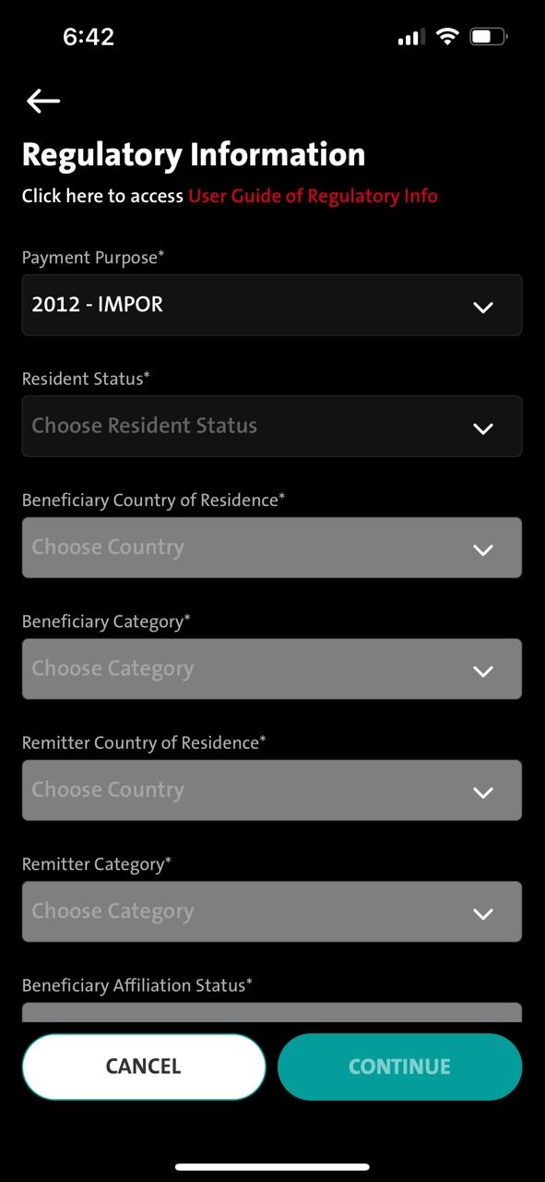
QC1344 – TT - Mandatory checking on Payment Purpose Field to reflect Remark field on Destination screen
Entry point
1. Transaction – Telegraphic – Transfer to a new bene – Regulatory information screen – Destination screen
2. Transaction – Telegraphic – Select Fav bene – Regulatory information screen
3. Transaction – Manage Saved Bene - Telegraphic – Select Fav Bene – Click Fund Transfer button - Regulatory information screen
4. Admin - Sav Bene – Fund Transfer button - Regulatory information screen
Remark:
This fix will fix for current production.
FE:
iOS version 24 UAT -
Android 28
Step #1
FE - Checking needed on [Regulatory Information] screen @ Payment Purpose field
When user selected - 2012 – IMPOR

Slide 3
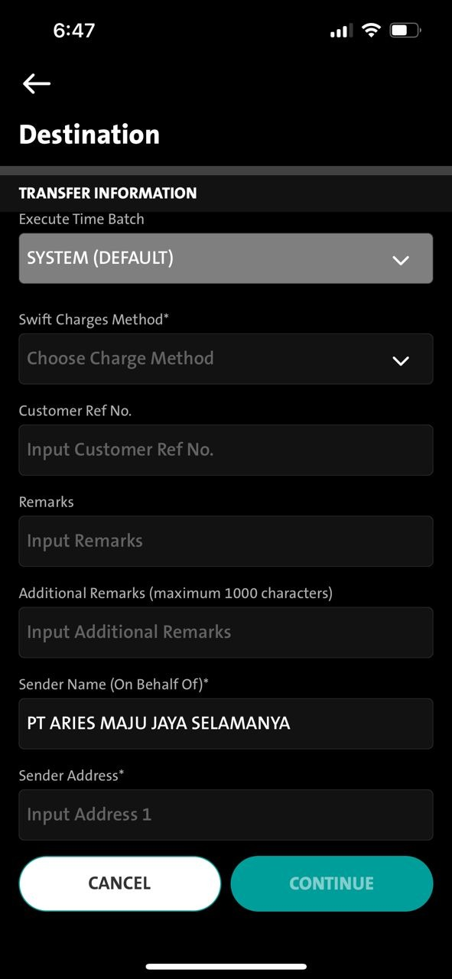
QC1344 – TT - Mandatory checking on Payment Purpose Field to reflect on Remark field Destination screen
Step #1
FE - Checking needed on [Regulatory Information] screen @ Payment Purpose field
When user selected - 2012 – IMPOR
Step #2
The next screen - [Destination] Screen - In Remark Field - User is required to input "2012//" as a mandatory prefix
- If user input without “ 2012// “ - transaction will not be allowed to continue
- (CONTINUE button will remain deactivated)

Slide 4
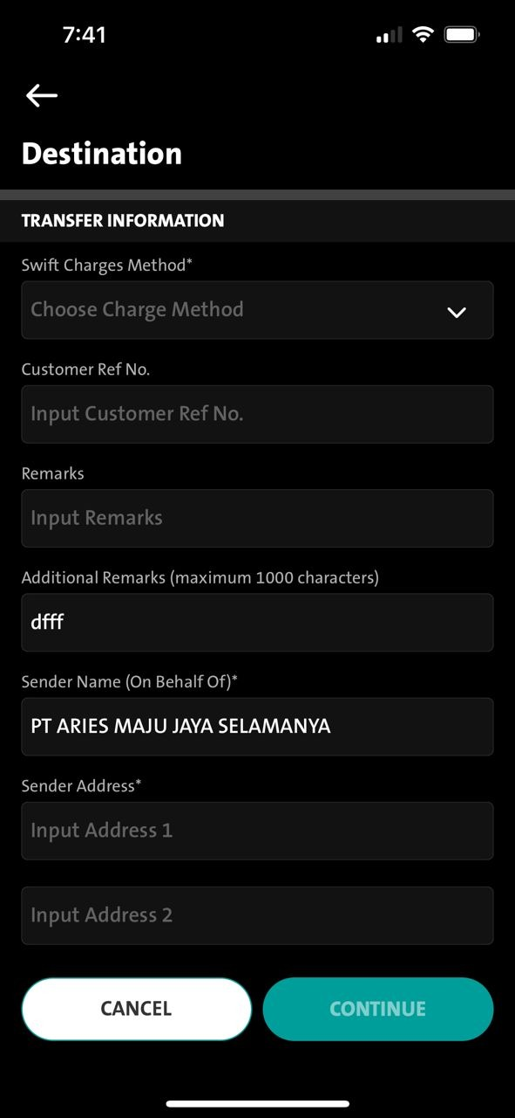
QC1344 – TT - Mandatory checking on Payment Purpose Field to reflect on Remark field Destination screen
Step #3
- If user input without “ 2012// “ - will display message under the Remark field ---
- When displaying under the Remarks field – will we be able to view it - then continue to display the next field – should be ok – cos it’s scrollable
Error Message
ENG: Telegraphic Transfer transactions for Import payment with payment purpose code 2012, customers are required to provide information in Remarks column with format 2012//Invoice Number 1(Invoice Amount 1) Invoice Number 2(Invoice Amount 2) or can be extended maximum 140 characters if needed, without currency. Example: 2012//123ABC(400000)234ABC(400000.25).
IND: Transaksi Telegraphic Transfer untuk pembayaran Impor dengan kode sandi tujuan 2012, wajib memberikan informasi pada kolom Keterangan dengan format 2012//Nomor Invoice 1(Nominal Invoice 1) Nomor Invoice 2(Nominal Invoice 2) atau dapat ditambah jika diperlukan dan maksimal 140 karakter, tanpa mata uang. Contoh: 2012//123ABC(400000)234ABC(400000.25).

