Slide 2
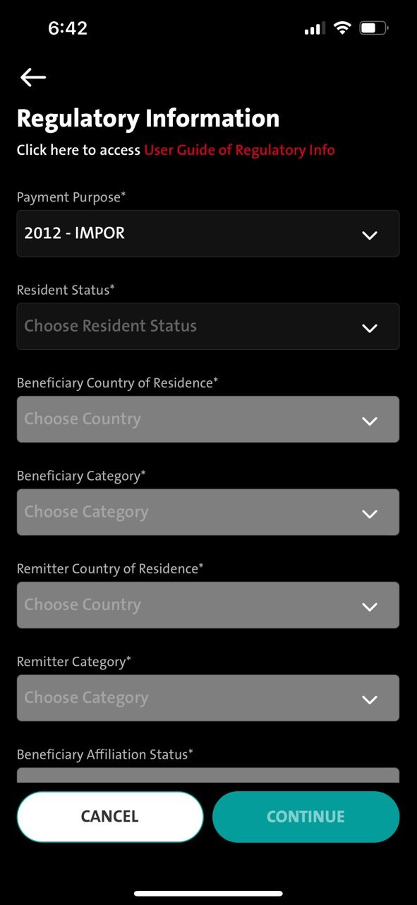
QC1344 – TT - Mandatory checking on Payment Purpose Field to reflect Remark field on Destination screen
Entry point
1. Transaction – Telegraphic – Transfer to a new bene – Regulatory information screen – Destination screen
2. Transaction – Telegraphic – Select Fav bene – Regulatory information screen
3. Transaction – Manage Saved Bene - Telegraphic – Select Fav Bene – Click Fund Transfer button - Regulatory information screen
4. Admin - Sav Bene – Fund Transfer button - Regulatory information screen
Remark:
This fix will fix for current production.
FE:
iOS version 24 UAT -
Android 28
Step #1
FE - Checking needed on [Regulatory Information] screen @ Payment Purpose field
When user selected - 2012 – IMPOR

Slide 3
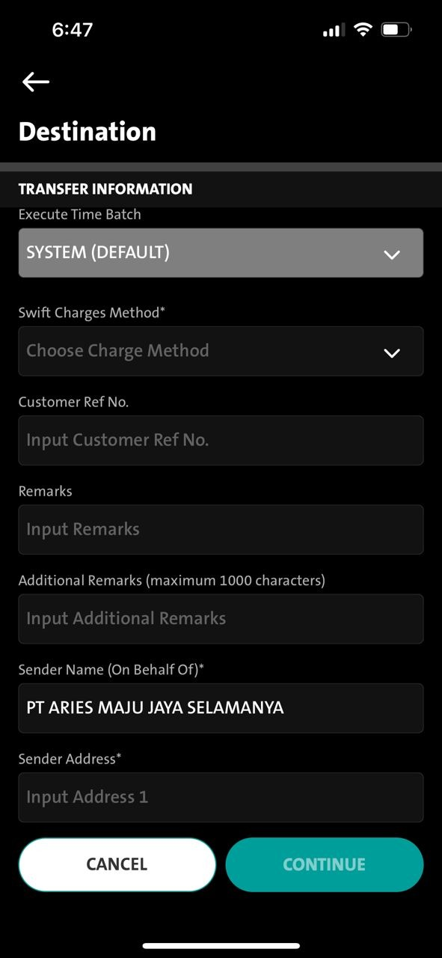
QC1344 – TT - Mandatory checking on Payment Purpose Field to reflect on Remark field Destination screen
Step #1
FE - Checking needed on [Regulatory Information] screen @ Payment Purpose field
When user selected - 2012 – IMPOR
Step #2
The next screen - [Destination] Screen - In Remark Field - User is required to input "2012//" as a mandatory prefix
- If user input without “ 2012// “ - transaction will not be allowed to continue
- (CONTINUE button will remain deactivated)

Slide 4
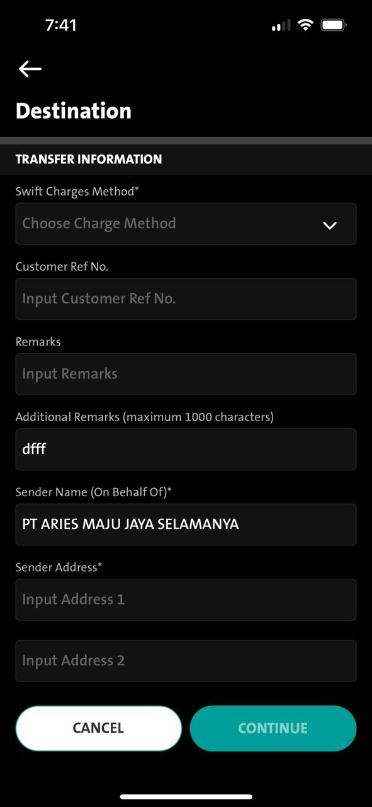
QC1344 – TT - Mandatory checking on Payment Purpose Field to reflect on Remark field Destination screen
Step #3
- If user input without “ 2012// “ - will display message under the Remark field ---
- When displaying under the Remarks field – will we be able to view it - then continue to display the next field – should be ok – cos it’s scrollable
Error Message
ENG: Telegraphic Transfer transactions for Import payment with payment purpose code 2012, customers are required to provide information in Remarks column with format 2012//Invoice Number 1(Invoice Amount 1) Invoice Number 2(Invoice Amount 2) or can be extended maximum 140 characters if needed, without currency. Example: 2012//123ABC(400000)234ABC(400000.25).
IND: Transaksi Telegraphic Transfer untuk pembayaran Impor dengan kode sandi tujuan 2012, wajib memberikan informasi pada kolom Keterangan dengan format 2012//Nomor Invoice 1(Nominal Invoice 1) Nomor Invoice 2(Nominal Invoice 2) atau dapat ditambah jika diperlukan dan maksimal 140 karakter, tanpa mata uang. Contoh: 2012//123ABC(400000)234ABC(400000.25).

Slide 5
QC1344 – TT - Mandatory checking on Payment Purpose Field to reflect Remark field on Destination screen – 2023.03.09
User input every mandatory field as needed BUT without input the remark field.
Please make CONTINUE button to be ENABLED if Remark Field is Empty.
Since CONITNUE button is ENABLED
Can we - when user clicks on CONTINUE button - the screen will auto scroll up to remark field with AUTO DISPLAY the message in RED below the Remark Field?
1. No input Remark field - CONTINUE button enable – BACK to BAU (BUT do now allow user to proceed to next screen until remark field is being filled up)
Behaviour CONTINUE
2. when remark field is EMPTY or input WRONG format in the remark field - then will display the message in red below the remark field.
3. No input Remark field - CLICKS on CONTINUE button – AUTO SCROLL UP to remark field with AUTO DISPLAY of message in red below remark field
- Input wrong format [2012//] - DISPLAY message in red below Remark field ----- (currently we have)
1
2

