Slide 1
QC1352 - MA05 – memcyp
Need your assistance t check our project if we are using those _strcat, _fopen...etc or not, if no then revert back to them we don't use any of them.

Slide 2
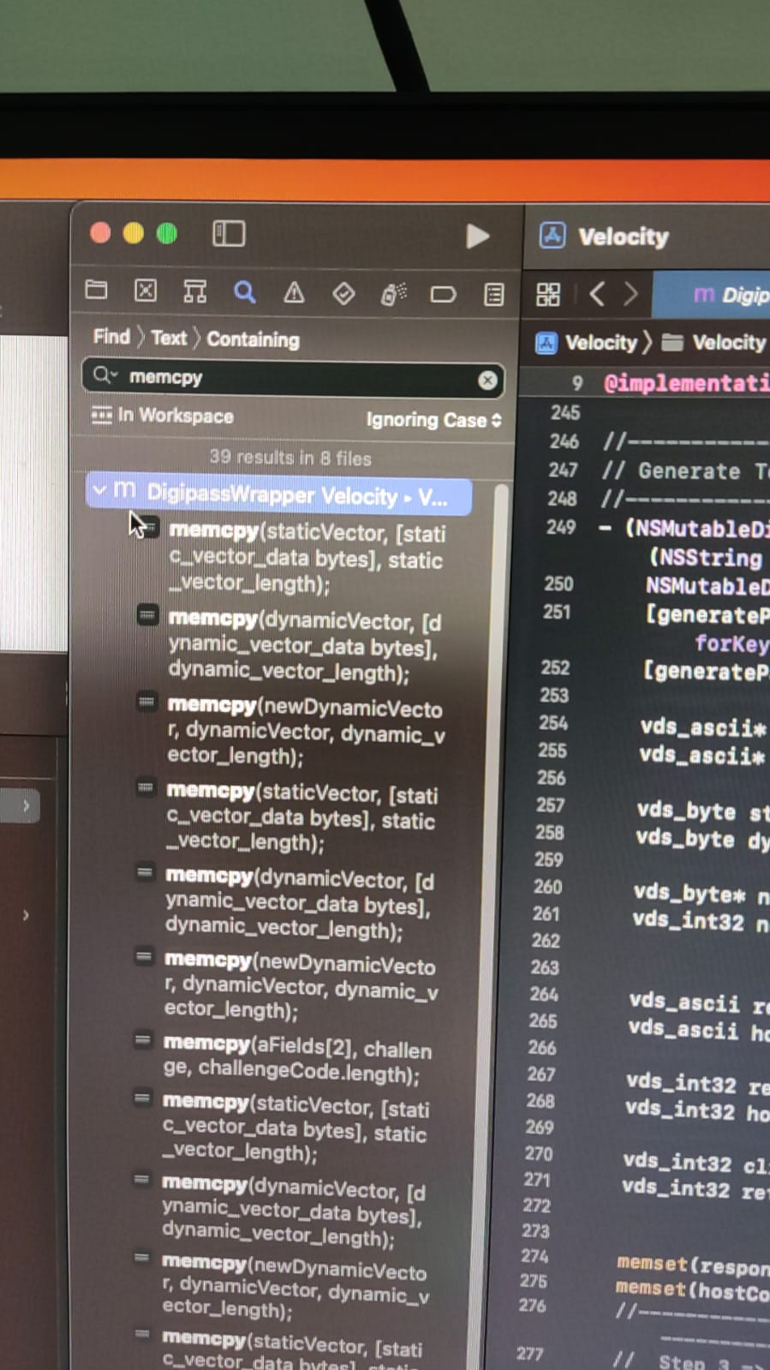
this is example from method memcpy, can you change name the method

