Slide 1
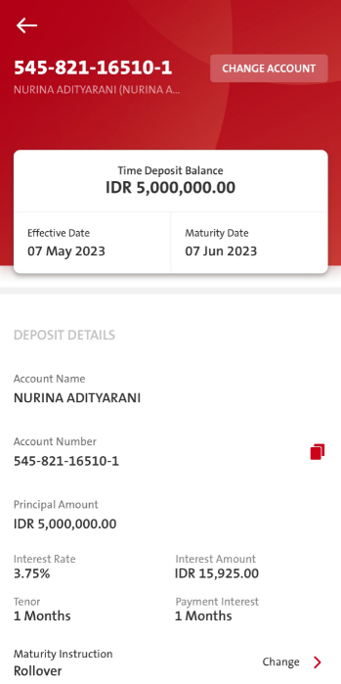
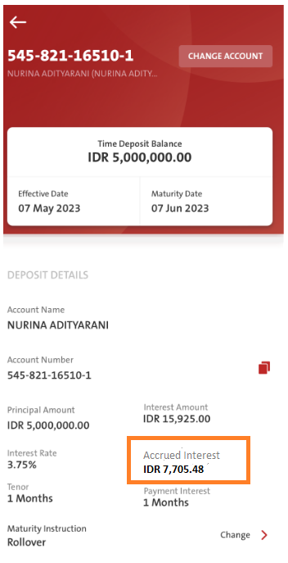
QC13 – Time Deposit - Accrued Interest Info
Entry > Sub Menu > My Accounts > Time Deposit
Adding a new information of Accrued Interest
BEFORE
AFTER
BE: needs to cater Accrued Interest in the response of acct_mgmt/inquiry.
May refer Omni Spec 6.5
FE:
Display values from RetrieveAccountDetails Response.
Please add new field on the right after Interest Amount and before Payment Interest
EN: Accrued Interest
ID: ???

