Slide 1
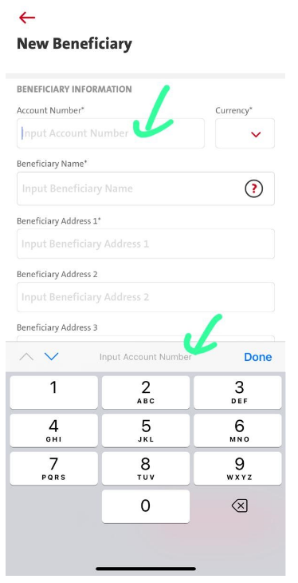
QC1345- TT – Account Number Field for IBAN
Transactions - Fund Transfer – Telegraphic Transfer – Field Account Number.
The Account Number Field need to be inputted with alphanumeric in order to
to accommodate the transaction to Europe or Middle East (using IBAN Number):
Android – 1 day – Tested Good
iOS – 1 day
Entry point
Transaction – Fund Transfer - Telegraphic – Select Transfer From & Transfer to - Transfer to a new bene - Create New Beneficiary
Transaction – Fund Transfer – Manage Saved Beneficiary – Telegraphic – New Beneficiary – Missing changes
Administration – Beneficiary Management – Telegraphic – New Beneficiary - Create New Beneficiary Missing changes
Dashboard – tap on favorite acct – Fund Transfer – Telegraphic Transfer – Same as point #1
Dashboard – tap on favorite acct – Fund Transfer – Telegraphic Transfer – Same as point #2 Missing changes
BE – cater new error code for FundTransferTransactionSubmit and description
BE – Cater New error code for mgmt/add_bene – Pending fix - Done

Slide 2
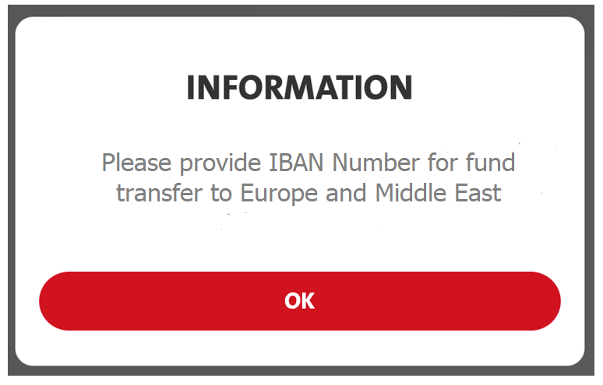
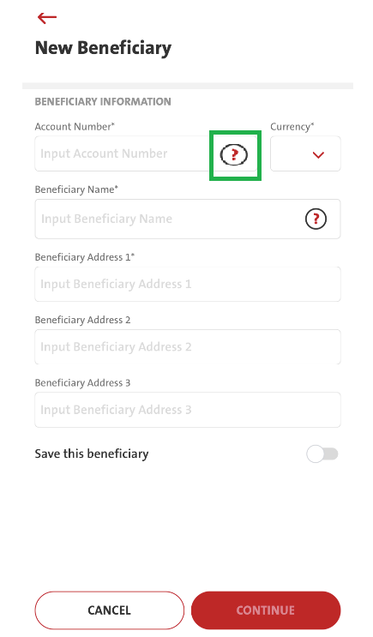
Therefore, please kindly help to:
1. Change & update the Validation on Account Number
field from numeric to alphanumeric.
2. Add the ? icon on Account Number field
Copywriting: EN
Copywriting: ID
Copywriting:
EN: Please provide IBAN Number for fund transfer to Europe and Middle East
ID: Cantumkan Nomor IBAN untuk transfer dana ke Eropa dan Timur Tengah
Need to check with BE if such
special characters validation is from BE
Android – 1day
iOS – 1 day

Slide 3
QC1345- TT – Account Number Field for IBAN
Account Number Field:-
Telegraphic Transfer in Velocity Mobile is 18 characters only. Please kindly extend the length to 35 characters (follow Velocity Web):

