Slide 1
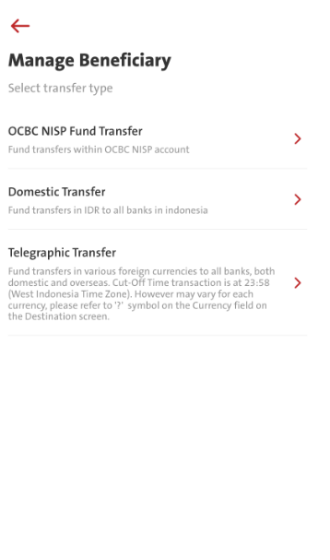
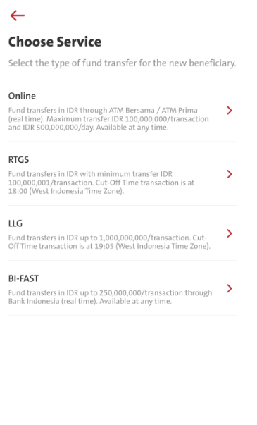
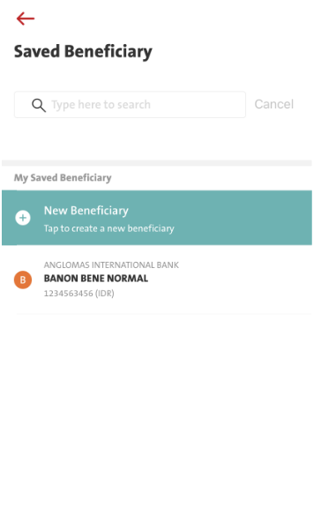
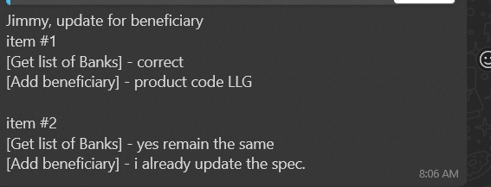
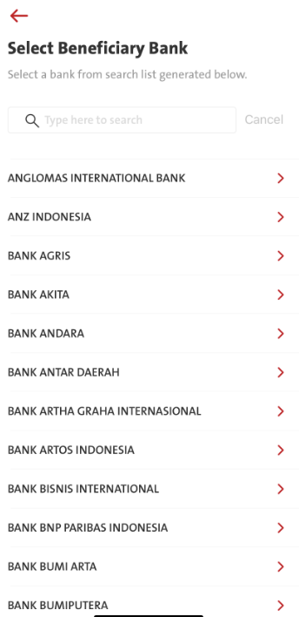
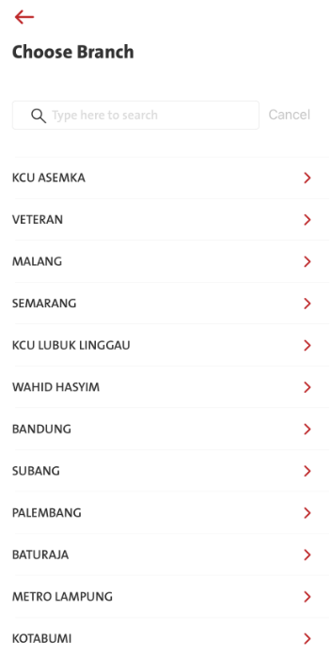
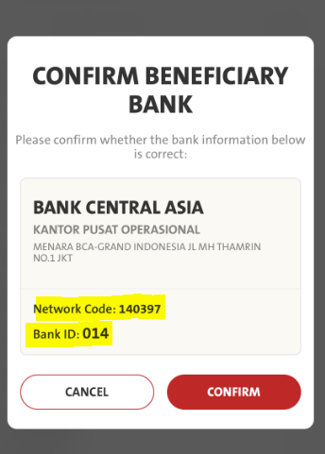
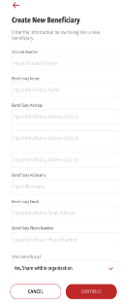
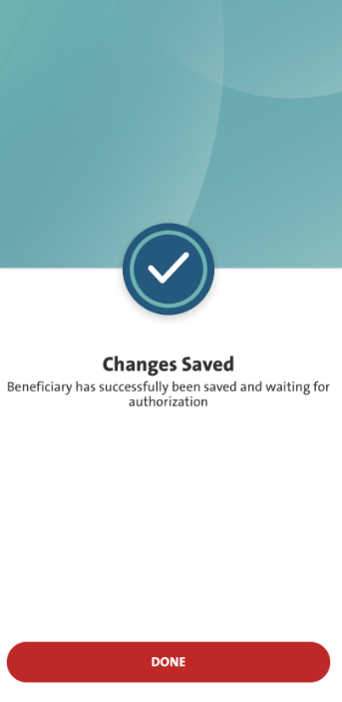
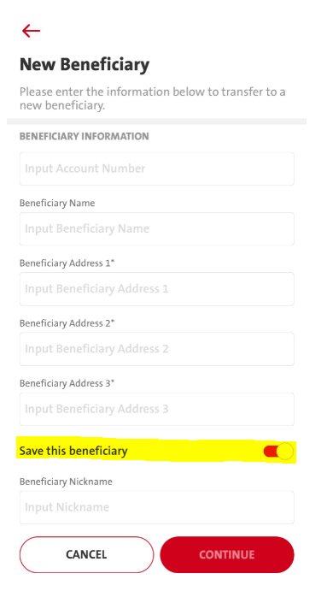
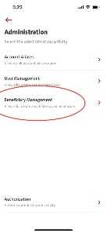
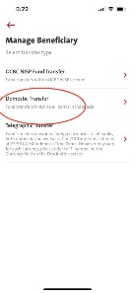
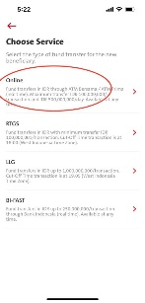
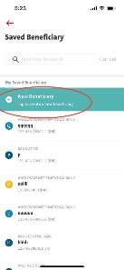
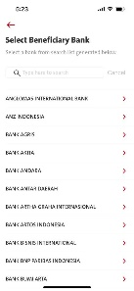
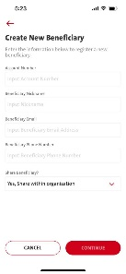
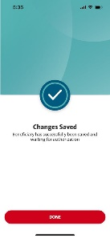
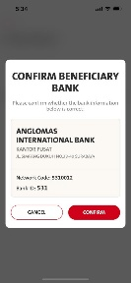
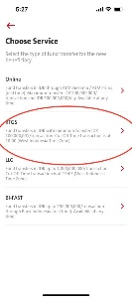
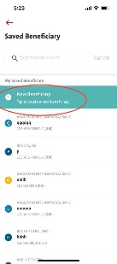
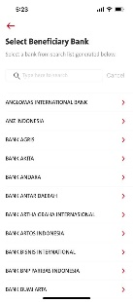
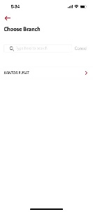
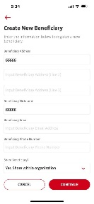
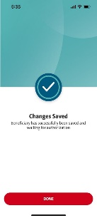
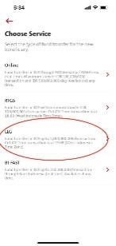

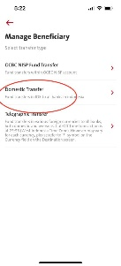
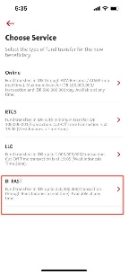
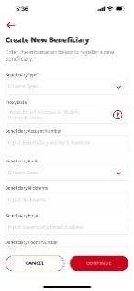
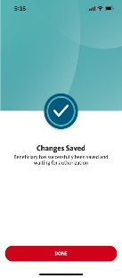
QC1356 – Administration – Beneficiary Management – Domestic Transfer
This is to Centralize Beneficiary for all Domestic Transfer (LLG/SKN, RTGS, Online Transfer, BI-FAST)
Current Flow
FE – Remove Screen
For Spec 14.1 Add Beneficiary & Spec 13.6 – we are using the same WS for below:
BE/ FE
1. Administration – Manage Saved Bene
Spec 13.6 [Get list of Banks] – pass TransferServiceType = LL – Will pass LL
Spec 14.1 [Add Beneficiary] – pass ProductCode = LLG – Will pass LLG
rtgs_member_code – Applicable for WS above
paricipant_bic – Applicable for WS above
Remark: Pending BE Spec
TransferServiceType: FE pass LLG when calling RetrieveBankList (related to 13.6)
BE passes LL to Omni
TransferServiceType: FE pass LLG when calling TransactionManageBeneficiaryAdd (Related to 14.1)
BE passes LLG to Omni
2. Transaction - Fund Transfer – Manage Saved Beneficiary
Spec 13.6 [Get list of Banks] – pass TransferType = RT, LL, OLT, TT, FAST – Remain the same as BAU.
Spec 14.1 [Add Beneficiary] – pass ProductCode = IFT, OAT, RTGS, LLG, TT, OLT, FAST This would have impact if below parameters have become Mandatory which is only applicable for item #1. (need to check spec)
TransactionFundTransferMenu
Remark:
FE call TransactonFUndTransferMenu,
BE response success – FE continue to call
FE - AdministrationBeneficiaryList
BE - 16.8 administration/beneficiary_ft/list
FE - RetrieveBankList
BE - 13.6 others/banks [Get list of banks]
New Flow – Final Entry:- Administration – Beneficiary Management – Domestic Transfer – Saved Beneficiary – New Beneficiary
TransactionFundTransferMenu
Remark: After FE call TransactonFUndTransfermenu and, BE response success – FE continue to call
FE - AdministrationBeneficiaryList
BE - 16.8 administration/beneficiary_ft/list
to display bene list
FE - RetrieveBankList
BE - 13.6 others/banks
[Get list of banks]
FE - RetrieveBankList
BE - 13.6 others/banks
[Get list of banks] to display
Refer to Slide #2 Additional Information for display.
FE - TransactionManageBeneficiaryAdd
BE - Spec 14.1 – transaction_mgmt/add_bene
FE – Please refer to Slide #2
Create New Beneficiary screen from current RTGS & LLG.
Centralize Beneficiary for all Domestic Transfer (LLG/SKN, RTGS, Online Transfer, BI-FAST)
Choose Domestic Transfer
Click ‘New Beneficiary’.
Select Beneficiary Bank.
Select Branch Name.
Beneficiary Bank confirmation screen will be displayed which consists of Beneficiary Bank Name, Bank Branch, Bank Address, Network Code, RTGS Member Code, BI-FAST BIC Code, and Bank ID.
Input all details of Beneficiary, then click ‘Continue’.
Confirmation screen will be displayed and waiting for authorization.
Equivalent
OLD Flow - Entry #1:- Administration – Beneficiary Management – Domestic Transfer – ONLINE - Saved Beneficiary – New Beneficiary
ADD
REMAIN
FE – Remove Screen
Refer to Slide #2 Additional Information for display.
OLD Flow - Entry #2:- Administration – Beneficiary Management – Domestic Transfer – RTGS - Saved Beneficiary – New Beneficiary
REMAIN
FE – Remove Screen
Refer to Slide #2 Additional Information for display.
OLD Flow - Entry #3:- Administration – Beneficiary Management – Domestic Transfer – LLG - Saved Beneficiary – New Beneficiary
REMAIN
FE – Remove Screen
Refer to Slide #2 Additional Information for display.
OLD Flow - Entry #4:- Administration – Beneficiary Management – Domestic Transfer – BI-FAST - Saved Beneficiary – New Beneficiary
FE – Remove Screen
ADD
FE – May refer to Slide #2
For Administration - Create New Bene Screen, we don't have to send Proxy Data right?
Cos the NEW Create new Bene Screen will only need to pass
OLD Fields Sequence – Remove/ Replace
1. Beneficiary Type: [Drop Down]
2. Proxy Data
3. Beneficiary Account Number
4. Beneficiary Bank: [Drop Down]
5. Beneficiary Nickname
6. Beneficiary Email
7. Beneficiary Phone Number
8. Share Beneficiary?: [Drop Down]
NEW Fields Sequence
1. Account Number
2. Beneficiary Name
3. Beneficiary Address 1*
4. Beneficiary Address 2*
5. Beneficiary Address 3*
6. Save this beneficiary [Toggle]
7. Beneficiary Nickname
Refer to Slide #2 Additional Information for display.

Slide 2
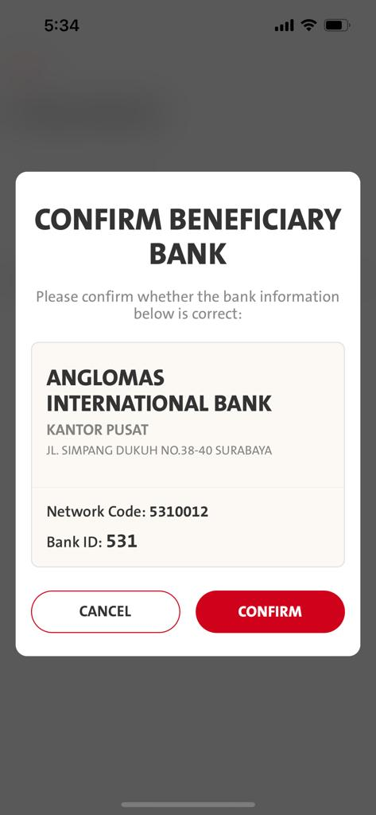
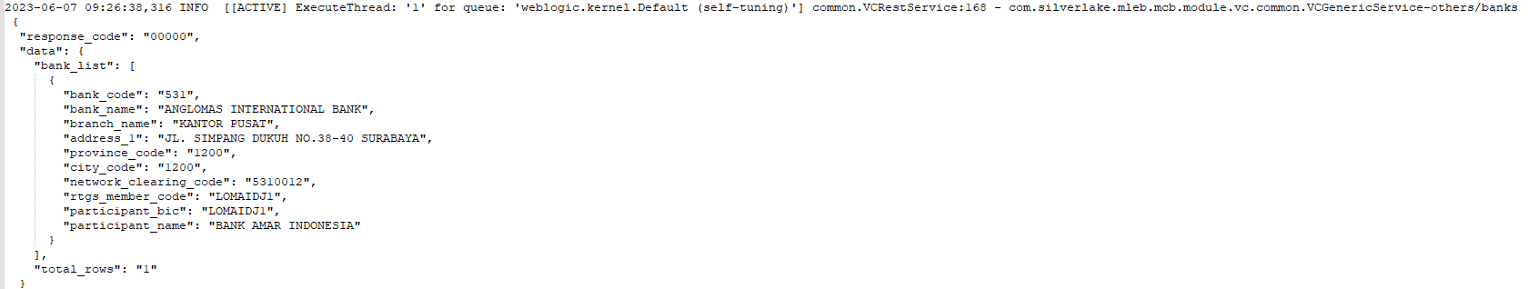
Add the information for RTGS Member Code and BIC Code. Example for the final result:
Network Code: 140397 - Existing
RTGS Member Code: CENAIDJA - New
BI-FAST BIC Code: CENAIDJA - New
Bank ID: 014 - Exiting
BE needs to cater Spec 13.6 and return to FE for mapping and display purpose
Rtgs_member_Code
Participant_bic
14.1 Add Bene – Create New Bene Screen Fields
NEW Fields sequence
1. Account Number
Input Account Number [Mandatory]
2. Beneficiary Name
Input Beneficiary Name [Mandatory]
3. Beneficiary Address 1*
Input Beneficiary Address 1 [Mandatory]
4. Beneficiary Address 2*
Input Beneficiary Address 2
5. Beneficiary Address 3*
Input Beneficiary Address 3
6. Save this beneficiary [Toggle]
7. Beneficiary Nickname
Input Nickname [Mandatory]
Without fulfilling the mandatory Field, CONITNUE button remains grey-out
NEED TO ADD
TransactionFundTransferConfirmSubmit Request
"isSaveBene": true
Need FE to check if sending above is correct?
BE –
iOS –
Android -

